Slide 1


Fluid substitution for an HTI medium
Long Huang, Nikolay Dyaur and Robert Stewart
University of Houston
Samik Sil
ConocoPhillips
Houston
May 16, 2013

Slide 2
Outline
Motivation
3D printed models➔ fractured rocks, anisotropy and fluid substitution
4D time lapse seismic
Experiments
3D printed model, velocity measurements, fluid substitution experiments
Theory
anisotropic Gassmann’s equations (recast for an HTI medium)
Discussion
experiment results versus theoretical predictions
Conclusions

Slide 3

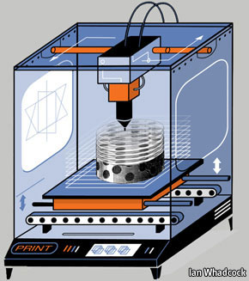
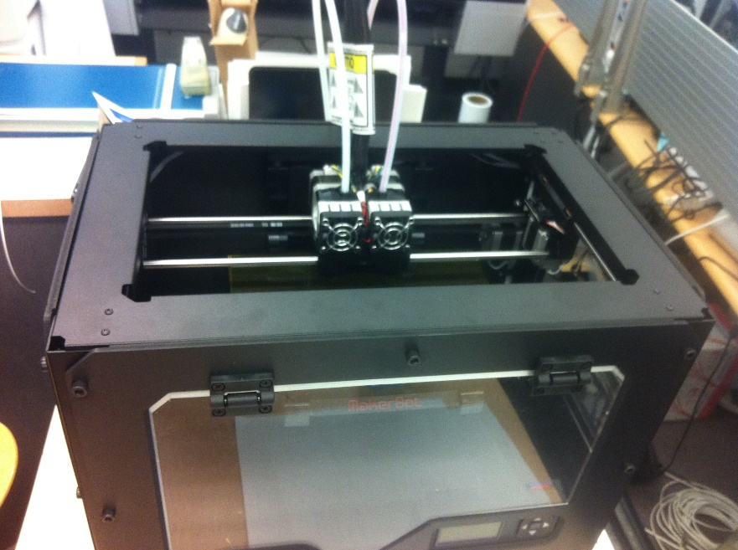
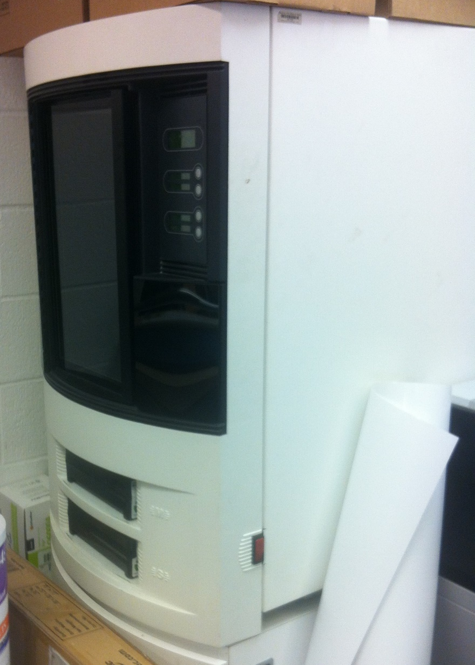
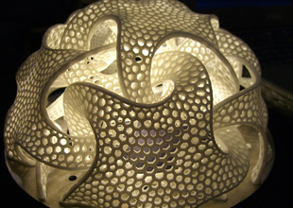
3D printing
We are the first generation of geophysicists
to use 3D printed models!
Notes:
USING A 3D PRINTER is like printing a letter; hit the print button on a computer screen and a digital file is sent to, say, an inkjet printer which deposits a layer of ink on the surface of a piece of paper to create an image in two dimensions. In 3D printing, however, the software takes a series of digital slices through a computer-aided design and sends descriptions of those slices to the 3D printer, which adds successive thin layers until a solid object emerges. The big difference is that the “ink” a 3D printer uses is a material.

Slide 4
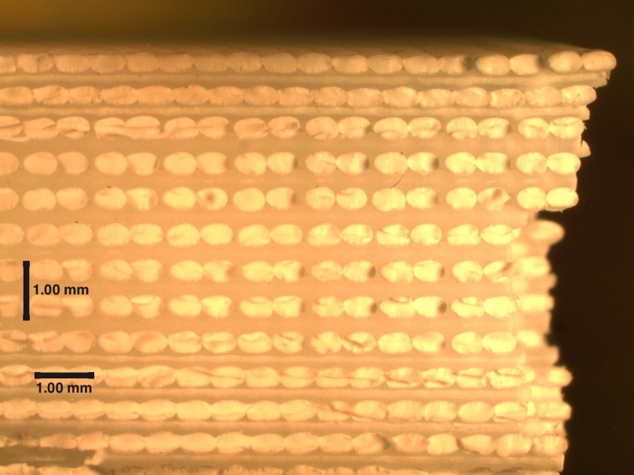
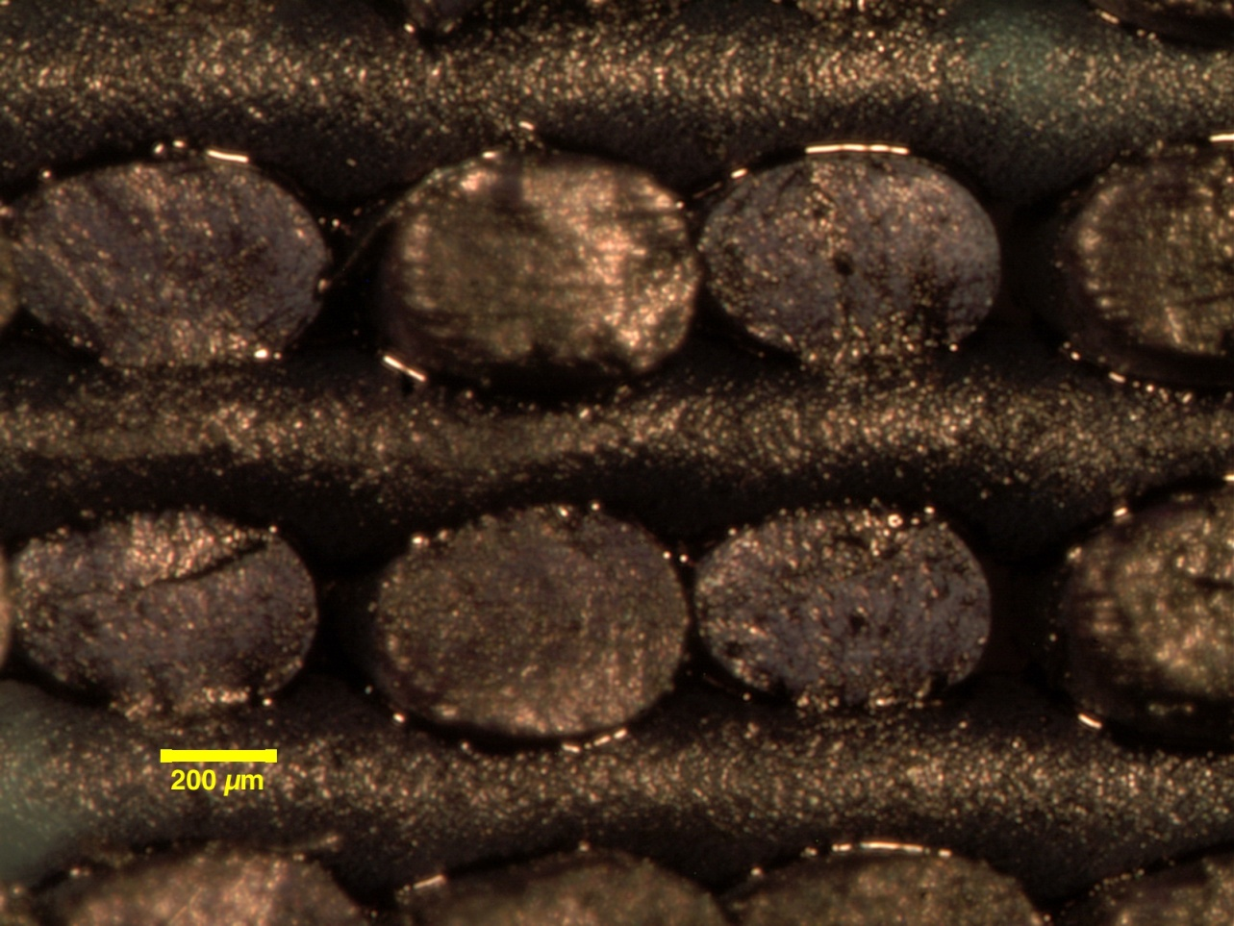
How it prints and where are the pores?
pore space

Slide 5
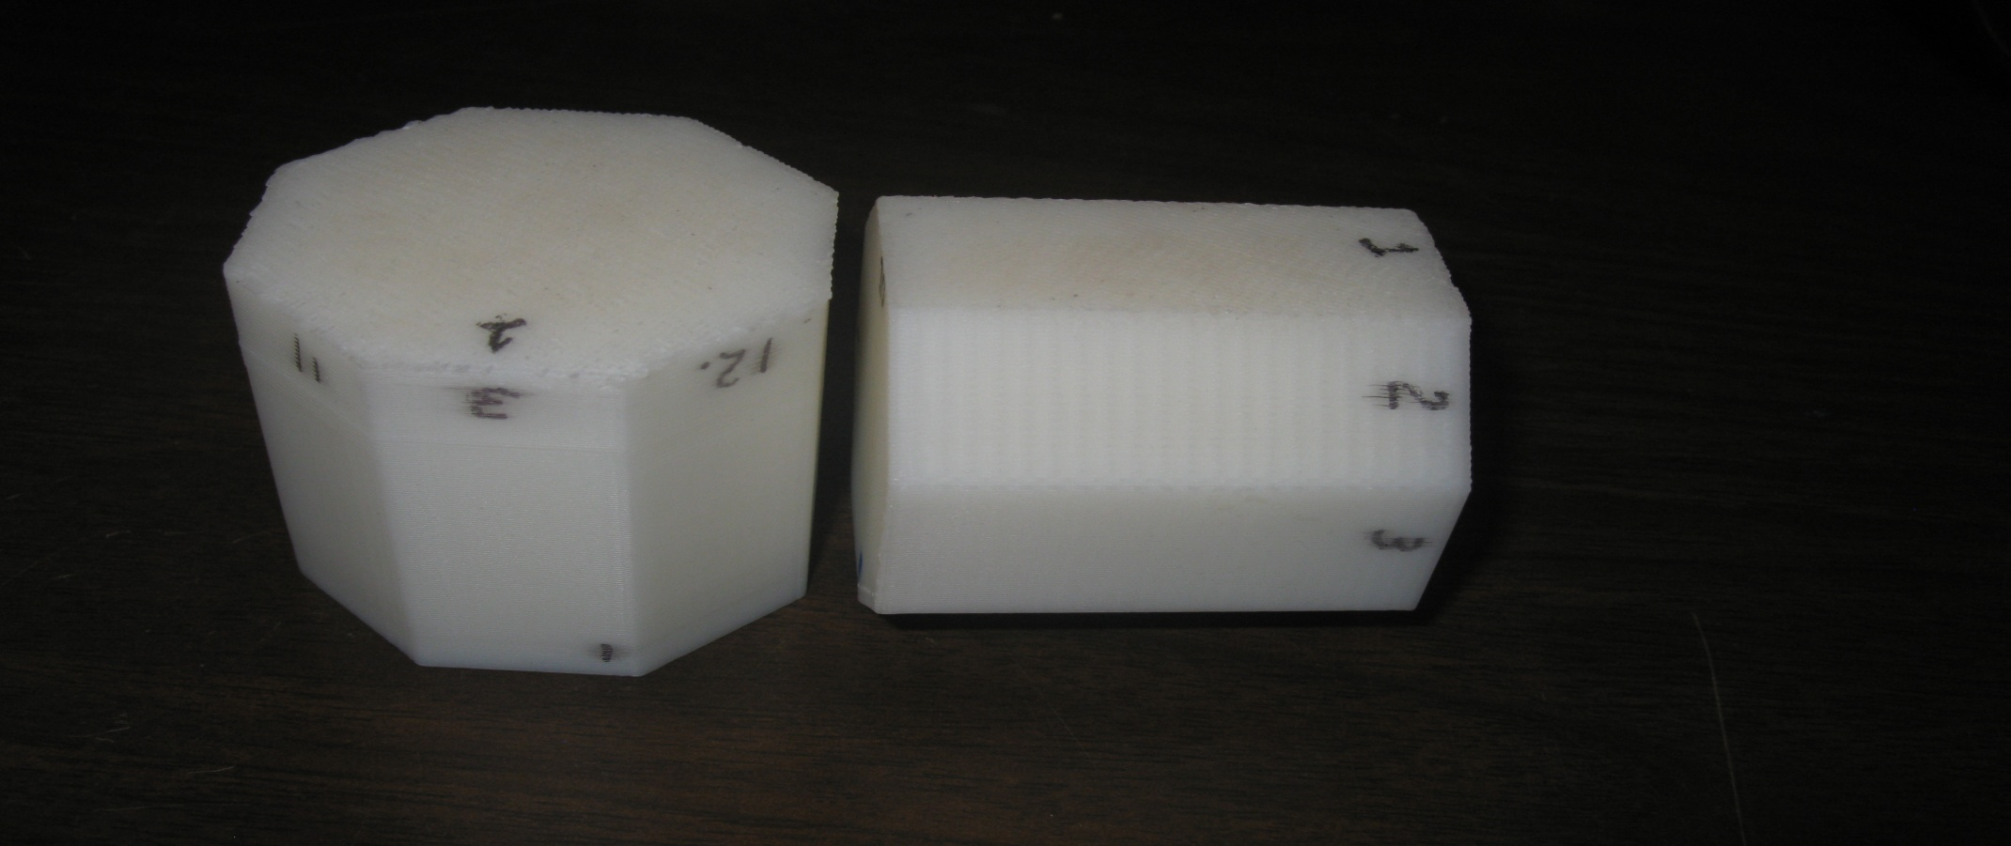
3D printed models
VTI model
51 mm
51 mm
HTI model
51 mm

Slide 6
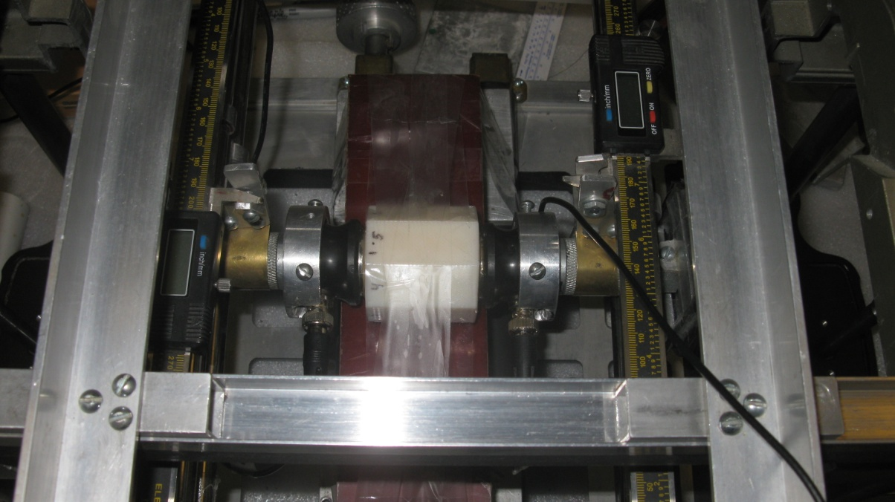
Rotation experiments
0
0
45
90
HTI model
VTI model
polarization vector
Transducer: 500 kHz horizontal component

Slide 7
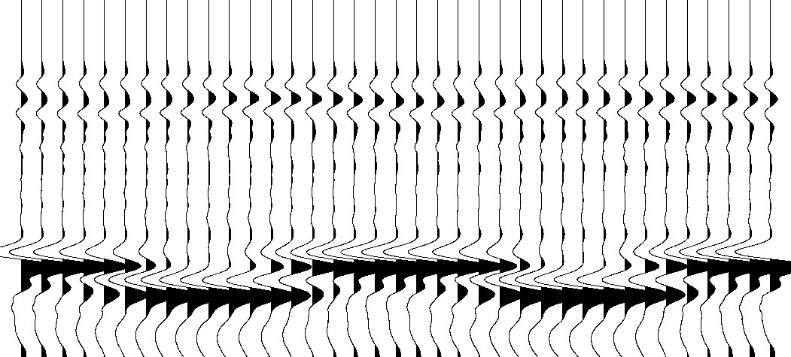
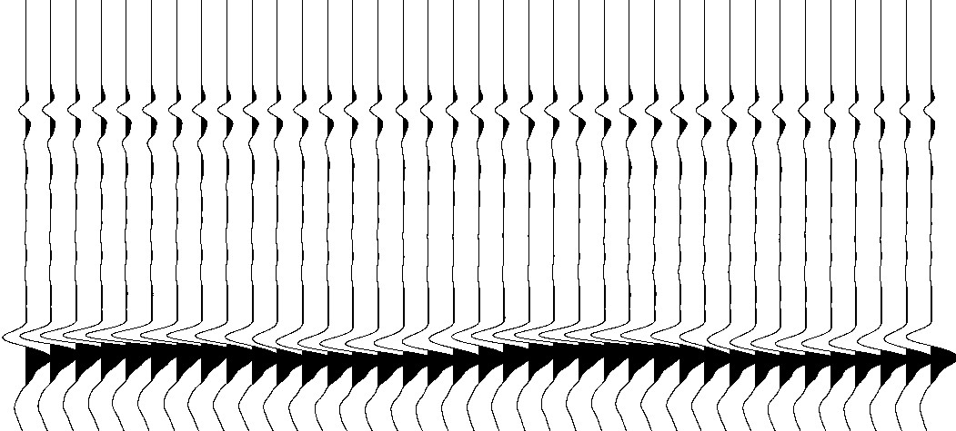
Velocity variation with polarization
HTI model
VTI model
0
180
360
0
180
360
polarization
polarization
T_{P}
T_{P}
T_{S1}
T_{S2}
T_{S1}
T_{S2}
time
time
slightly splitting, slightly orthorhombic
shear wave splitting

Slide 8
What if we saturate the models?
How velocity will change after saturation?
(P-wave, S-wave?)
How can we theoretically predict the changes?
(Gassmann’s equations?
isotropic or anisotropic? VTI, HTI, orthorhombic?
Hudson’s model? Linear slip model? GSA?)
Why do we care?
(simulating 4D time lapse seismic!)

Slide 9
Recast Gassmann’s equations
(Gassmann, 1951)
linear slip model
New!
(Schoenberg and Sayers, 1995)
Dry term
Fluid term

Slide 10
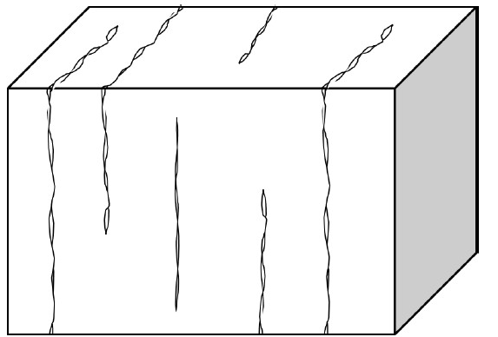
Parameter estimation
Well logs:
(Hsu and Schoenberg, 1993)
(Sil et al., 2013)
(Sayers and Kachanov, 1995)

Slide 11
Fluid substitution experiment (HTI model)
air➔
vacuum
HTI model
water
air pump

Slide 12
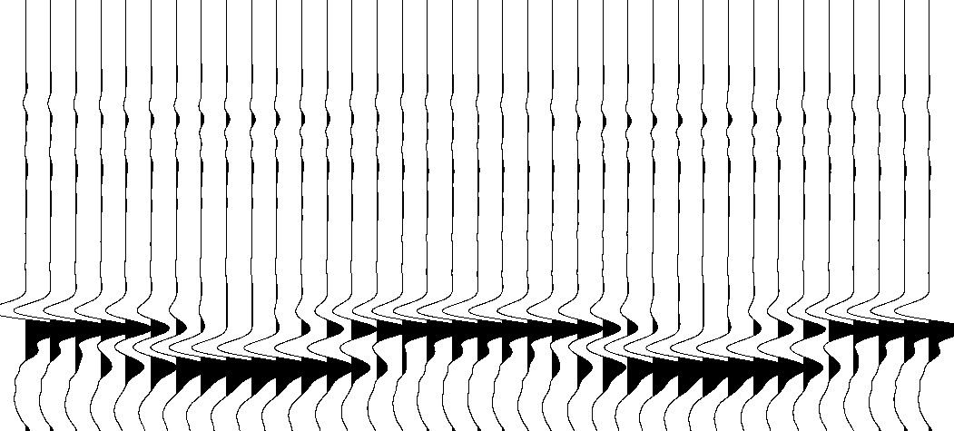
Fluid substitution
dry
saturated
0
180
360
0
180
360
polarization
polarization
T_{P}
T_{P}
T_{S1}
T_{S1}
T_{S2}
T_{S2}
time
time

Slide 13
Velocity measurement from sides
transmission measurements with every 45-degree azimuth
0
315
45
symmetry
axis
90
270
225
135
polarization vector
180
S1
P-wave velocity measurement:
500 kHz vertical component transducer
S-wave velocity measurement:
500 kHz horizontal component, polarized in two orthogonal directions
S2

Slide 14
P-wave velocity change after saturation
0
315
45
Vp (km/s)
90
270
225
135
180
We see 2% - 4.6% increase in P-wave velocity

Slide 15
S-wave velocity change after saturation
V_{S1} and V_{S2} before saturation
V_{S1} and V_{S2} after saturation
Vs (km/s)
Black denotes fast shear-wave (V_{S1})
Red denotes slow shear-wave (V_{S2})

Slide 16
S-wave velocity change after saturation
V_{S1}
V_{S2}
Vs (km/s)
about 1.2% decrease
about 1.6% decrease
Black denotes dry
Red denotes saturated

Slide 17
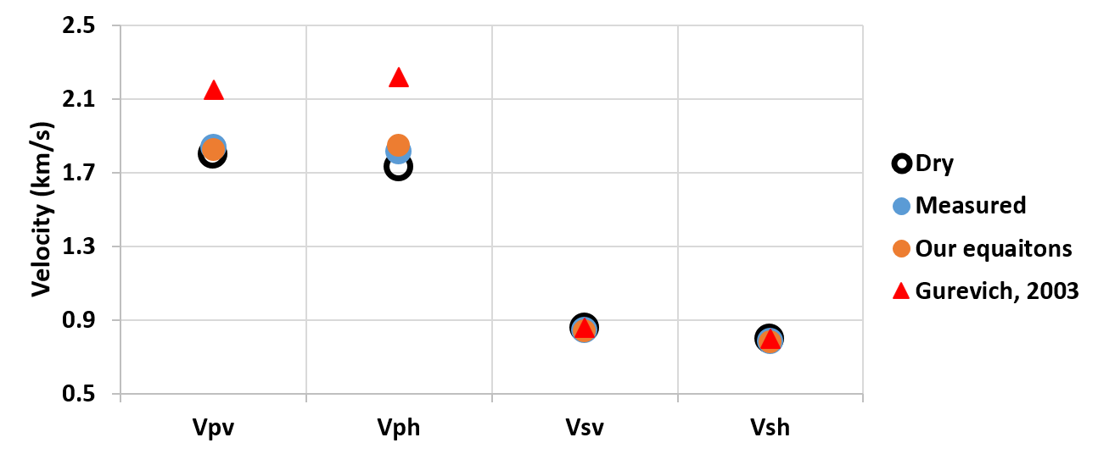
Theoretical predictions for the HTI model
Density increases about 4% after water saturation, which contributes about 2% decrease in velocity

Slide 18
Conclusions
Innovative physical models
- print any structure with 3D printing
- cheap and fast.
Rich anisotropic response
- transverse isotropic symmetry
- clear shear wave splitting
New equations
- Gassmann’s equations for an HTI medium
- predict better results for fluid substitution.

Slide 19
Acknowledgement
Allied Geophysical Laboratories, UH
Dr. Robert Sheriff and SEG
ConocoPhillips
Bode Omoboya, Tao Jiang and all the other AGL members

