Slide 1
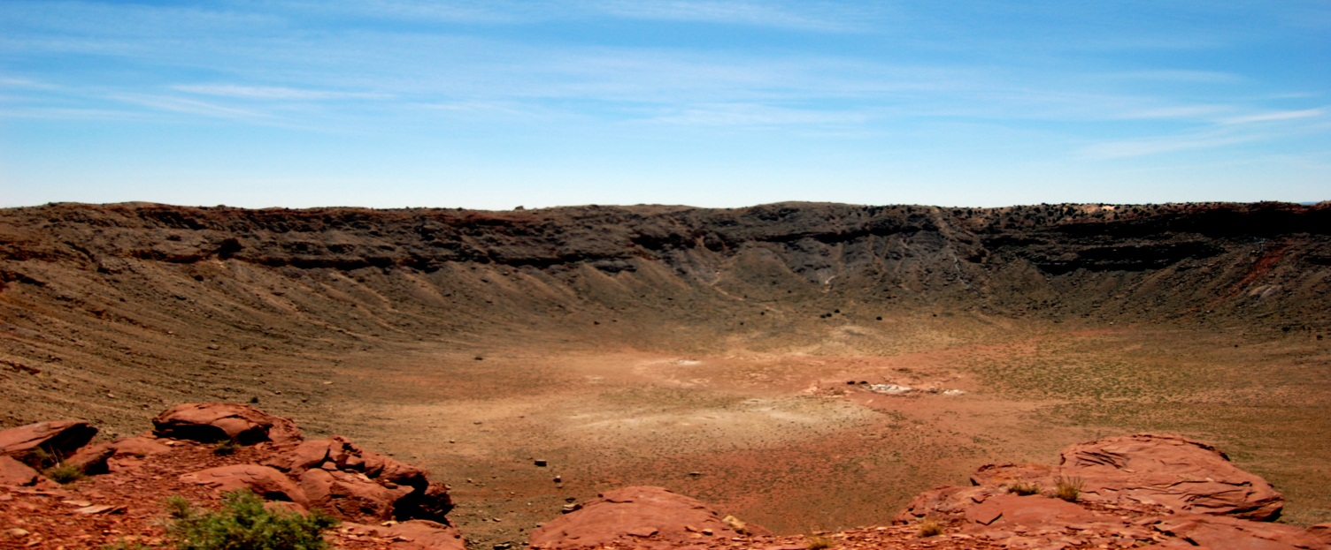
Near-surface Imaging at Meteor Crater, Arizona
Soumya Roy, Ph. D. Student
Advisor: Dr. Robert R. Stewart
AGL Annual Meeting
University of Houston, 2nd May 2012

Slide 2
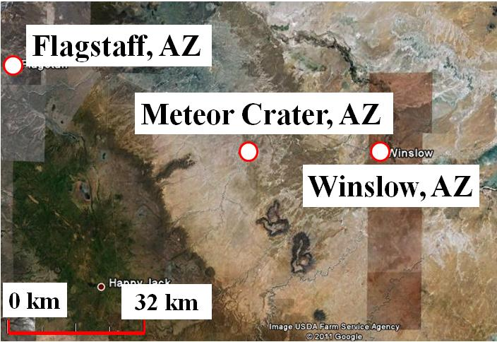
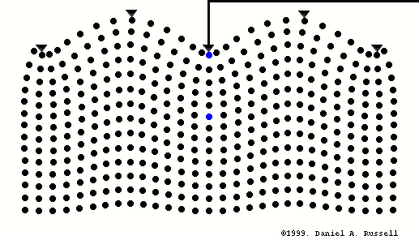
Journey Through An Astrobleme
Objectives
N
Meteor Crater, Arizona
Geophysical surveys:
- Ultrasonic, Seismic, Gravity and Magnetics, GPR
Methodology:
- Seismic refraction and reflection analysis
- Ground-roll inversion
Results and Interpretations
Conclusions
Daniel A. Russell (1999)
(Animation showing particle movements
for Ground-roll or Rayleigh-wave )

Slide 3
Objectives
To understand seismic wave propagation through brecciated
materials
To estimate the thickness of the ejecta blanket (a sheet of
debris thrown out of the crater during the meteorite impact)
To characterize the near-surface physical properties
To develop general survey methodologies to image a highly
complex near-surface
To image near-surface reflectors and faults

Slide 4
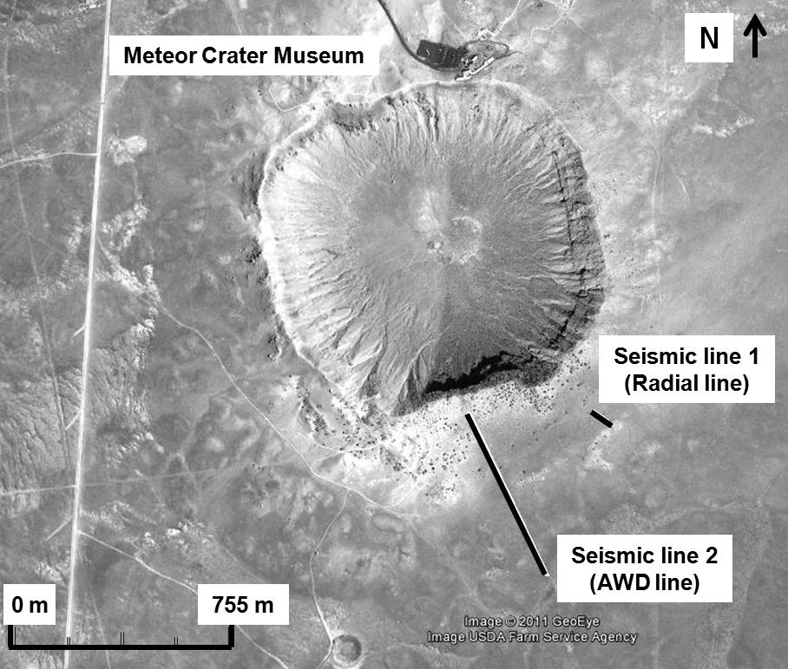
Barringer (Meteor) Crater, Arizona
1
Ejecta curtain
4
2
(Shoemaker et al., 1974 and Kring, 2007)
Excavated some 49,000 years ago
Diameter of 1.2 km and a bowl-shaped
depression of 180 m
Startigraphy similar to Grand Canyon sequence
Ejecta blanket
- P. H. Schultz, Brown University, NASA Ames Research Center
3

Slide 5
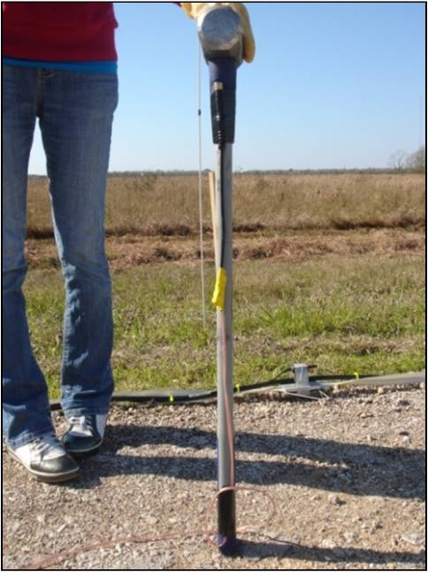
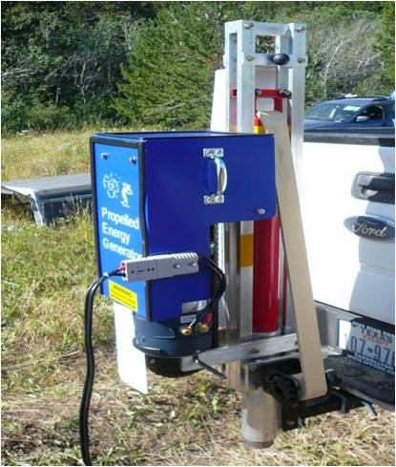
Seismic Surveys
Seismic Line | Source Type | Receiver Type | Source interval (m) | Receiver interval (m) | Total receivers | Receiver spread length (m) | Record length (s) | Sample interval (ms)
Hammer | 10 lb (4.5 kg) Sledgehammer | Planted vertical | 2 | 2 | 34 | 66 | 1000 | 0.25
AWD | 88 lb (40 kg) Accelerated Weight Drop | Planted vertical | 3 | 3 | 216 | 645 | 3000 | 0.5

Slide 6
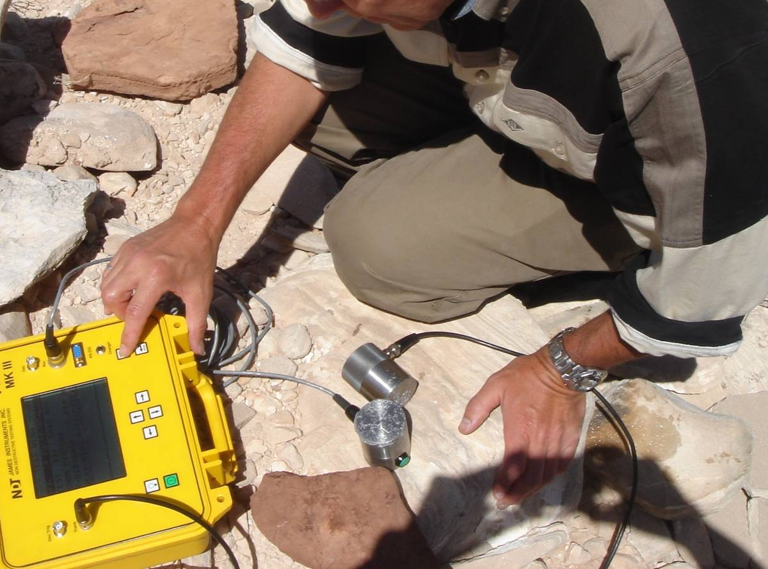
Ultrasonic Measurements
Rock formation | P-wave velocity (m/s)
Moenkopi 1 | 815 ± 33
Moenkopi 2 | 1255 ± 106
Moenkopi 3 | 1570 ± 89
Why do velocities vary?
Samples are weathered differently
Samples are of irregular shapes and sizes
Measurement errors

Slide 7
P-wave Velocity from
Seismic Refraction Analysis
First-break Pick analysis
Initial P-wave velocity model
Raw shot from AWD line
P-wave Velocity Structure
Iterative travel-time tomography
through ray tracing
Minimizing the error between
calculated and observed
traveltimes

Slide 8
Result and Interpretation:
P-wave Velocity Structure

Slide 9
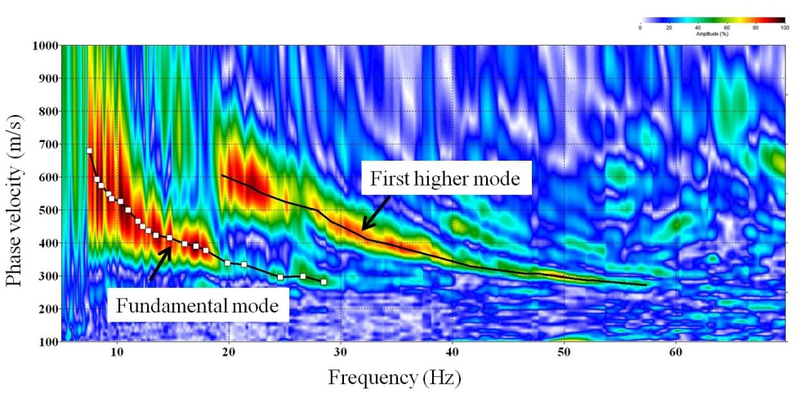
S-wave Velocity from Ground-roll Inversion
Dispersion Curve
Raw shot from AWD line
Phase velocity (m/s)
S-wave Velocity Structure
Frequency (Hz)
Multichannel Analysis of
Surface Waves (MASW)
(Park et al., 1998, Park et al., 1999, Xia et al., 1999)

Slide 10
Result and Interpretation:
S-wave Velocity Structure
Ejecta blanket
Moenkopi

Slide 11
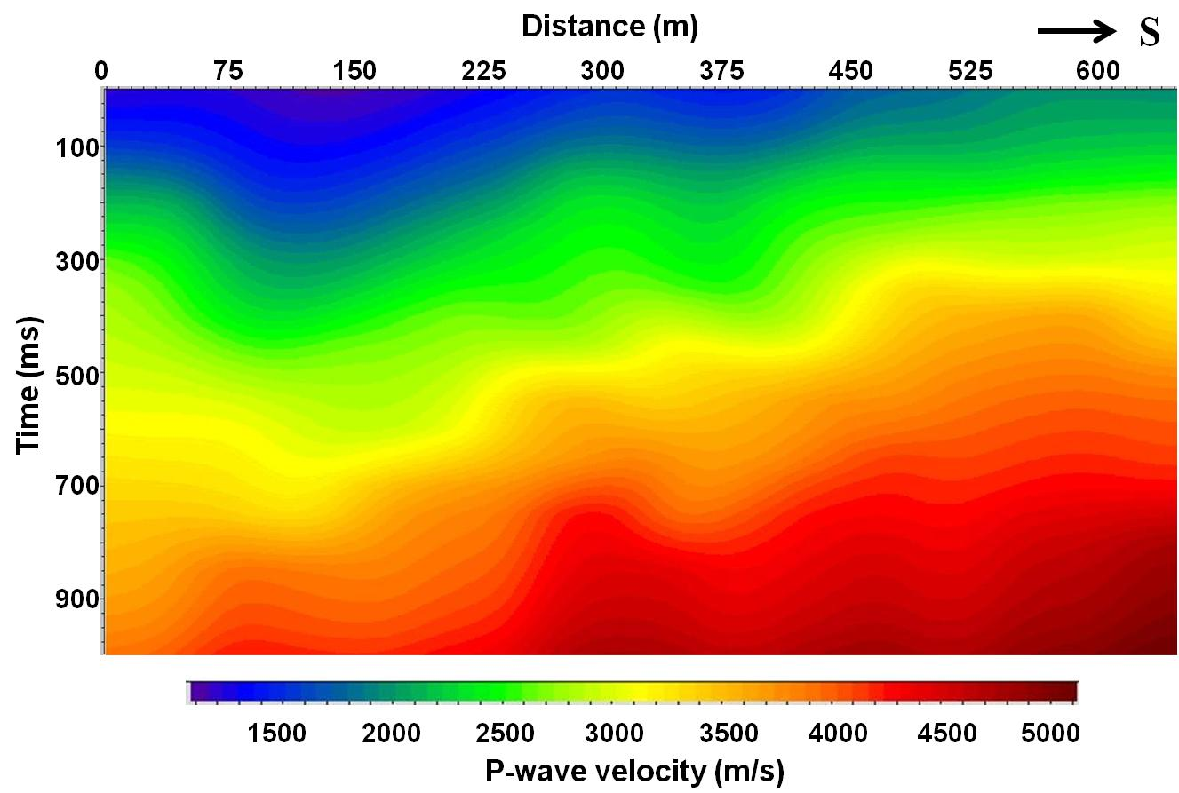
Result: P-wave NMO Velocity Structure
Showing similar thinning pattern in low P-wave velocities
(Turolski, 2012)

Slide 12
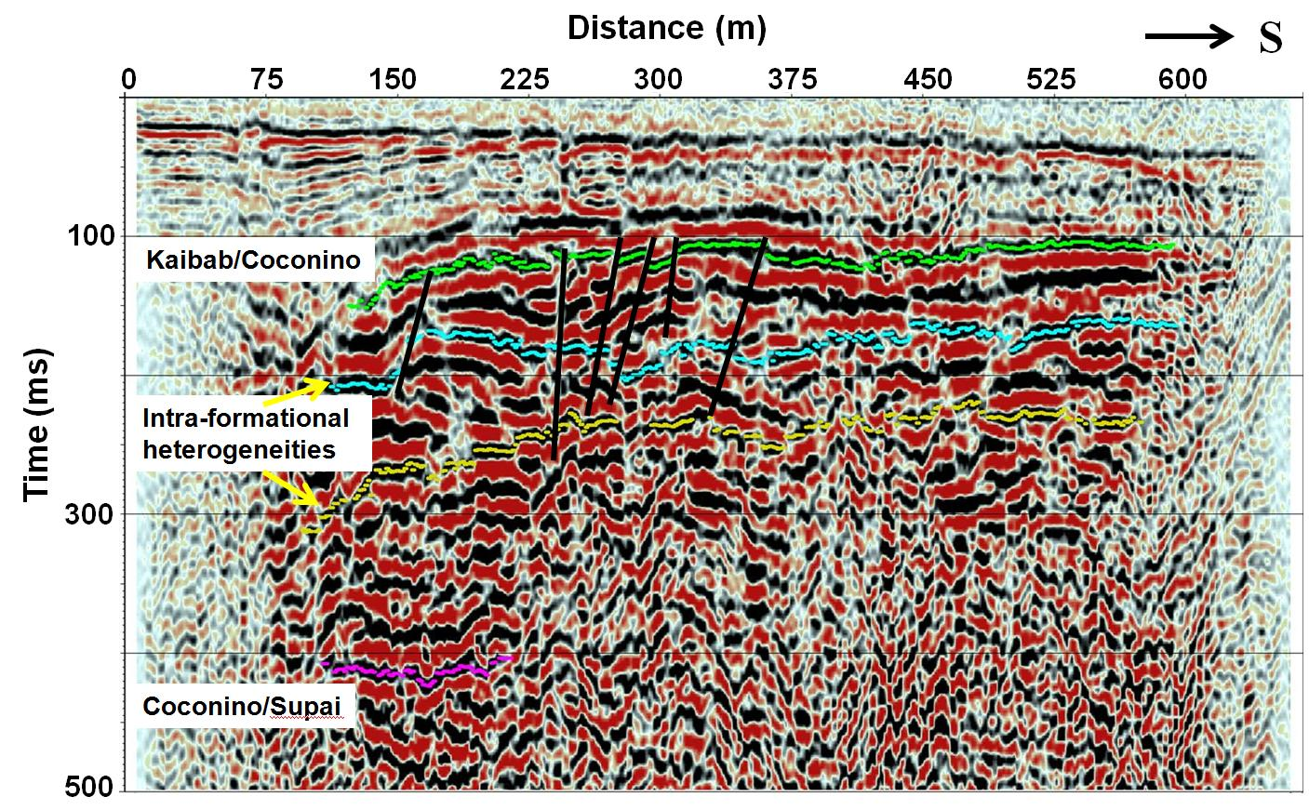
Interpretation:
Near-surface Faults
(Turolski, 2012)

Slide 13
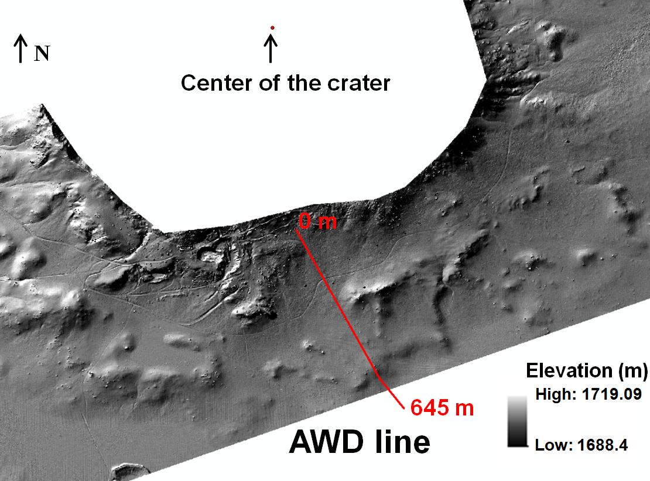
Supporting Materials
(Turolski, 2012)
South-East Line (Roddy et al., 1975) | Hammer Line | South Line (Roddy et al., 1975) | AWD Line
10-19.5 m | 10-14 m | 13.5-18 m | 15-20 m
LiDAR (Light detection and ranging)
for high-resolution topography data
- National Center for Airborne Laser Mapping (NCALM)

Slide 14
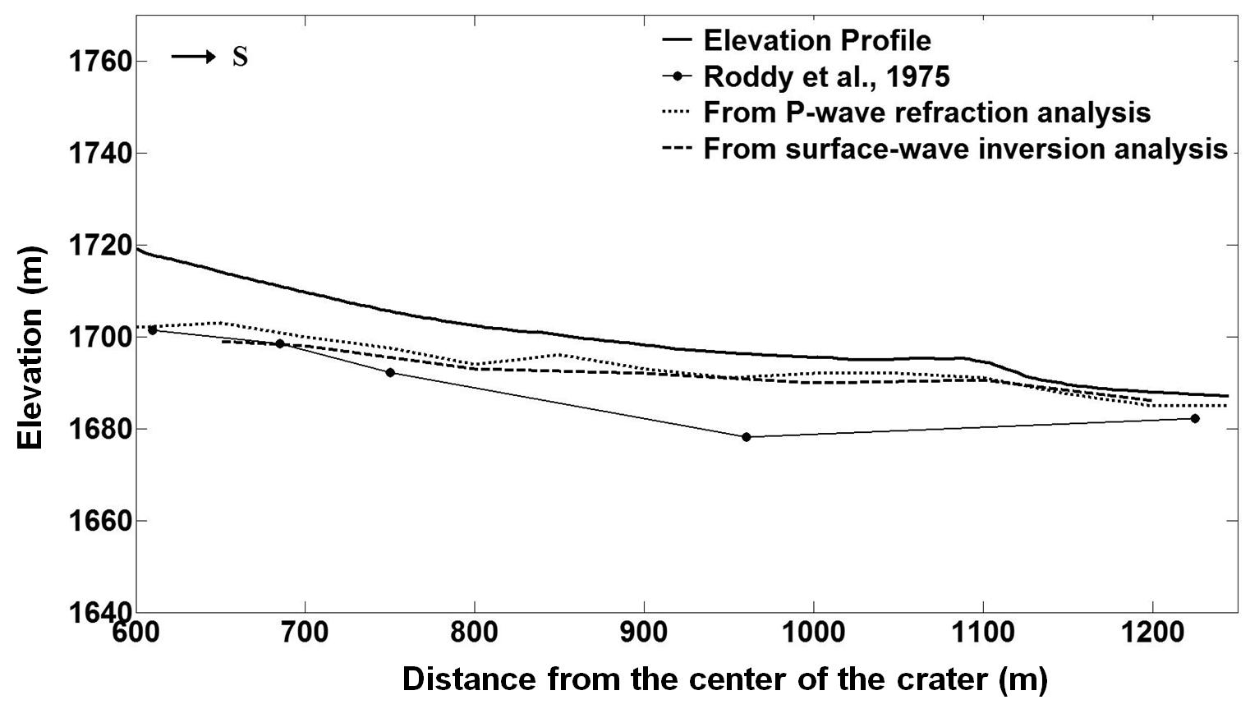
Interpretation:
Ejecta Blanket Structure and Thickness

Slide 15
Conclusions
Ultrasonic measurements:
P-wave velocities of 800-1600 m/s for Moenkopi hand specimens
Seismic refraction:
P-wave velocities of 450-2500 m/s for a 55 m deep model
Ground-roll inversion:
S-wave velocities from 200-1000 m/s for a 38 m deep model
A prominent change in velocities (low to high) is identified as the
transition from ejecta blanket to bed-rock Moenkopi
Thinning of low-velocity ejecta blanket away from crater rim
Ejecta blanket thickness is estimated (15-20 m thick near the rim to
only 5 m thick away from the rim)

Slide 16
Future Work and Proposals
3D seismic surveys with densely spaced (1 m) receivers (3C)
Anisotropic studies of a complex near-surface
Using estimated S-wave velocities to calculate multi-component
(anisotropic) statics
Developing a low-cost, stable method to estimate 2D rock properties
(e.g. densities)
Elastic full-waveform inversion through ground-roll modeling

Slide 17
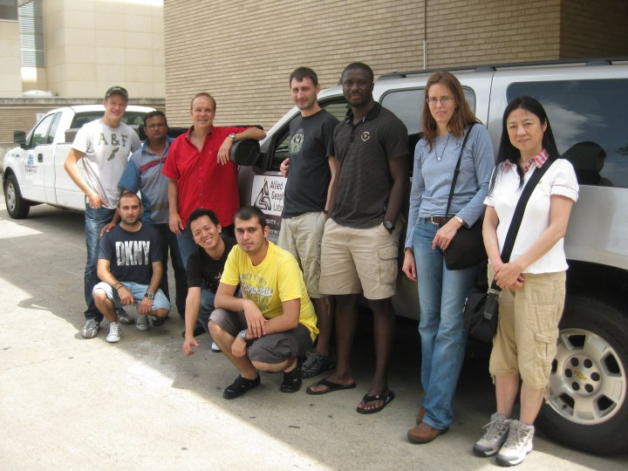
Acknowledgments
Dr. Robert R. Stewart
Dr. C. Liner
Dr. S. Hall
Meteor Crater Field Crew (May, 2010)
Dr. D. A. Kring (Lunar and Planetary Institute)
Generous staff at the Meteor Crater Museum
Dr. K. Spikes and Ms. Jennifer Glidewell (The University of Texas at Austin)

Slide 18
Thank You
What’s so optimistic about this? This guy must be a geophysicist !!!

Slide 20
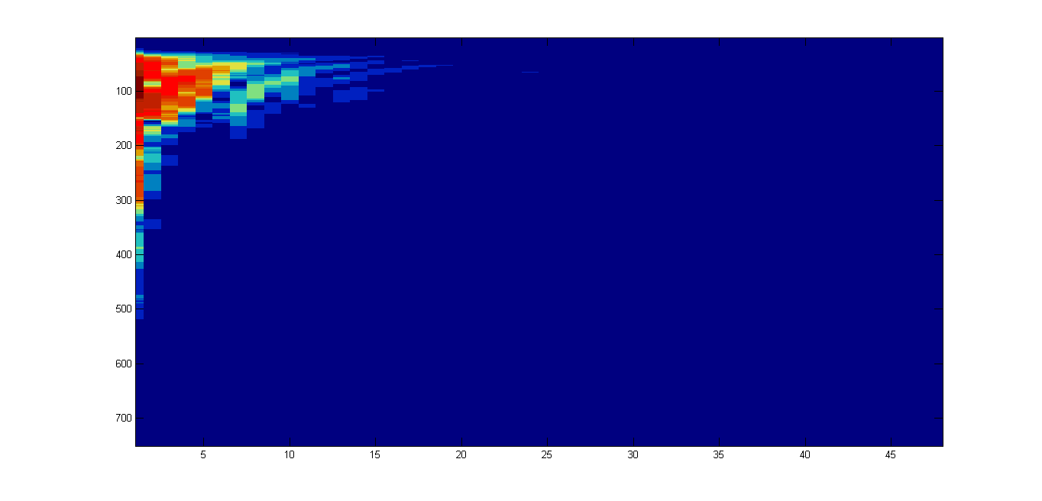
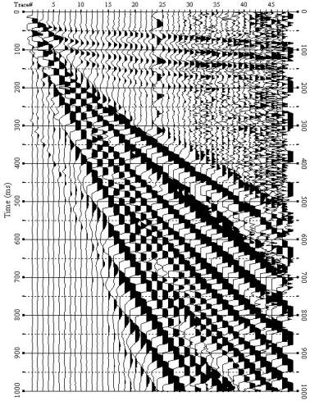
Methodology: MASW
Multichannel Analysis of Surface Waves (MASW)
- Generation of dispersion curves (phase velocity versus frequency plots)
(Park et al., 1998; ibid 1999; Xia et al., 1999)
x
x
Phase
t
f
Amplitude spectra

Slide 21
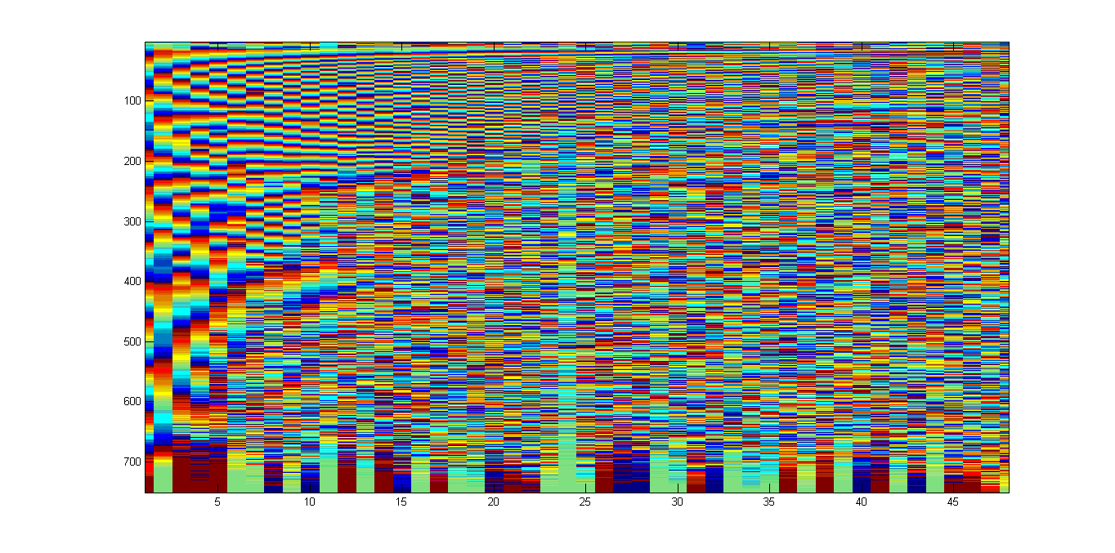
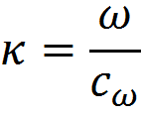
MASW (Dispersion curves)
x
x
*
t
f
Phase spectra
, ω = angular frequency and c_{ω} = phase velocity
Values are stacked over entire offset
The maximum value is obtained when -

Slide 22
MASW (Inversion algorithm)
Observed
Dispersion Curve
C_{Rayleigh} = 0.92* V_{S}
Initial V_{S} model
Initial V_{S} model
Update V_{S} model
Observed
Dispersion Curve
Calculated
Dispersion Curve
Error minimized?
NO
YES
- Modified after Xia et al., 1999
Final V_{S} model

