Slide 1
Convolutional Time-Lapse Seismic Modeling for CO2 Sequestration at the Dickman Oilfield, Ness County, Kansas
Jintan Li
Advisor: Dr. Christopher Liner
May 2nd, 2012

Slide 2
Outline
Background/Introduction
Methods
Completed results
Summary and future Work

Slide 3
Background
CO2 capture and storage (CCS)
was first discussed in late 1970s (Baes, et al.)
has aroused great interest with increasing concern of global warming
CCS candidates:
Deep saline aquifer (storage capacity is estimated to range from 1,000-100,000 giga tons worldwide, IPCC,2005)
Depleted hydrocarbon reservoirs
Coal beds

Slide 4
Previous Studies
Sleipner field: Norwegian North Sea
1st field test to inject CO2 into a saline aquifer (1996)
Salah project: in Algeria
an industrial-scale CO2 site, with injection into an aquifer of a gas producing field (since 2004)
Weyburn Field : Canada
has injected CO2 into depleted gas reservoirs
( since 2000)
Others (Germany,etc.)

Slide 5
Motivation
Previous and on-going time lapse studies
rarely involve the output of a commercial reservoir simulator as input to the seismic earth model.
difficult issues of scaling and smoothness in geological, flow simulation, and seismic earth models.
Calibration
Flow simulation scale
seismic scale
Log scale

Slide 6
Introduction
Study area: Dickman Field, Kansas
Geology: carbonate build-ups, karst feature (Mississippian angular unconformity)
Two CO2 capture and storage targets
Deep Saline Aquifer – primary (200-300ft)
Shallower depleted oil reservoir – secondary (~100ft)(in this study)
Flow simulation
Residual gas trapping
Solubility trapping
Free CO2 geological trapping (hydrodynamic)

Slide 7
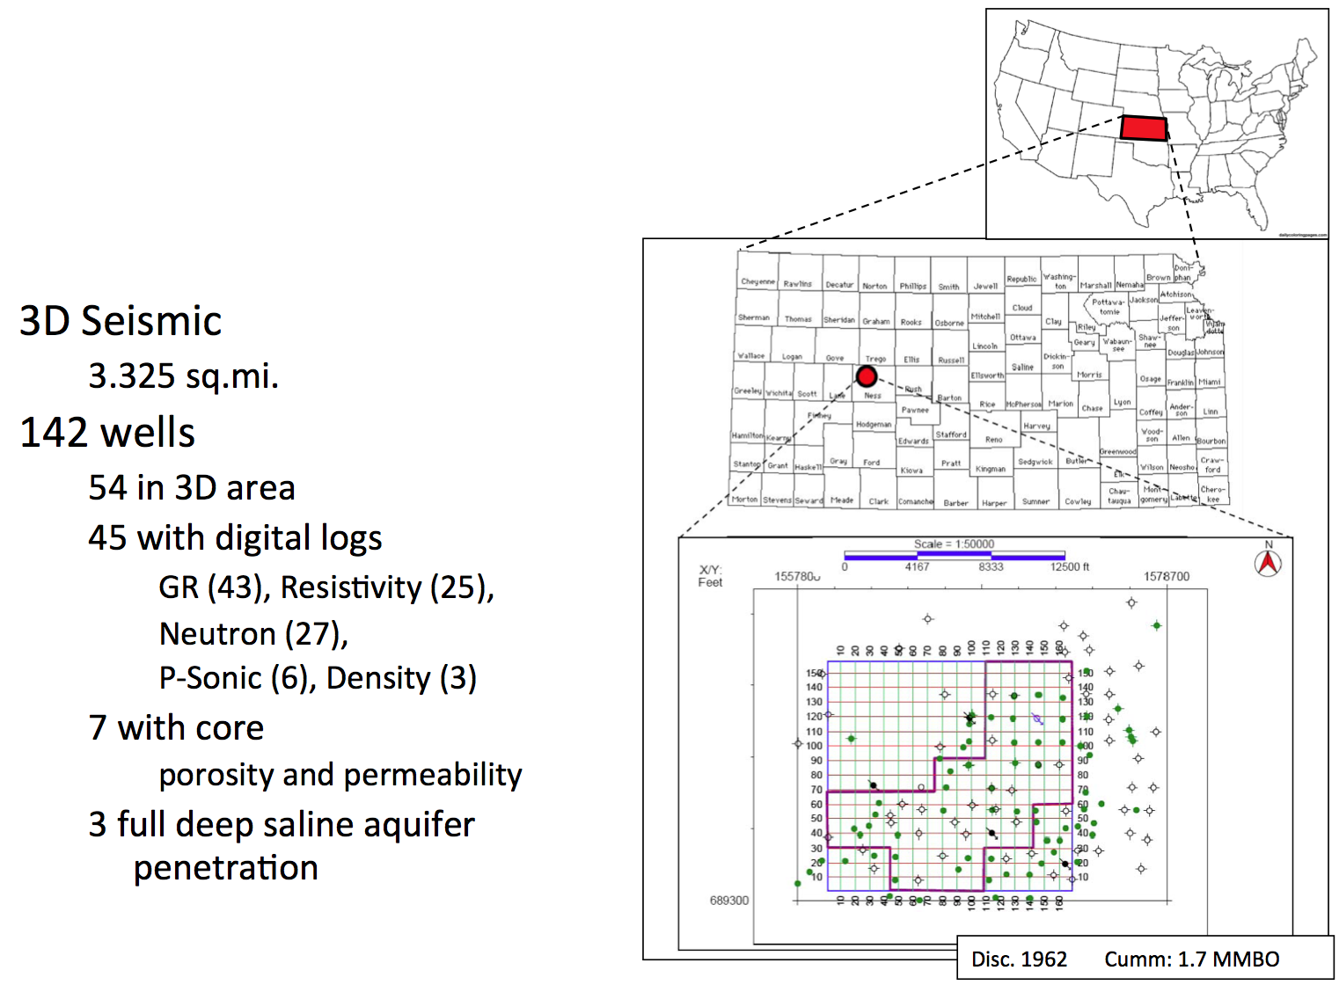
Dickman Field Site
Live 3D area
Type log

Slide 8
Type Log for Dickman Project Area
Fort Scott Limestone
Cherokee Group
Lower Cherokee Sandstone
Depleted oil reservoir
Mississippian Limestone
Osage Formation
This study
Deep saline reservoir
Gilmore City Limestone
Viola Limestone
Arbuckle Group
( Liner et al.,2009)

Slide 9
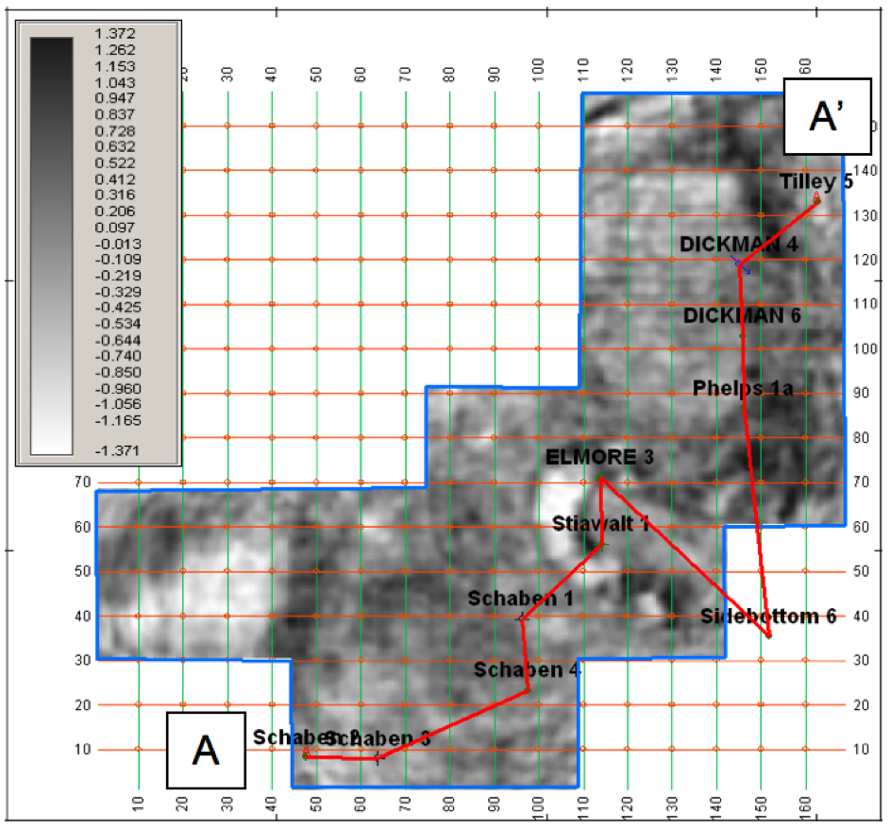
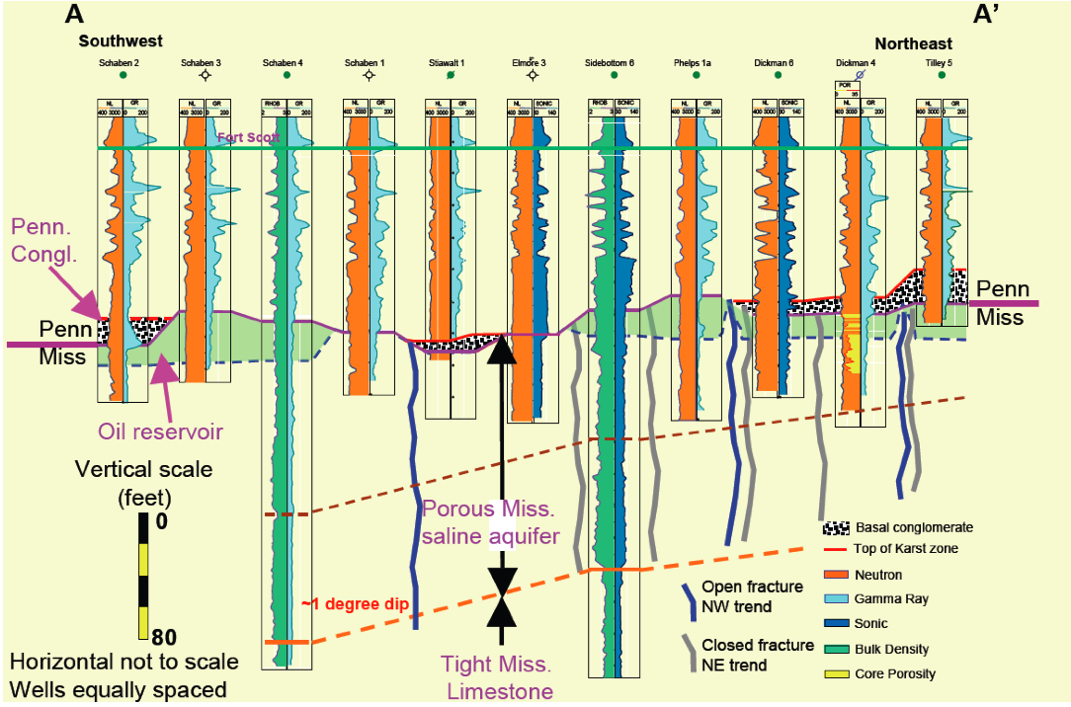
3D Seismic area, time slice at the Mississippian
Cross section courtesy of Tom Bjorklund .
( Liner et al.,2009)

Slide 10
Flow Simulation
Simulate liquid and gas flow in real world conditions
Simulator : Generalized equation of state compositional simulator (GEM)- by CMG (computation modeling group).
Used for:
CO2 capture and storage (CCS)
CO2 enhanced oil recovery
Well data
+core data
+seismic
Flow simulation

Slide 11
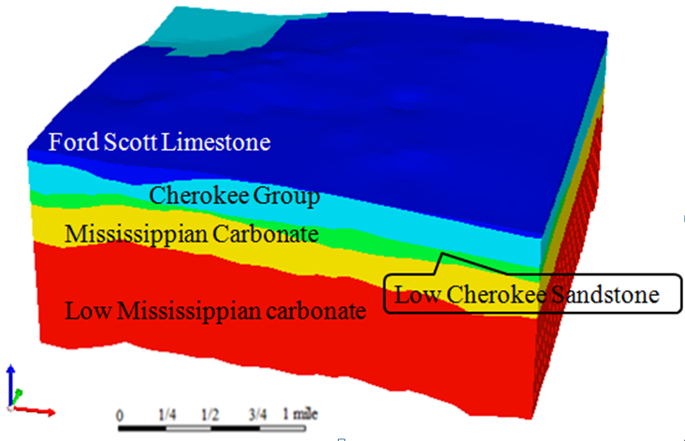
Flow Simulation
Geology model for five aquifer layers

Slide 12
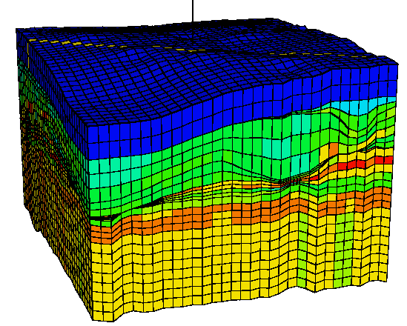
Perm K (md)
PermK (md)
Flow Simulation Model (cross sect.)
32 simulation layers
z
x
Flow simulation grid
dx=500ft; dy=500ft; dz: variable ( 0.5 ft to 300ft)
Sim Layer No. | VerticalPerm | Porosity(%) | Formation Name
1-6 | 10 md | 18.2 | Shallow Reservoir layers
7-8 | 0.01 md | 20.0 | Two Seal Layers
9-10 | 0.7 Horizontal Perm | 10.3 | Ford Scott Limestone
11-13 | 0.5 Horizontal Perm | 19.1 | Cherokee
14-15 | 0.5 Horizontal Perm | 16.5 | Lower Cherokee
16 | 0.7 Horizontal Perm | 14.8 | Mississippian Unconformity
17-20 | 0.7 Horizontal Perm | 20.0 | Mississippian Porous Carbonate
25-32 | 0.7 Horizontal Perm | 22.45 | Mississippian Osage and Gillmor City

Slide 13
Regridding
x
Flow Model
Seismic Model
dz=30ft
Porosity=15%
Porosity=15%
dz=8ft
Porosity=12%
Porosity=12%
Porosity=18%
dz=0.5ft
Porosity=18%
Set dz= smallest dz in the flow simultion model, and top fill the properties with the same value, to maintain the subtle features in the geology model
z

Slide 14
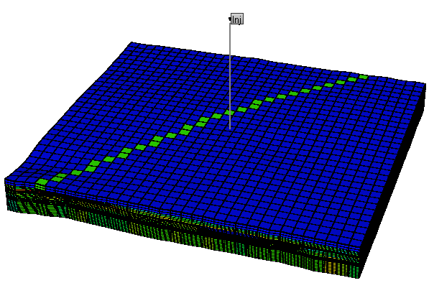
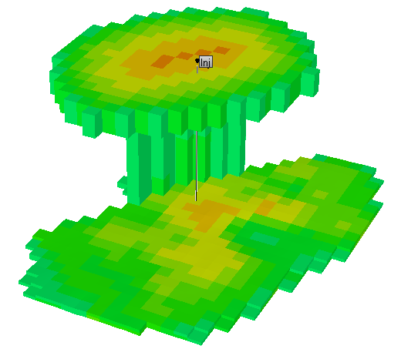
CO2 Saturation at 250 Years
Free CO₂ Sat
a)
Leakage Test
b)
CO2 saturation
N
Notes:
Figure 7 : (a) Flow simulation grid showing fault (green) and location of seismic inline 100(red) (b) Accumulation of CO2 at the Fort Scott level after 50 years of injection and 200 years continued simulation.

Slide 15
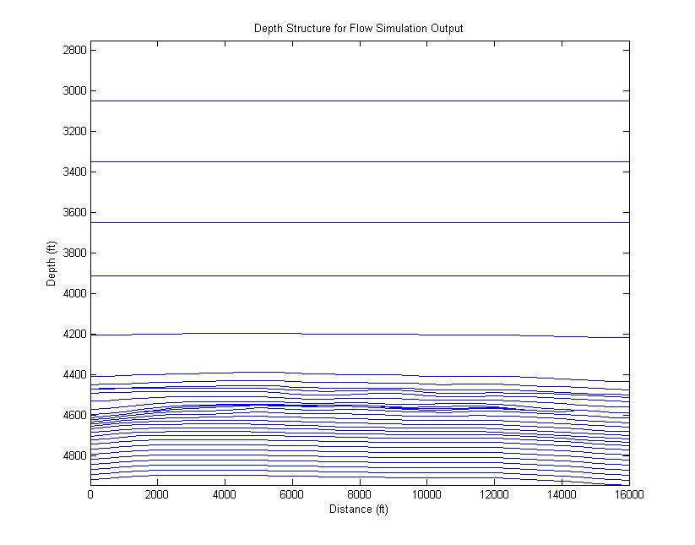
Example: Geology Structure for Sim Layers
x
z
Mississippian unconformity and porous carbonate

Slide 16
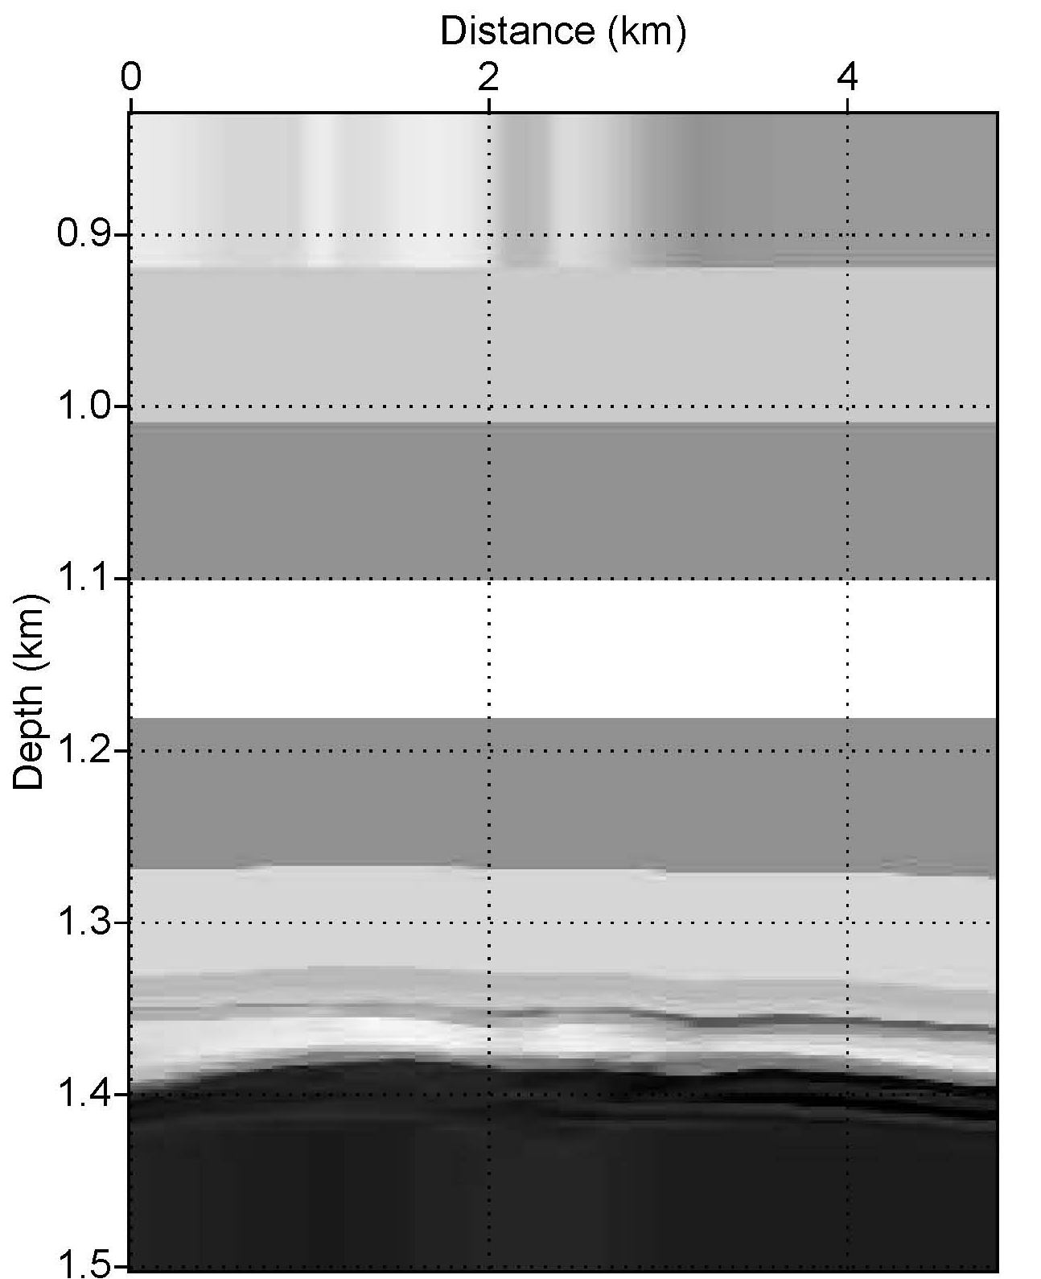
Velocity Model at Year 0
Notes:
Figure 9. (a) Seismic P-wave earth model before CO2 injection. (b) Simulation year 250, after 50 years of CO2 injection and 200 years of continued flow simulation. Note vertical faults acts as CO2 conduit. (c) Saturation levels of CO2 in year 250.

Slide 17
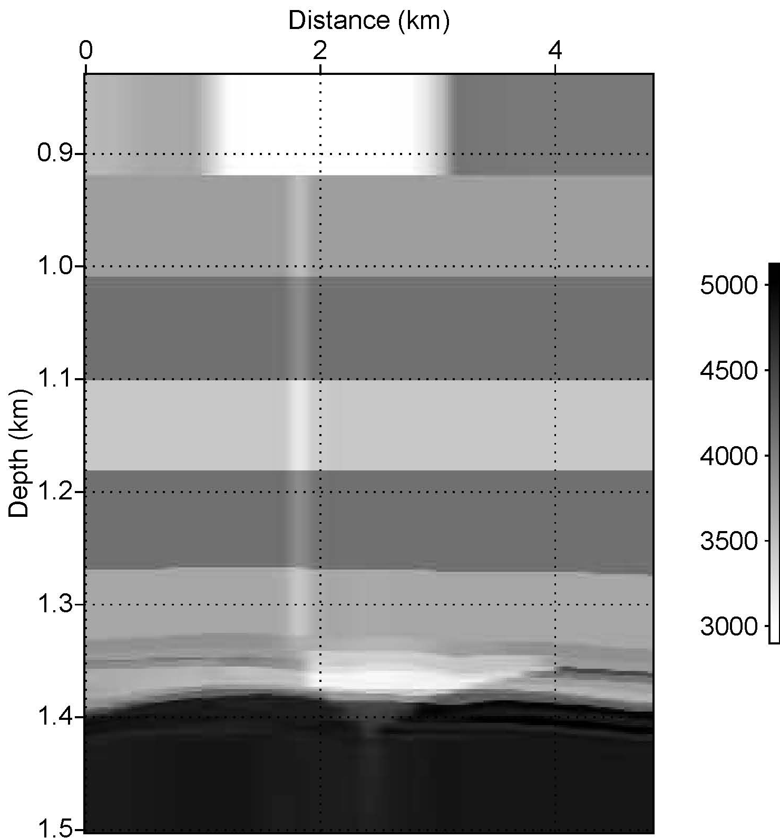
Velocity Model at Year 250
Average velocity difference 500-600 m/s
Notes:
Figure 9. (a) Seismic P-wave earth model before CO2 injection. (b) Simulation year 250, after 50 years of CO2 injection and 200 years of continued flow simulation. Note vertical faults acts as CO2 conduit. (c) Saturation levels of CO2 in year 250.

Slide 18
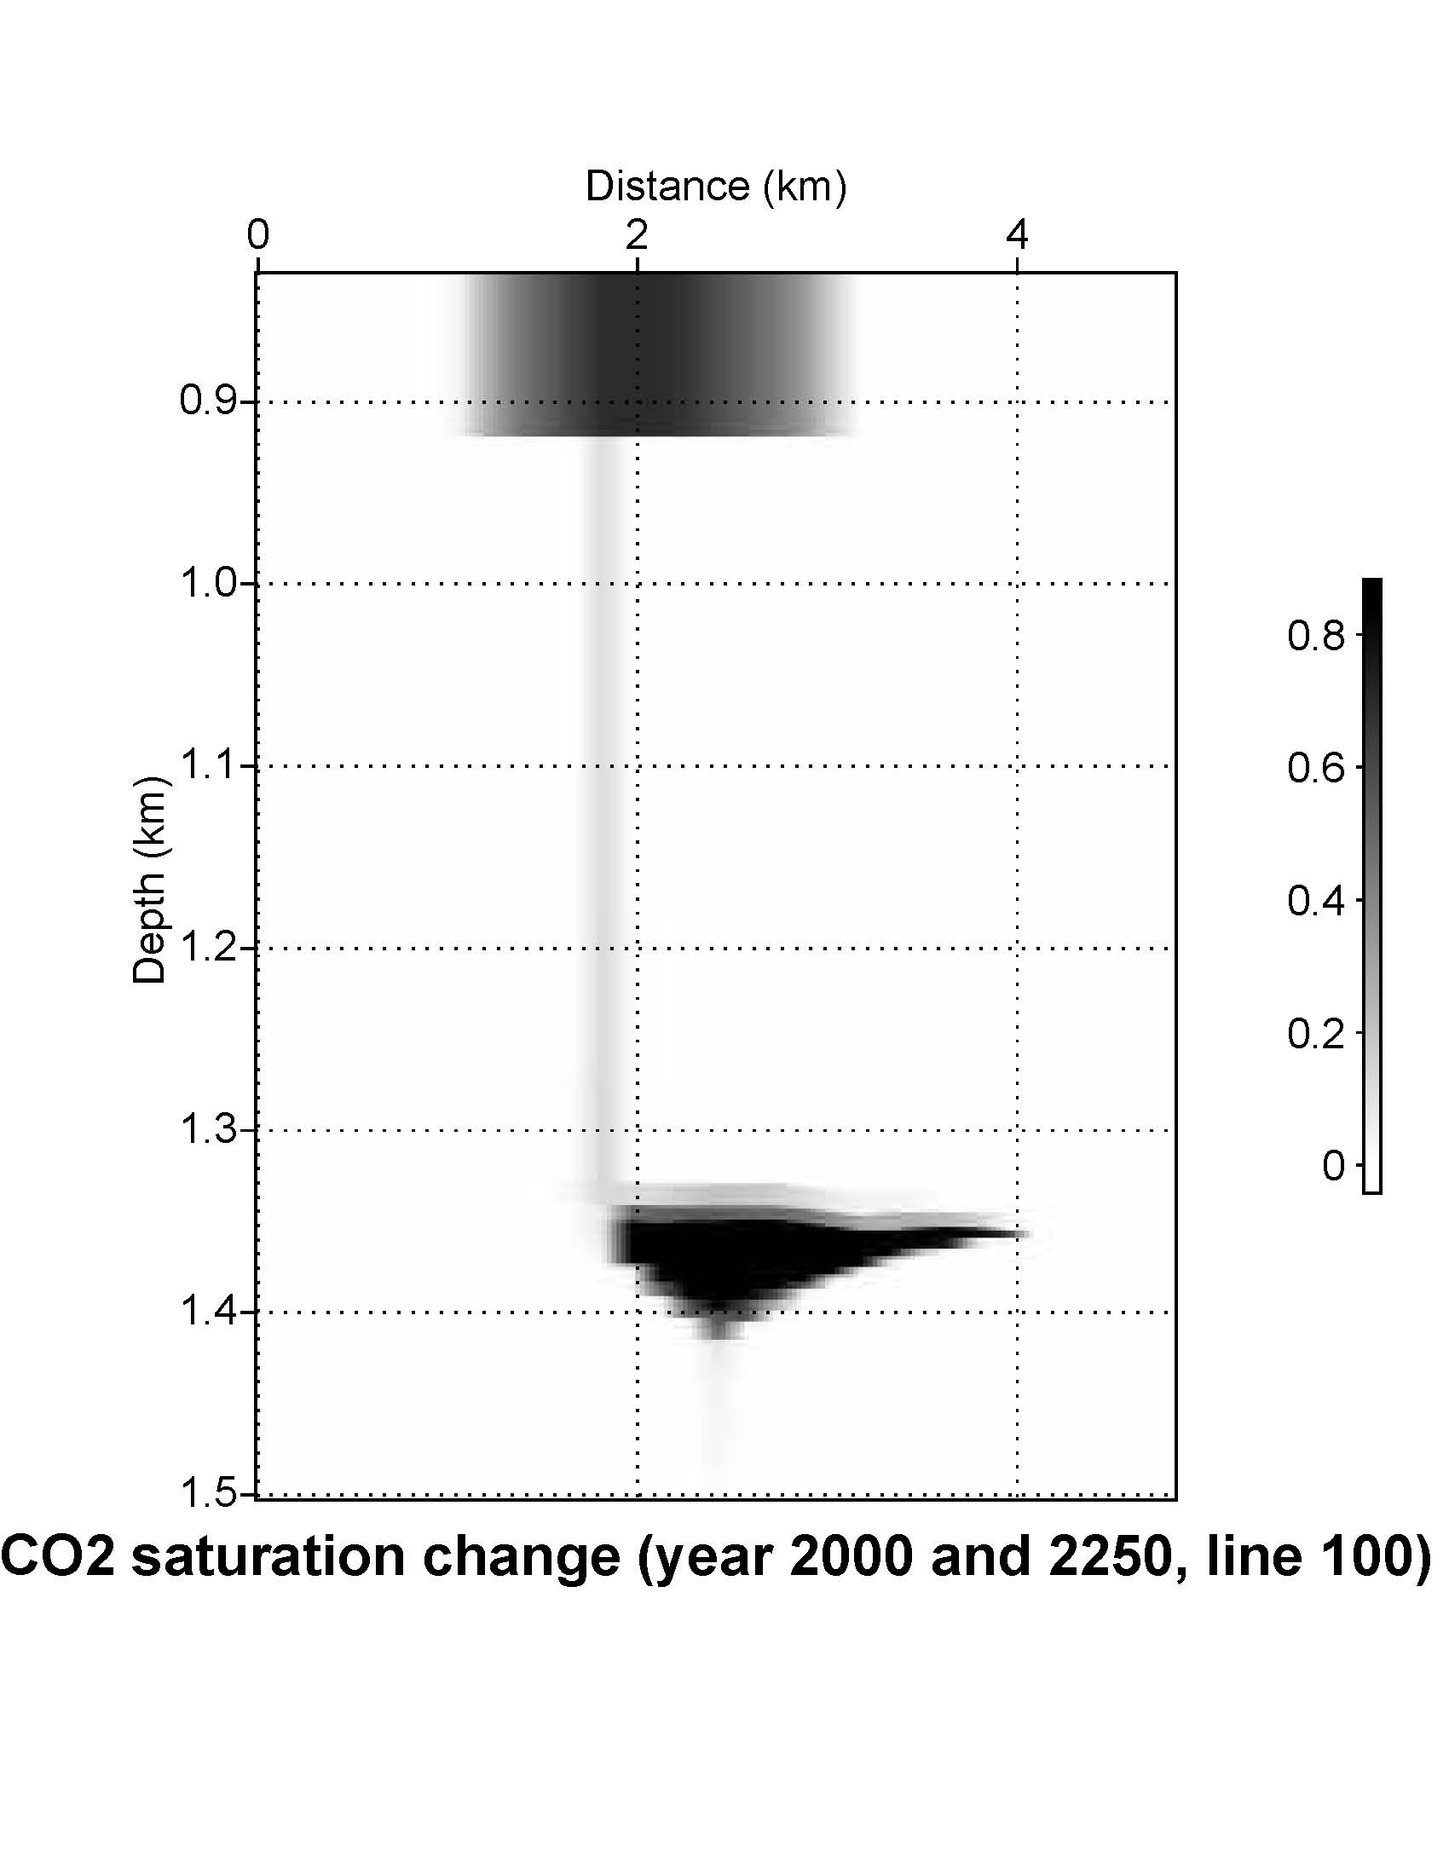
Velocity Model at Year 250 and CO2 Saturation
CO2 saturation
Sco2
Average velocity difference 500-600 m/s difference
Notes:
Figure 9. (a) Seismic P-wave earth model before CO2 injection. (b) Simulation year 250, after 50 years of CO2 injection and 200 years of continued flow simulation. Note vertical faults acts as CO2 conduit. (c) Saturation levels of CO2 in year 250.

Slide 19
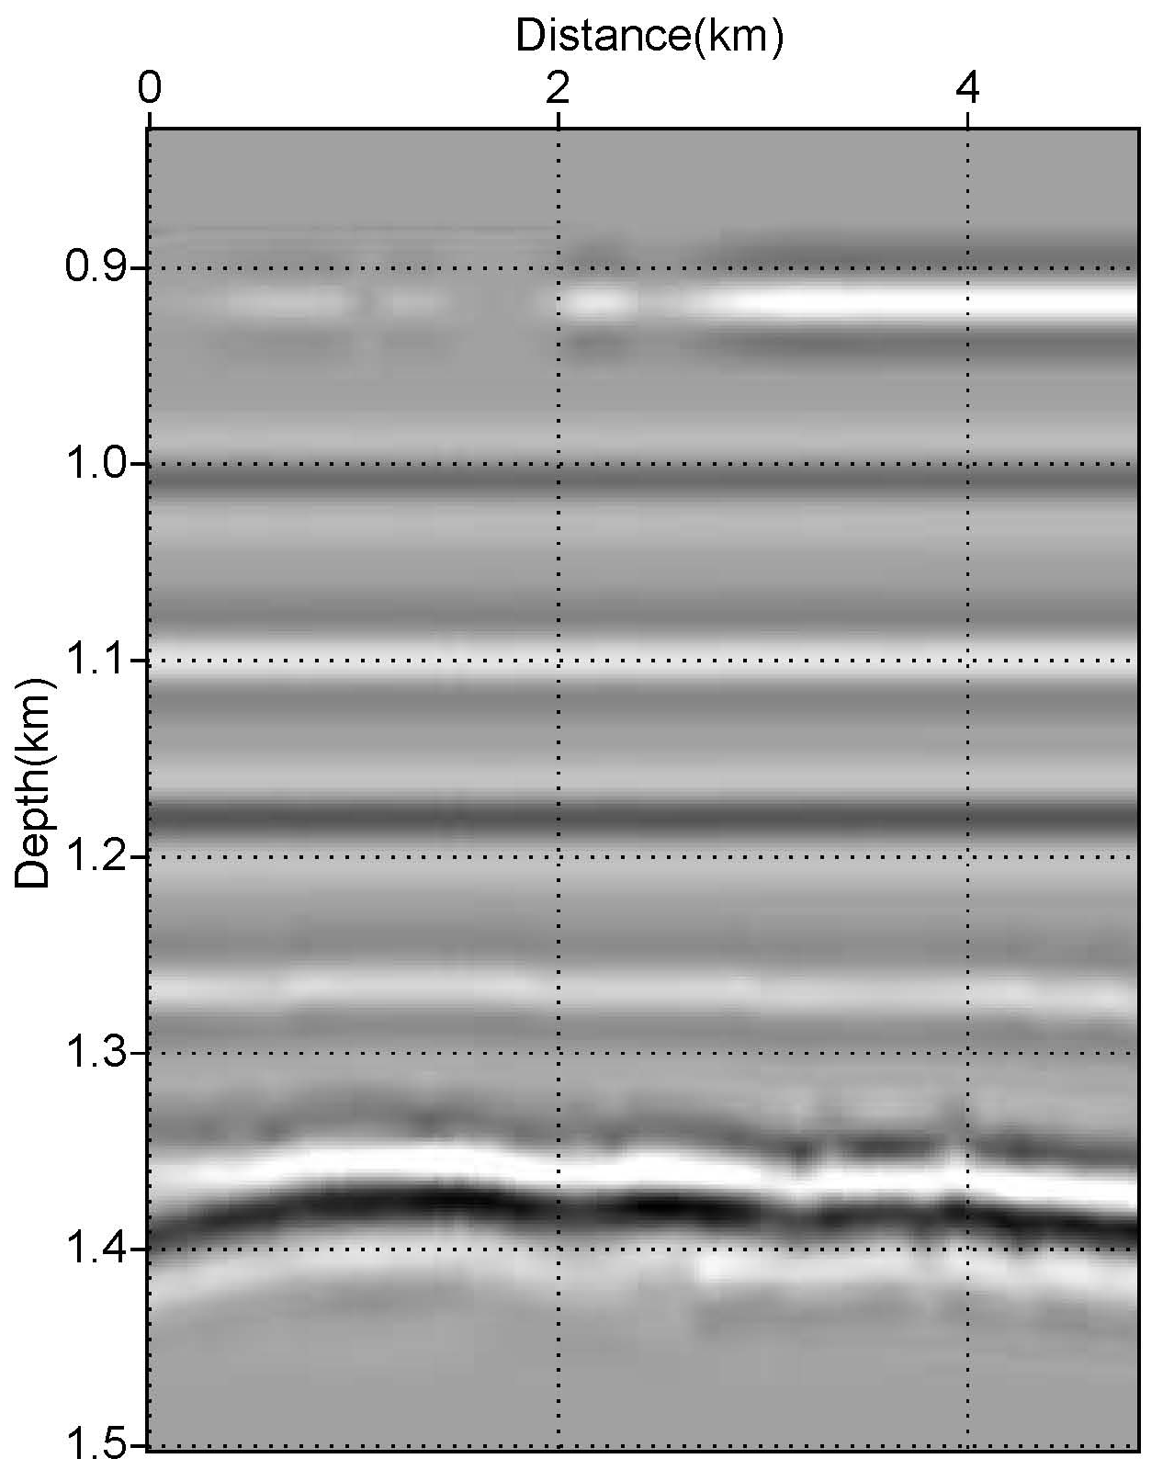
Seismic Simulation Results ( Year 0)
Notes:
Figure 11. 1D seismic convolutional forward modeling results for inline 100: (a) 1st year of injection (b) last year of monitoring (2250) (red arrow shows top of sequestration cite at around 1348m measured depth).

Slide 20
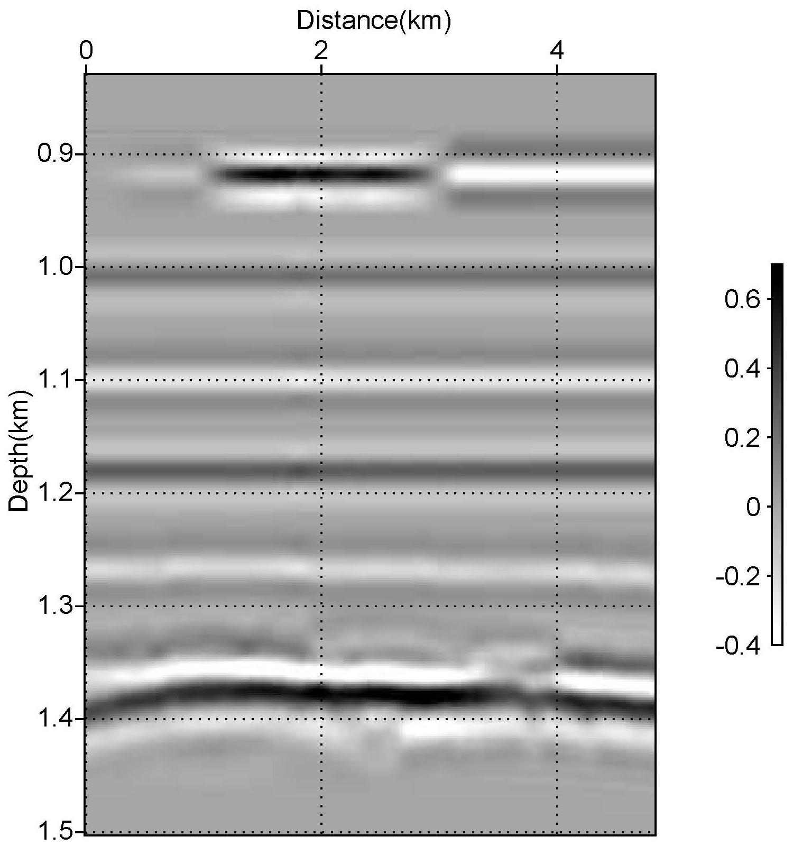
Seismic Simulation Results (Year 250)
amp
Notes:
Figure 11. 1D seismic convolutional forward modeling results for inline 100: (a) 1st year of injection (b) last year of monitoring (2250) (red arrow shows top of sequestration cite at around 1348m measured depth).

Slide 21
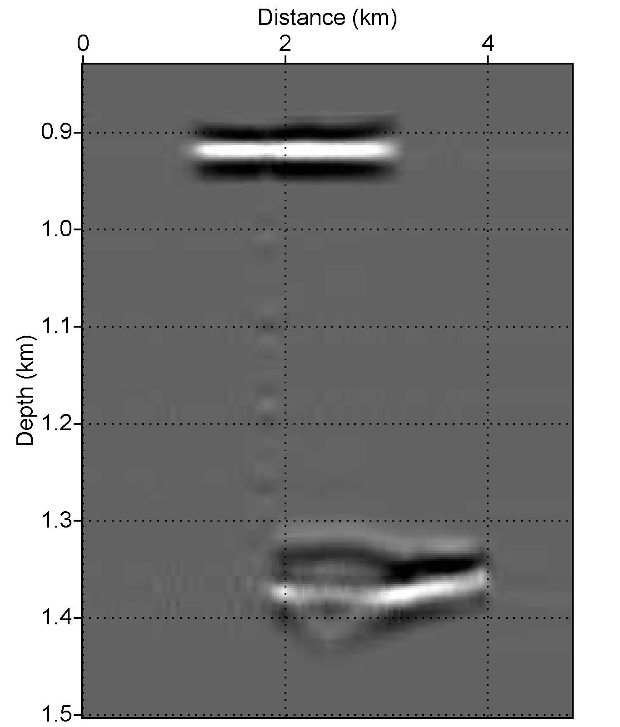
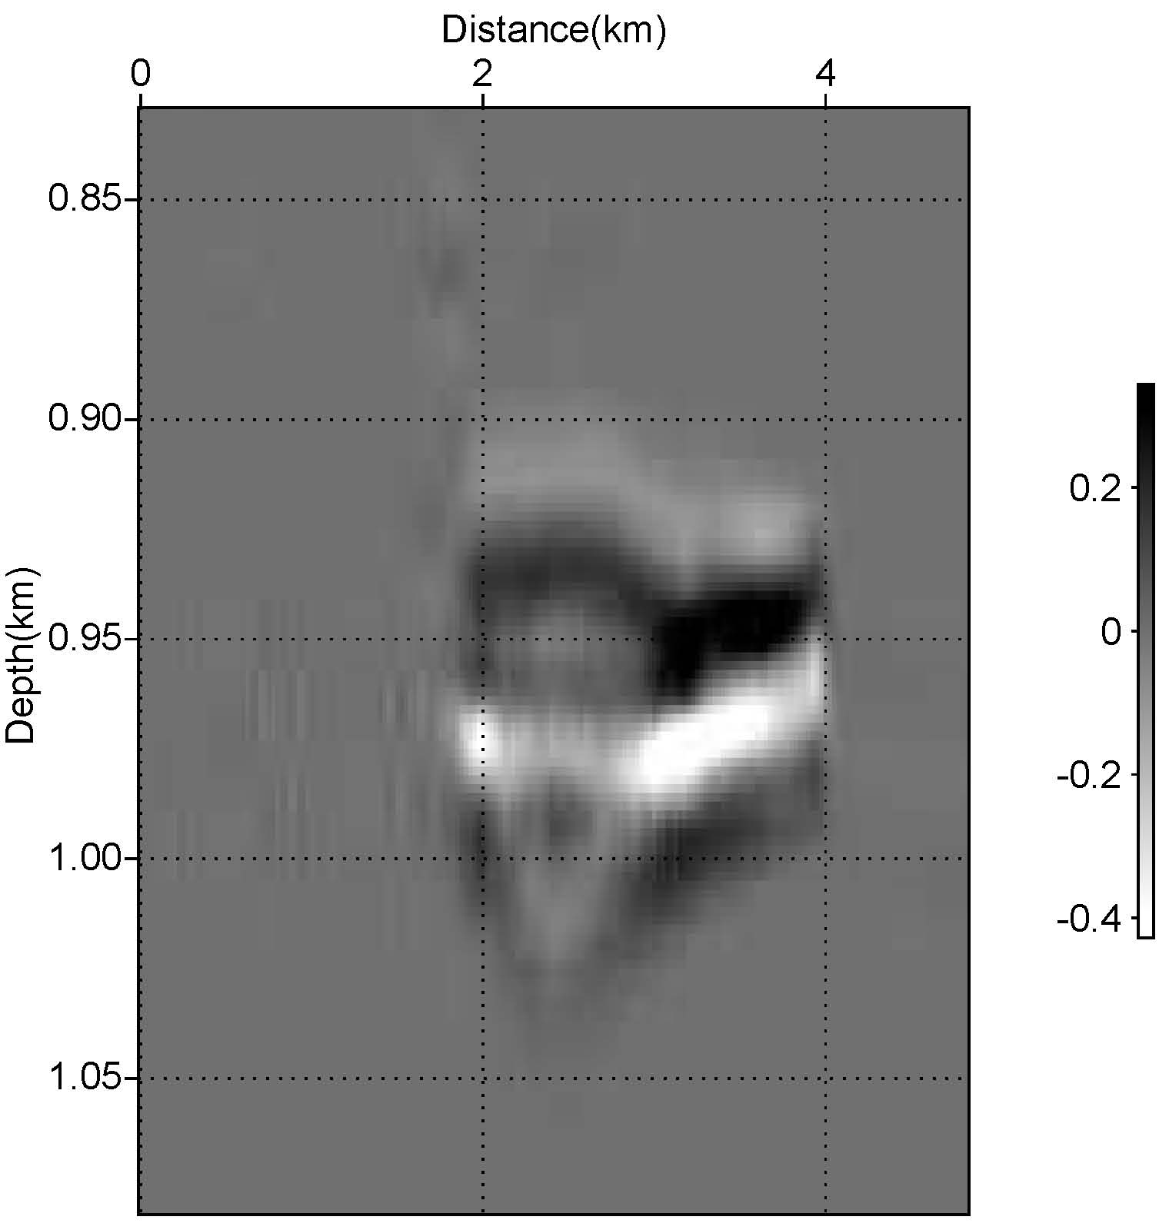
Difference on Seismic ( Year 0 and Year 250)
Difference
CO2 Sat
a)
b)
c)
amp
Sco2
Notes:
Figure 13. (a) Difference on seismic between year 0 and 250 due to CO2 injection (b) Detailed 1D convolutional seismic simulation result at the sequestration level. (c) CO2 saturation at the last year of monitoring ( year 250).

Slide 22
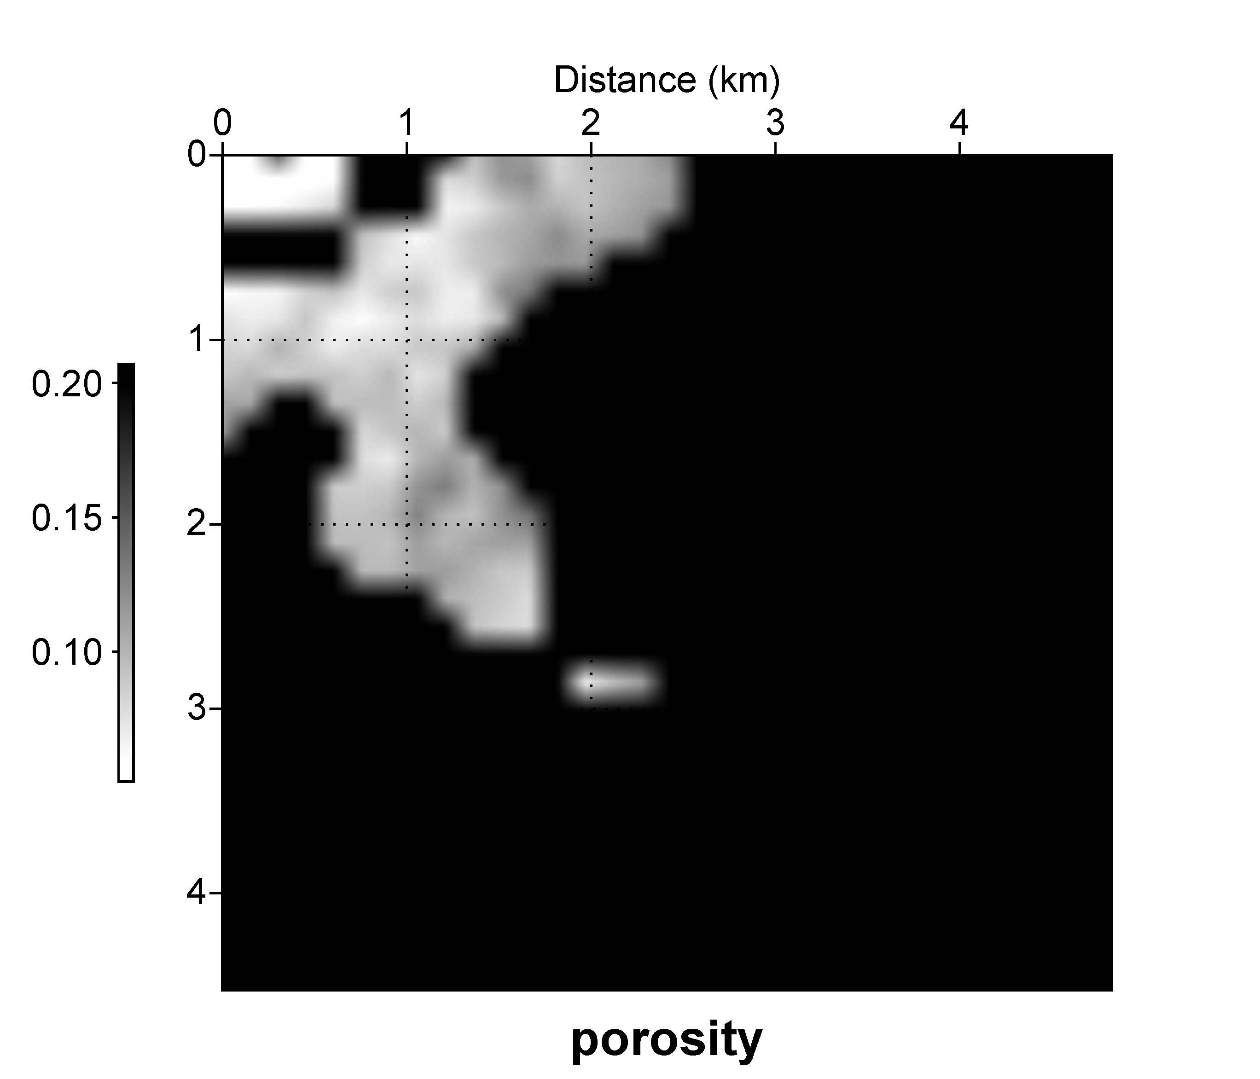
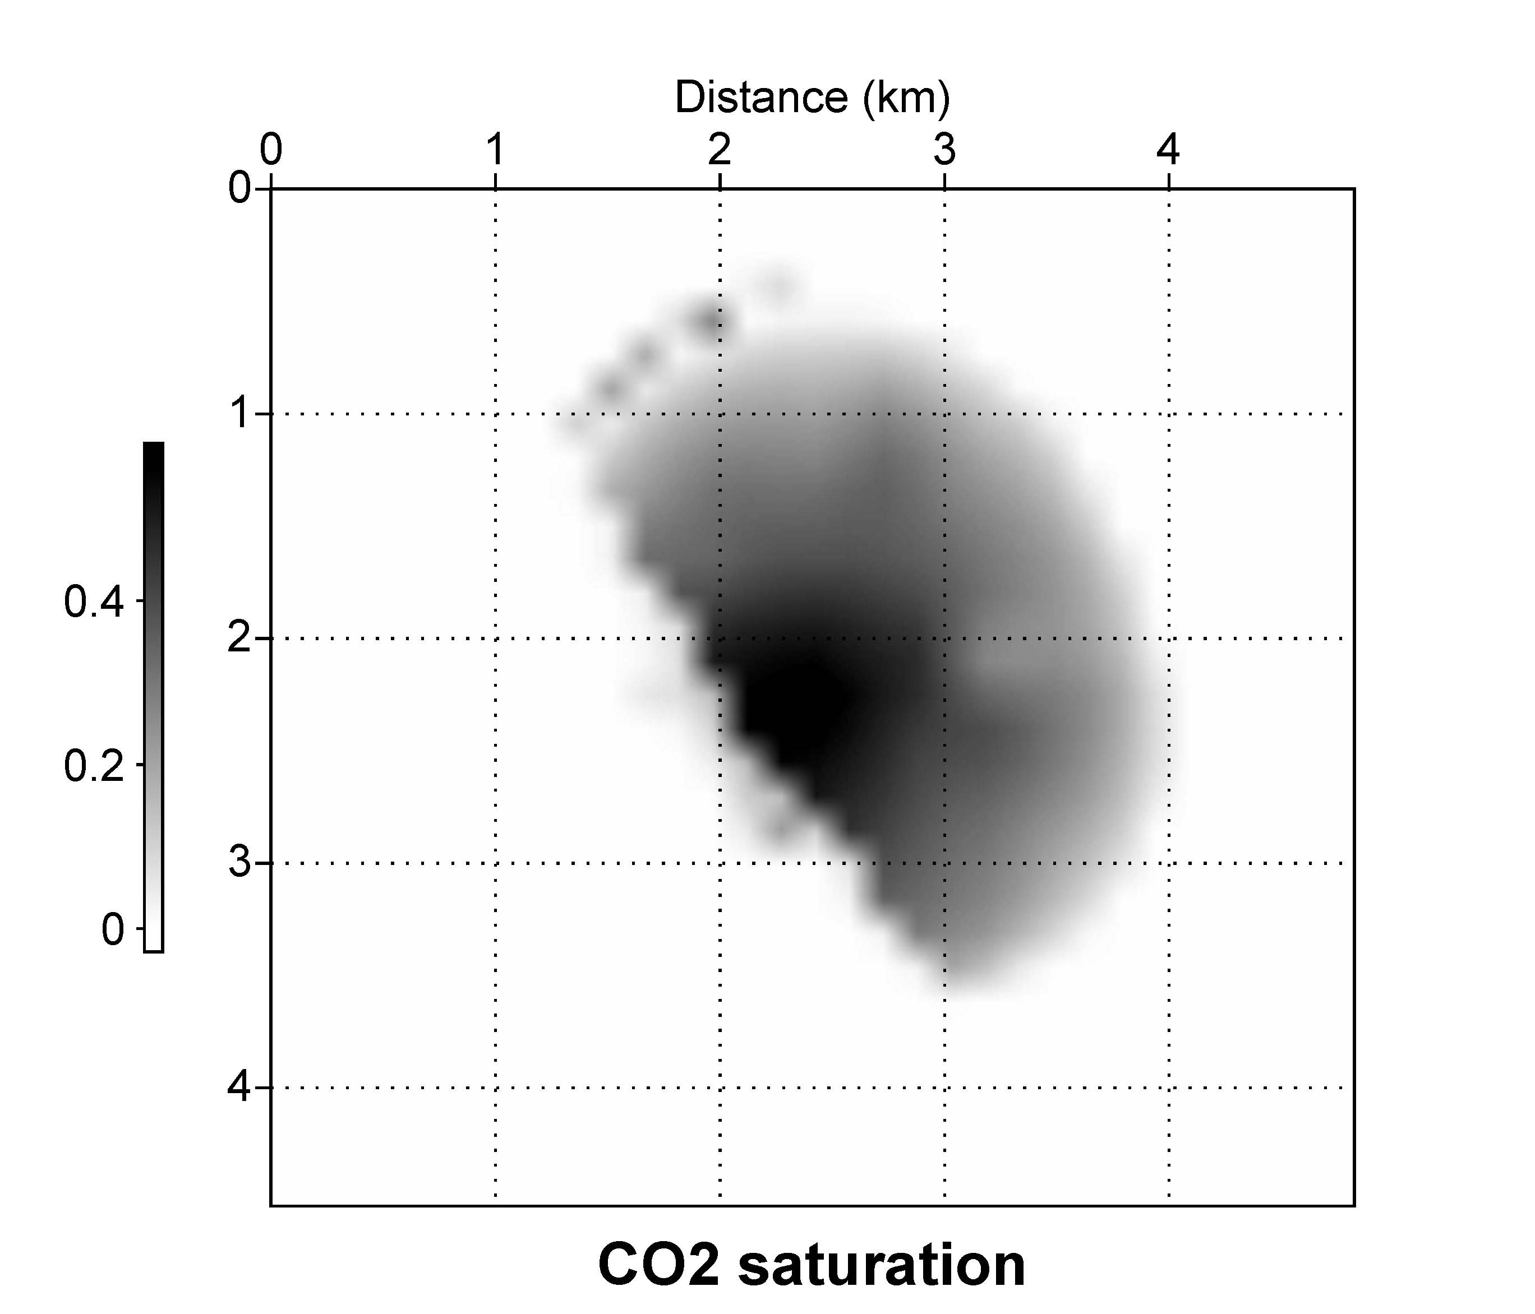
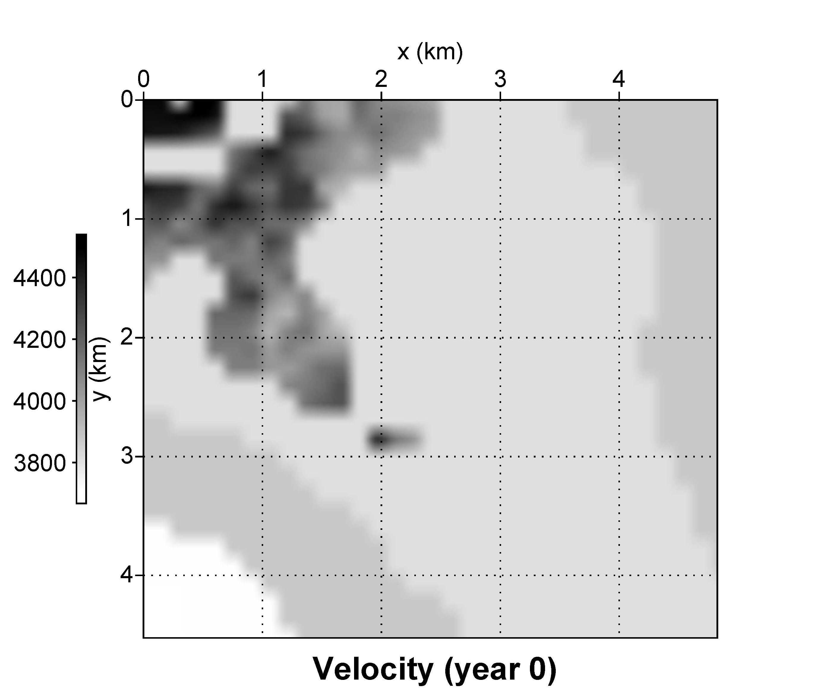
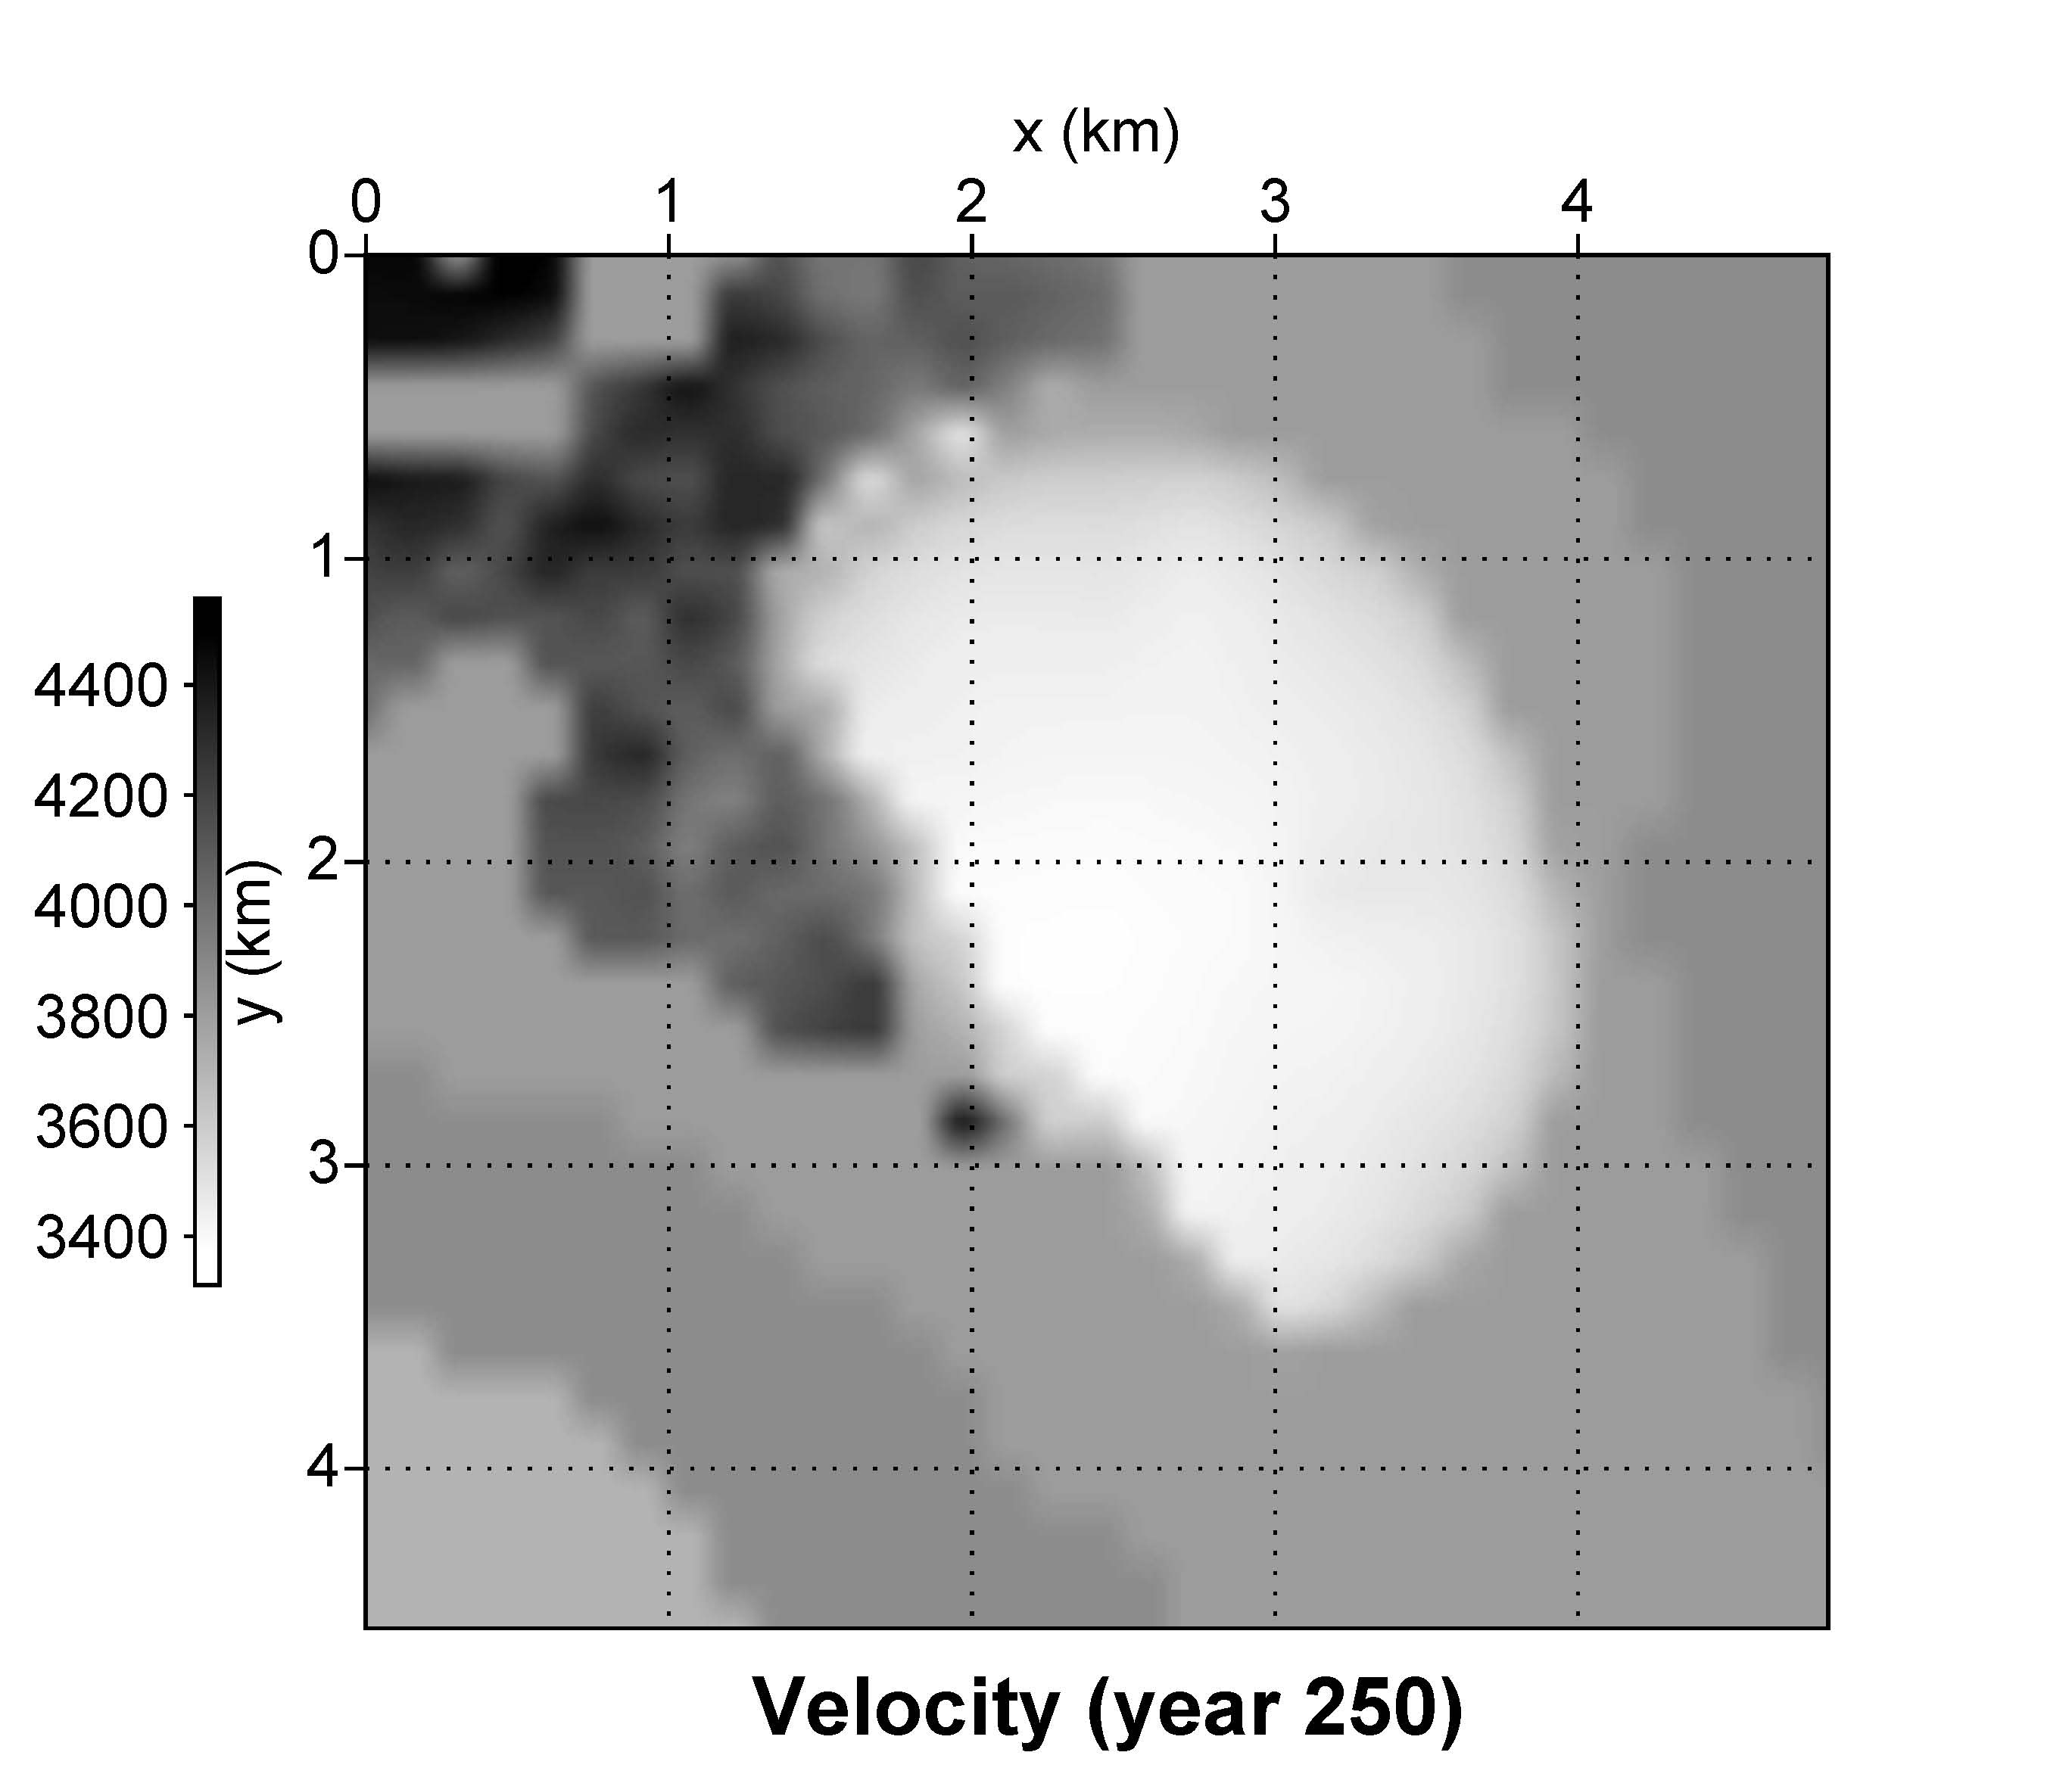
Map View of Reservoir Properties (Depth 1348 m)
a)
b)
m/s
m/s
c)
d)

Slide 23
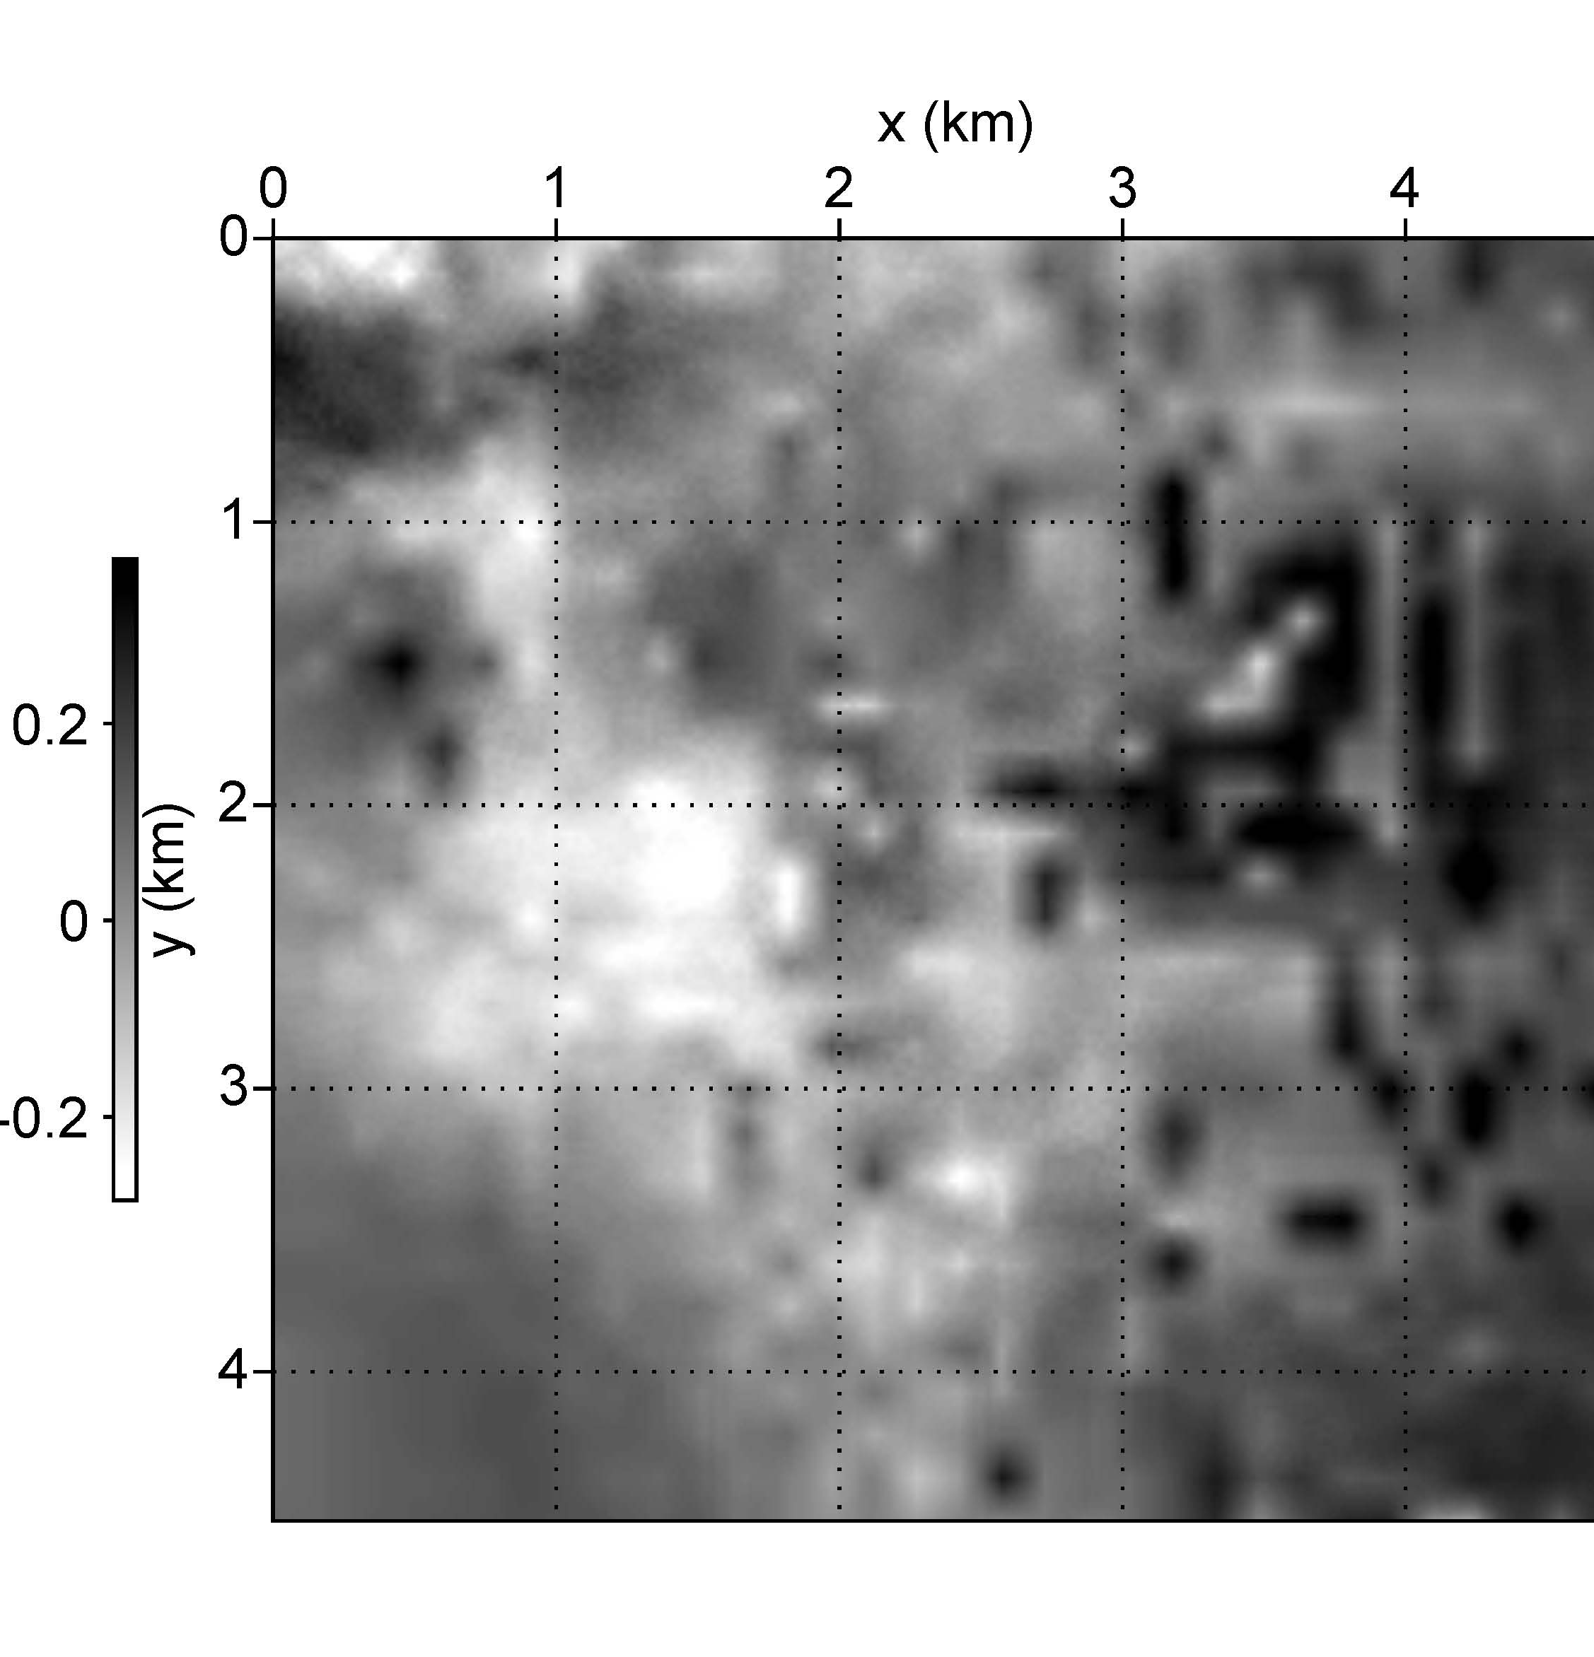
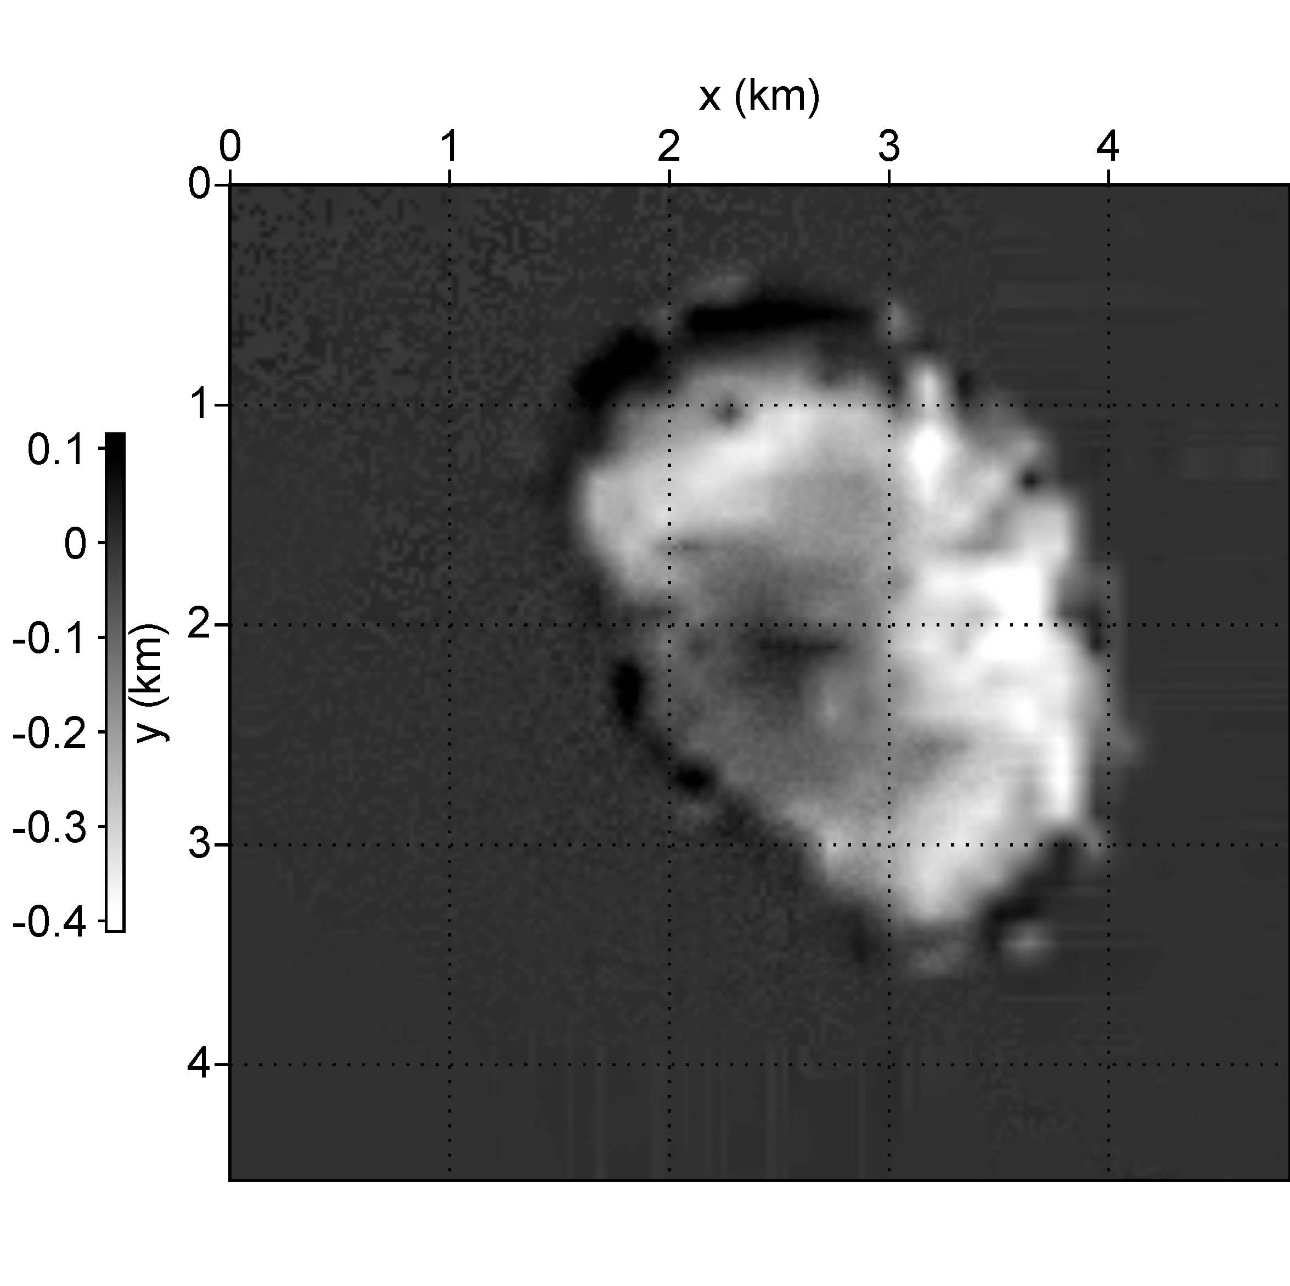
Year 0
Year 250
Difference
a)
b)
c)
amp
amp
Depth Slice 1348 m
Notes:
Figure 15. Depth slice (1348m) of 1D convolutional forward modeling results (a) Year 0. (b) Year 250. (c) Difference.

Slide 24
Conclusions and Discussions
Work flow: flow -> seismic
Re-gridding from flow simulation to seismic is challenging, which includes both downscaling and upscaling
The followings need to further investigated
Is any geology feature lost during this process?
If all the features is maintained, can it all be detect on seismic? ( may be below seismic resolution )
1D convolution forward modeling-> 2D/3D acoustic/elastic

Slide 25
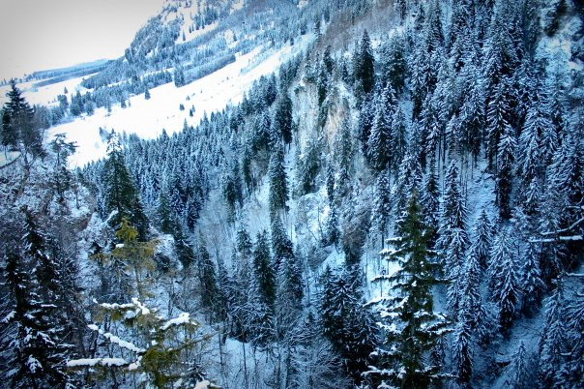
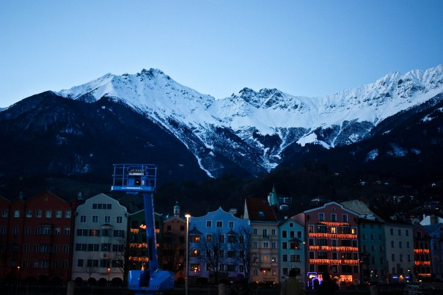
Acknowledgement
Dr. Christopher Liner (PI)
Po Geng (Flow simulation)
June Zeng (Geology)
UH CO2 Sequestration Group

Slide 26
Thank You !!!

Slide 28
Flow simulation Output
y
Data format (for each layer):
x y property value ( depth, pressure, porosity, saturation, etc.)
x

Slide 29
Flow Simulation Property Format
X(ft)
Y(ft)
Z(ft)
dx=500 ft
dx=2000 ft
Data points at the truncation or pinch-out will be skipped when exported from flow simulation model

Slide 30
X(ft)
Y(ft)
Z(ft)
dx=2000 ft
Fill the gaps : assume z is missing
1563747.00 694023.00 1987.29
1564247.00 694023.00 0
1564727.00 694023.00 0
1565227.00 694023.00 0
1565747.00 694023.00 1954.98
After this step, the grid will be regular with NX by NY by NZ in each direction

Slide 31
Flow simulation Output
x(ft)
y(ft)
z(ft)
1563747.00 694023.00 1987.29
1564247.00 694023.00 0
1564727.00 694023.00 0
1565227.00 694023.00 0
1565747.00 694023.00 1954.98
1563747.00 694023.00 1987.29
1564247.00 694023.00 1986
1564727.00 694023.00 1984
1565227.00 694023.00 1970
1565747.00 694023.00 1954.98
Assumptions:
If z is zero, then fill the zeros value with the same depth of the next top layer and also corresponding property values

Slide 32
Frequency Spectrum
Amp
Freq
(Liner, 2012)
fdom: 35Hz

Slide 33
Flow Simulation
Grid types
Unconstructed
Constructed (preferred, high efficiency of simulation performance)
Orthogonal corner grid (easy, fewer faults structure) (used in this study)
Un-orthogonal corner grid (more complicated, more faults structure)

Slide 34
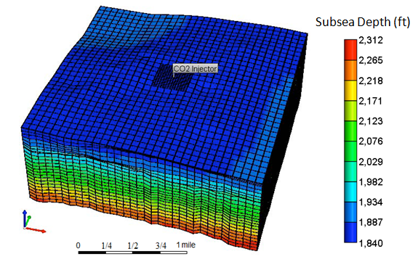
Flow Simulation
Single well with only CO2 injection: 368 tons per day
Both local grid refinement (LGR) around the injection well and uniform grid are used

Slide 35
Flow Simulation
TVD subsea (ft)
Vertical CO₂ injection well, perforated in the bottom layers)

Slide 36
Flow simulation Output
y
dx=500ft
dy=500ft
dz varies: <1ft
>200ft
32 layers total
x

Slide 37
Re-gridding to Seismic Grid
1) dz=0.8ft to dz =5ft
2) dx=500ft to dx=82.5ft (seismic bin size)
3) dy=500ft to dy=82.5ft (seismic bin size)
a. interpolation /averaging is needed
b. top/bottom fill
Uncertainties:
Top fill may cause considerate variation in the velocity and produce sharp boundaries, which greatly affect velocity model
2) Smoothing may be necessary to avoid the shape edges

