Slide 1
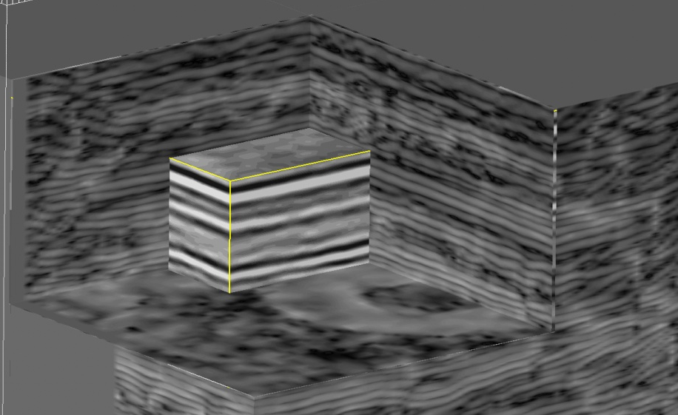
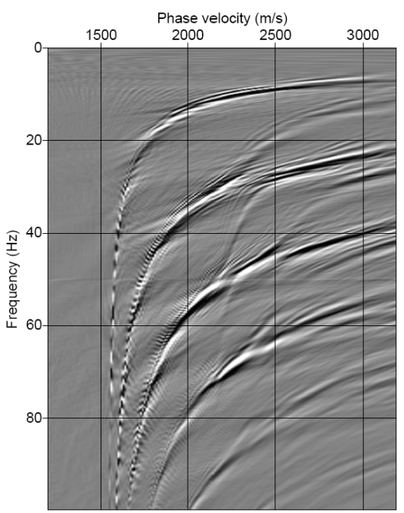
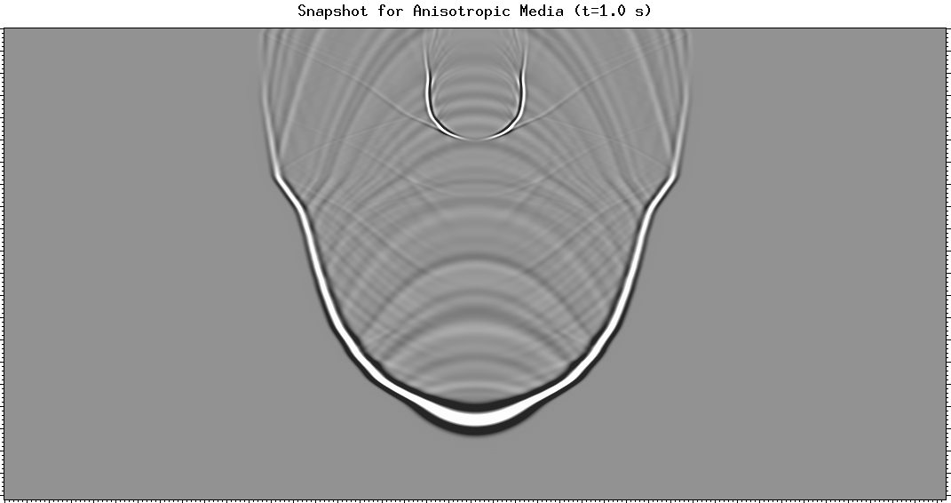
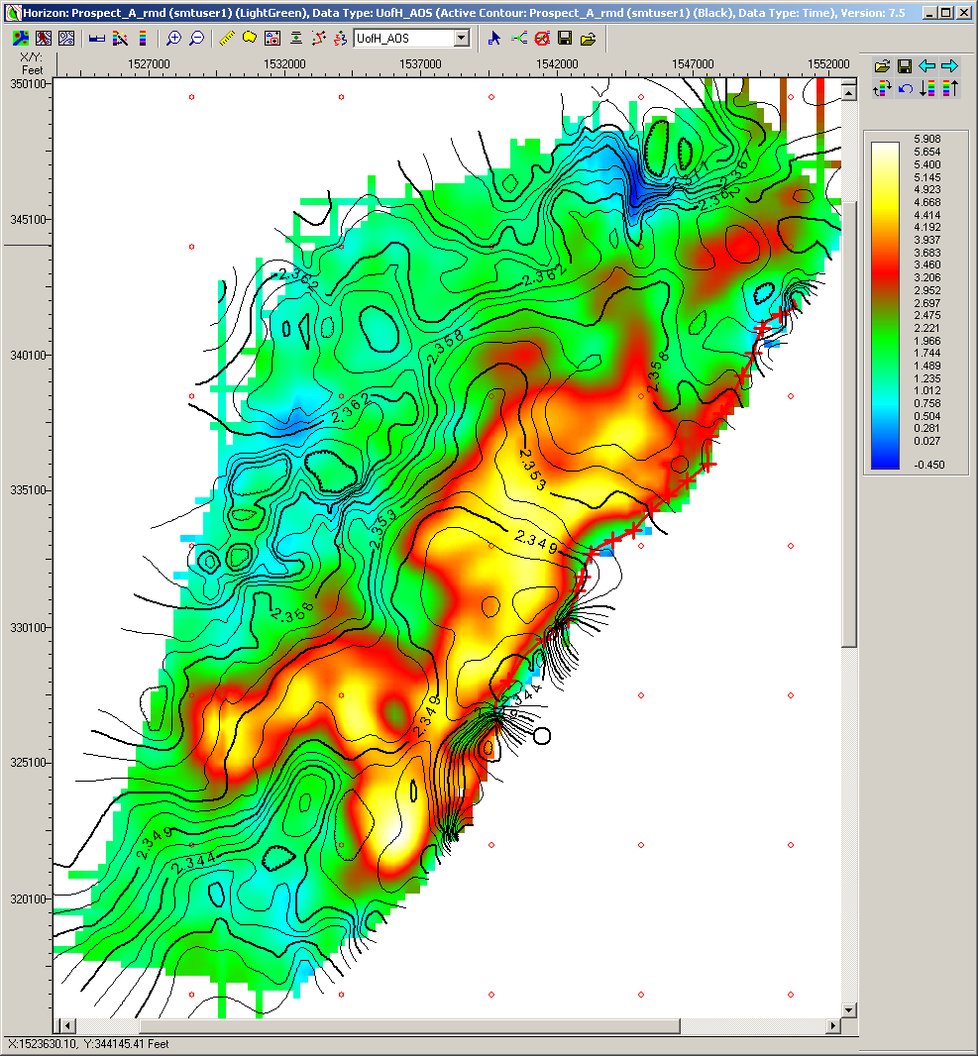
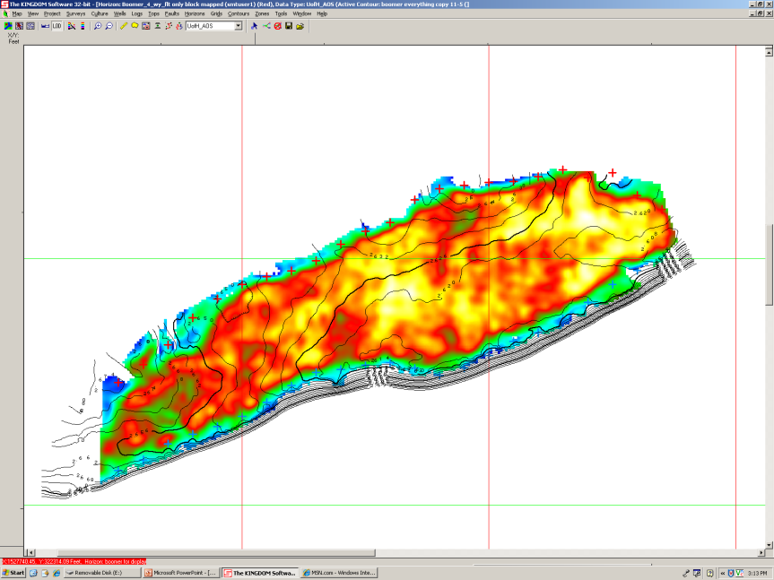
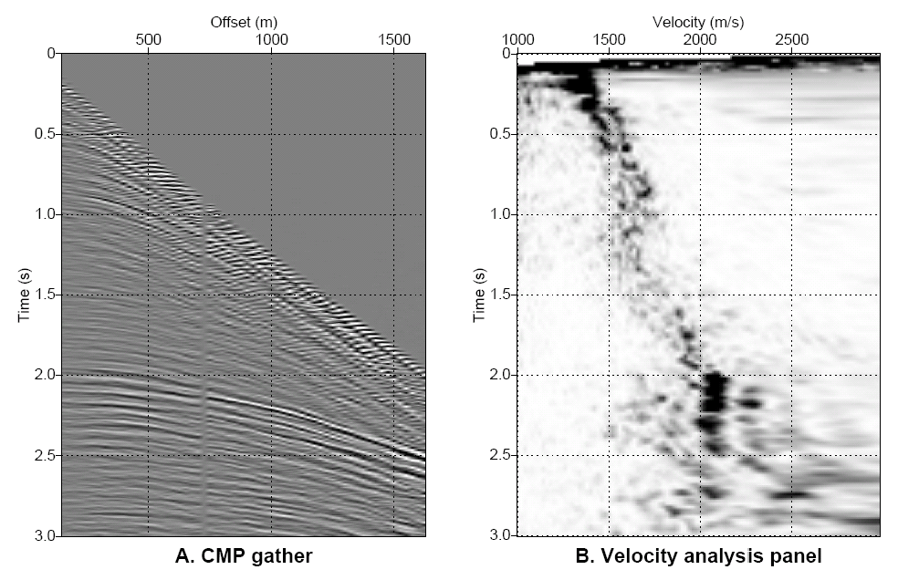
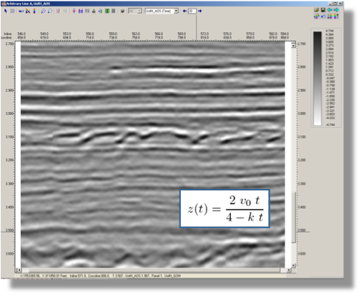
UH Energy
Attributes
Prestack
Data Analysis
Numerical
Modeling
Seismic
Interpretation
Prospect Generation
Data Processing
Quantitative
Interpretation

Slide 2
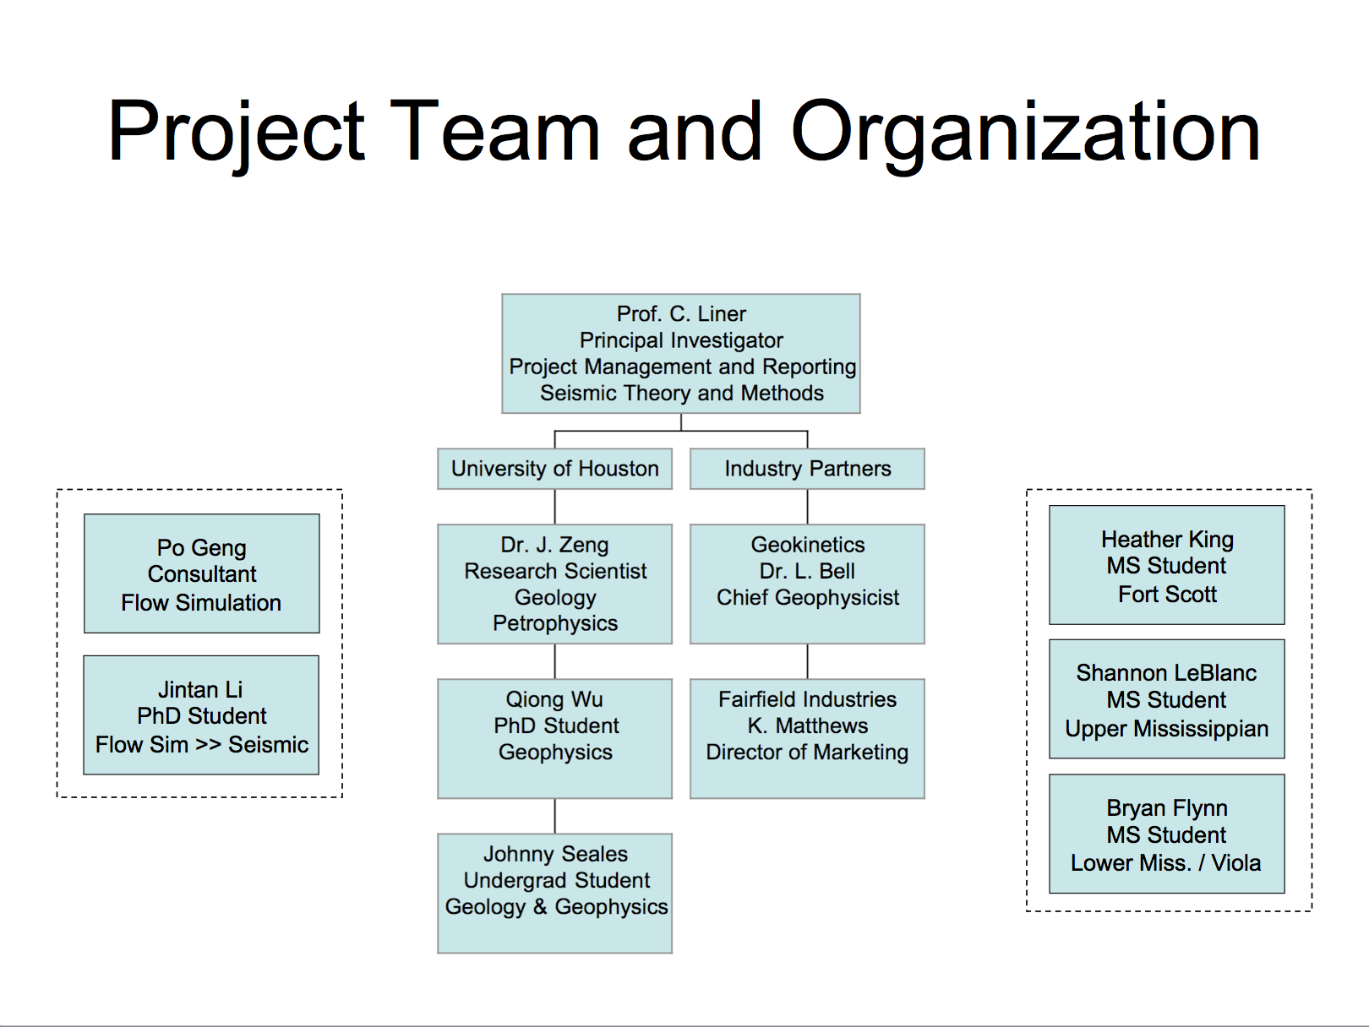
UH Energy
CCS Team
CCS = Carbon Capture and Sequestration

Slide 3

Direct Imaging of group velocity dispersion curves in shallow water
Christopher Liner (Univ. of Houston, AGL)
Lee Bell and Richard Verm (Geokinetics)

Slide 4
Introduction
Shallow water wave guide
  Pekeris (1948)
  Normal mode theory
    EJP (1957), Officer (1958), Budden (1962)
      Beware notation and mode numbering scheme
Imaging of phase vel dispersion curves
  McMechan and Yedlin (1981)
    Fourier method
      2D, regular offset sampling
  Park et al.(1998)
    Direct integration method
      2D or 3D, irregular offsets

Slide 5
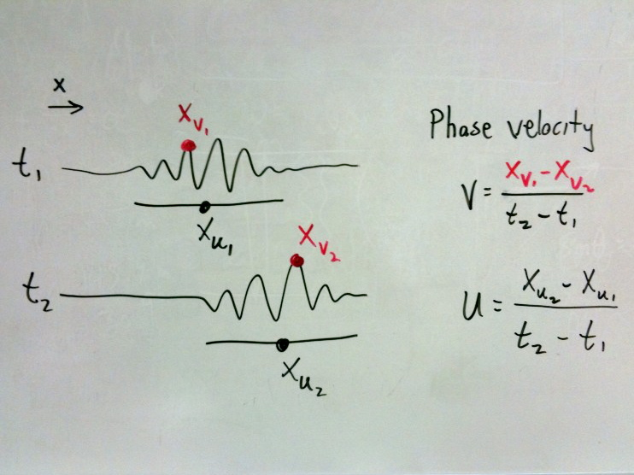
Phase and Group Velocity
X₁ X₂

Slide 6
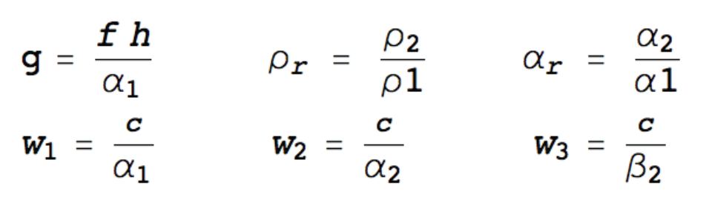
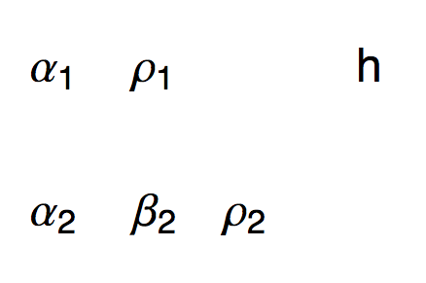
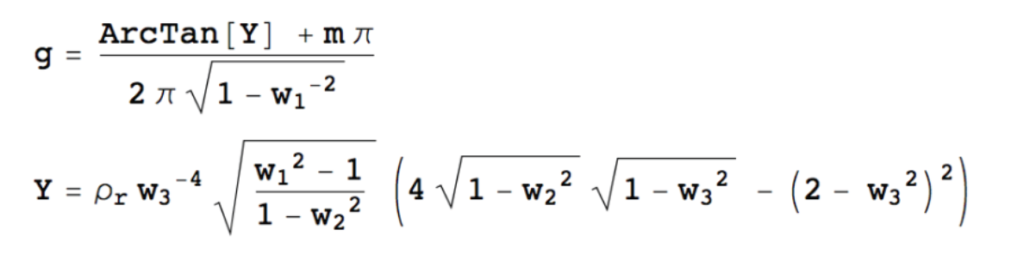
Theory of Guided Wave Modes
c = phase velocity
U = c + f (dc/df)
= group velocity
Period equation
m = mode
= 0, 1, 2, …

Slide 7
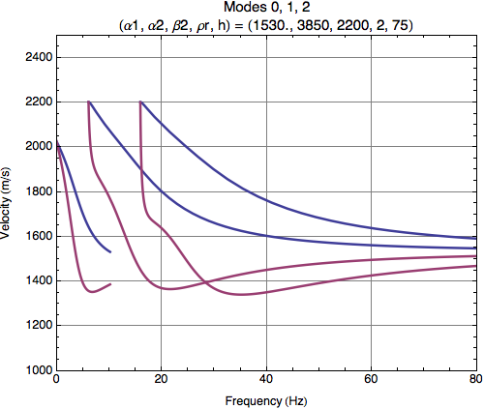
Example

Slide 8
Field Data
3D Shot record
  4C Ocean bottom cable
    (p,x,y,z)
  Offshore Australia
  Three parallel receiver lines
    Total 880 groups
Processing
  Component extraction
  5 Hz low-cut filter

Slide 9
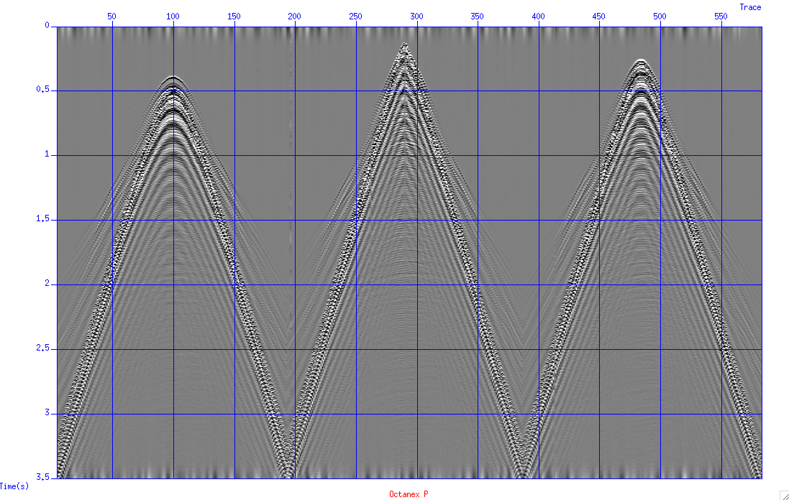
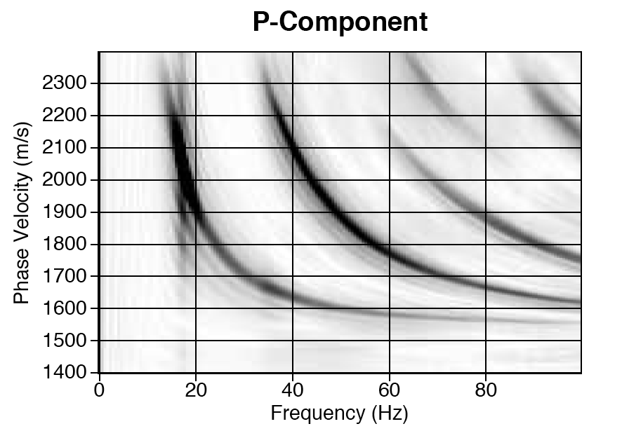
Shot Record
P Component

Slide 10
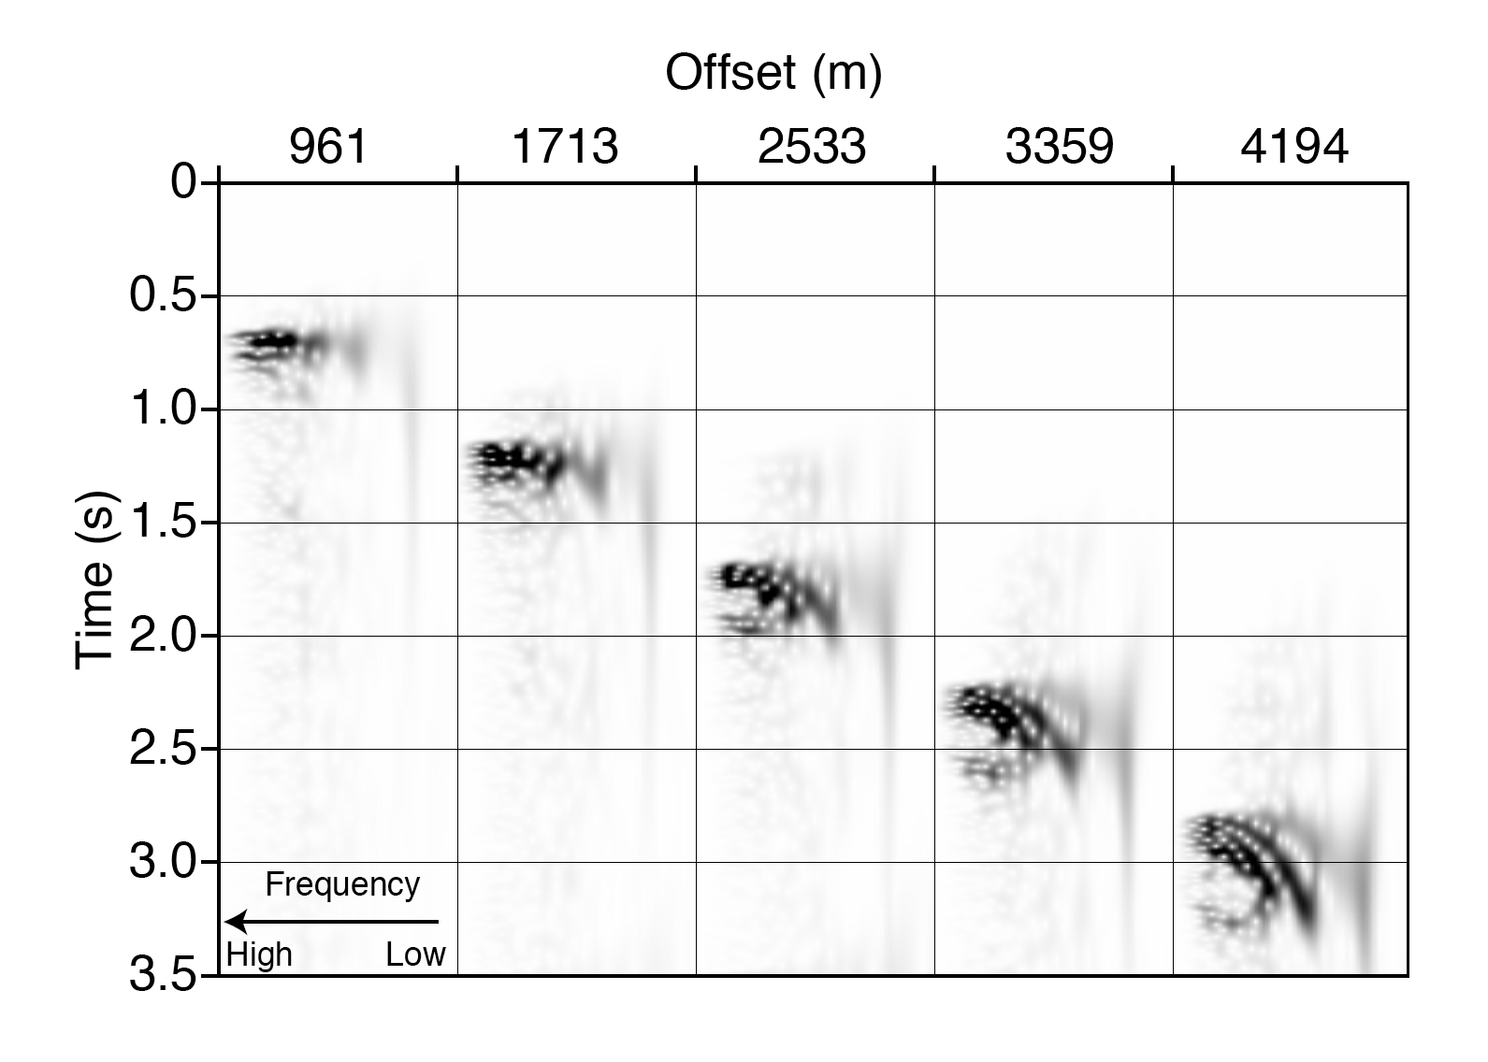
CWT of Selected Traces

Slide 11
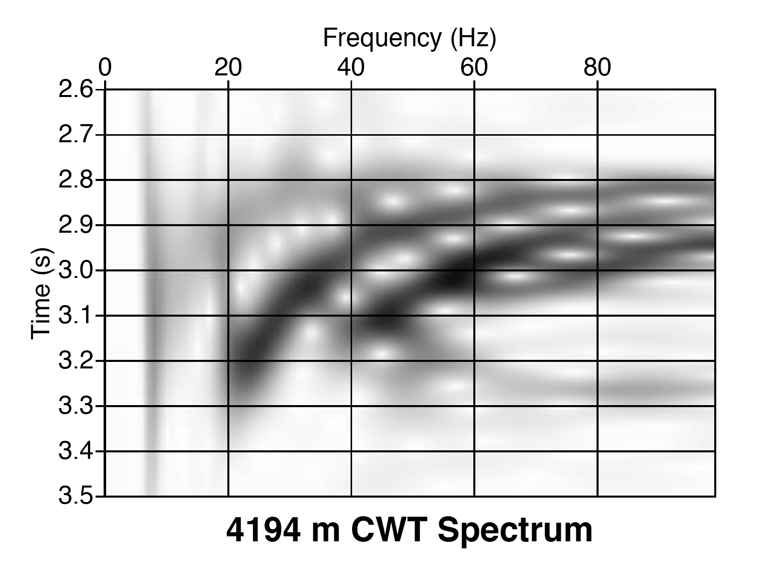
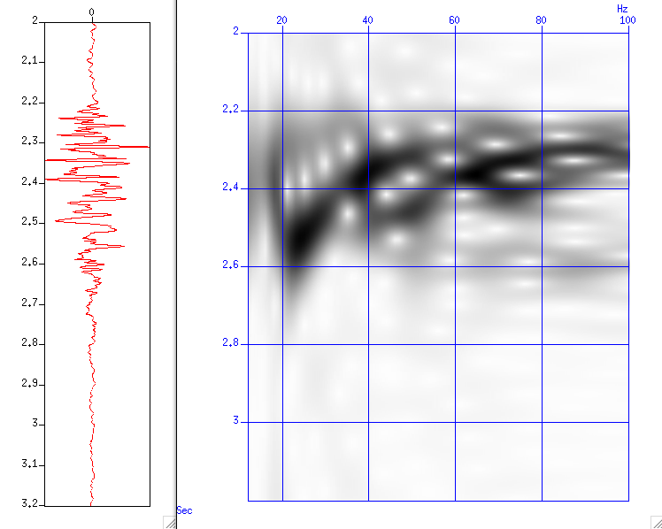
Offset 4194 m
v(f)=x/t

Slide 12
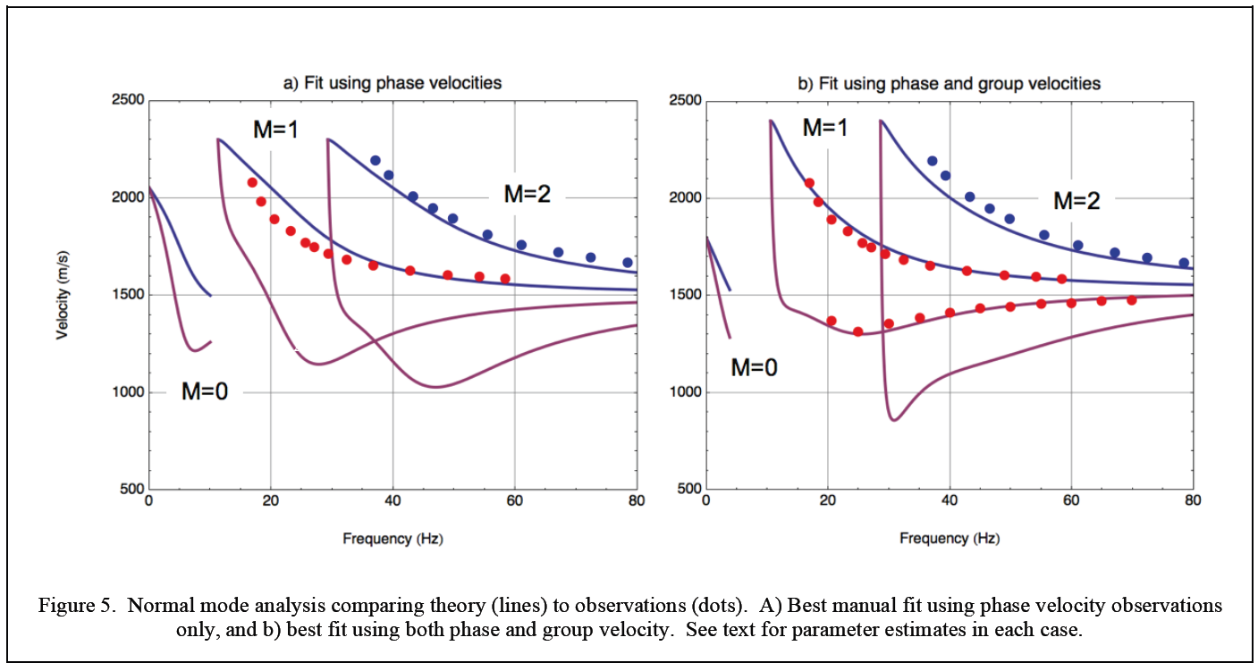
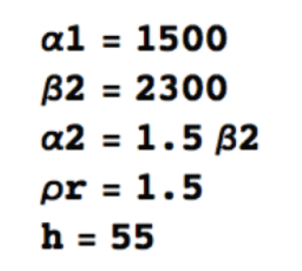
Phase Velocity Fit

Slide 13
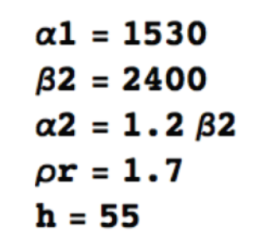
Phase & Group Velocity Fit

Slide 14
Phase & Group Velocity Fit

Slide 15
Conclusions
Direct dispersion curve imaging tools
  Phase velocity since 1981
  Group velocity…now
    Tuned continuous wavelet transform
    Requires one prestack trace
Demonstrated on field data
  Estmation of waveguide parameters
    Phase + Group = more information

Slide 16

Any Questions?

