Slide 1
University of Houston
Department of Earth and Atmospheric Sciences
Allied Geophysical Lab
Multicomponent seismic interpretation of the Marcellus shale
(Bradford County, Pennsylvania)
Advisor: Dr. Robert Stewart
Mouna Gargouri
Notes:
I will be presenting my master thesis proposal entitled Multicomponent seismic interpretation of the Marcellus shale (Bradford County, Pennsylvania)

Slide 2
Outline
Introduction
Study objectives
Study area
Marcellus shale stratigraphy and depositional setting
Brittleness Index
Vp/Vs estimation
Poisson’s ratio estimation
Seismic inversion
Seismic attribute analysis
Conclusion
Notes:
First I will go through the outline which starts with a general introduction and the study objectives followed by a map showing the study area location and then I will be talking about the Marcellus stratigraphy and its depositional setting done in previous studies then the estimation of brittleness at the well location to go to the main part of my study which will be about the Vp/Vs ratio estimation I will be showing my workflow, showing the well logs used and the seismic synthetics generated as well as the seismic interpretation the isochrons to to get the Vp/Vp map which will lead to the Poisson’s ratio map and then the seismic inversion followed by seismic attribute analysis to end up with the conclusion

Slide 3
Introduction
Shale represents around 75% of most sedimentary basins and contains largely untapped natural gas reserves.
The Marcellus shale has a significant potential with a natural gas content estimated about 500 trillion cubic feet (Engelder, 2009).
Characterization of gas shale reservoir is challenged by its highly heterogeneous nature.
Multicomponent seismic brings the opportunity to analyze P-wave and S-wave type velocity which play a very important role in the characterization of these unconventional plays by mapping the distribution of sweet spots.
Notes:
Shale represents around 75% of most sedimentary basins and it contains large amount of untapped natural gas reserves. The Marcellus shale is one example of these unconventional resources with an estimation of 500 trillion cubic feet of gas. Characterization of gas shale reservoir is challenged by its highly heterogeneous nature. Multicomponent seismic brings the opportunity to analyze P-wave and S-wave type velocity which plays a very important role in the characterization of these unconventional plays by mapping the distribution of sweet spots.

Slide 4
Study Objectives
The main focus of this research is:
The estimation of Vp/Vs velocity ratio from multicomponent seismic travel-times
The application of Vp/Vs ratio estimation for reservoir characterization and prospect delineation in the gas shale reservoir
Challenge: screening exploration targets by determining the brittle intervals
Notes:
the main focus of this study will be the estimation of the Vp/Vs velocity ratio from multicomponent seismic travel-times and its application for reservoir characterization and prospect delineation in the gas shale reservoir
Shale is tight and needed to be fractured in order to flow gas to the wellbore The challenge will be to screen exploration targets by locating the brittle intervals
Shale exhibits low matrix porosity and such a low permeability that gas does not flow economically unless it contains high-permeability fractures, either natural or man-made.

Slide 5
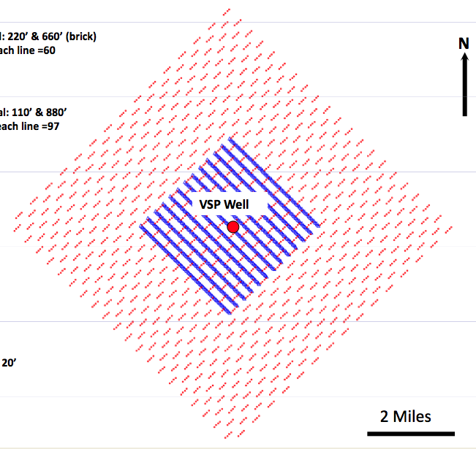
Study Area
3D- 3C
well
Notes:
The Marcellus is present in much of the Appalachian Basin with an areal extent of about 54,000 square miles, our study area is located in Bradford County, North-Eastern Pennsylvania. The green rectangle represents the 3D-3C seismic survey which was acquired using dynamites as a source and 3C Vectorseis sensors covering an area of about 25 square kilometers. The red dot represents the well log location

Slide 6
Marcellus Shale Stratigraphy
Tully limestones
Tully Fm
Marcellus shale
Onondoga limestones
The lithology variation is a result of the sea level oscillation
Notes:
Stratigraphically the Marcellus shale is the oldest member of the Hamilton group dating approximately 350 – 415 million years (middle Devonian age)
It is trapped between the Onondoga limestones from underneath and sealed by the Tully limestones.
The impervious limestones layers underlying and sealing the Marcellus formation, have trapped huge amount of natural gas in this shale
The Marcellus is mainly black shale. It comprises two black shale intervals separated by lighter shales and interbedded limestones

Slide 7
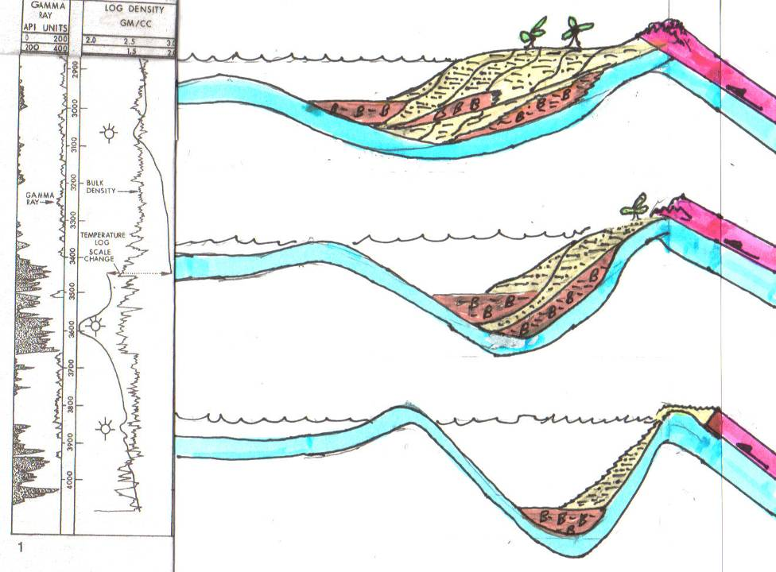
Marcellus Depositional setting
WEST
EAST
Ohio Shale
PHASE THREE – Erosion of highlands rapidly fills shallowing basin, Trough and Bulge features migrate further west.
Marcellus Shale
Rhinestreet Shale
Bulge and Trough Migrate West
PHASE TWO–Collision ends and NA Plate rebounds. Deep, Anoxic, Sediment Starved Basin shallows and both Bulge and Trough migrate westward.
Overriding African Plate
Proximal Trough
PHASE ONE – Initial Collision - African Plate Overrides and Depresses NA Plate – Generating a very Deep, Anoxic, Sediment Starved Basin Termed a Proximal Trough and associated Peripheral Bulge.
Marcellus Shale
Notes:
The Marcellus shale was deposited in a very Deep, Anoxic, Sediment Starved Basin, this basin shallowed later allowing a rapid fill of sediments eroded from the highlands
The Marcellus was buried to depths to five kilometers.

Slide 8
Key for successful shale gas production
High TOC
+
Suitable thermal maturity
Previous studies
+
Naturally enhanced fractures
+
Brittle: can be easily stimulated (fracturability) to create pathways to the wellbore
Objective of this study
(Zielinski and McIver, 1982)
Notes:
The key for a successful shale gas production depends upon the coincidence of several factors including having a a high TOC at a suitable thermal maturity with naturally enhanced fractures and which can be easily stimulated to create pathways to the wellbore. The 3 first factors were determined in previous study so what is needed to be done is to estimate the brittleness which is the objective of this study.

Slide 9
Brittleness Index
Marcellus mineralogy: quartz 50%, clay minerals 40%‐45% (illite 3g/cc), pyrite 5‐10% (5g/cc)
where
BI: brittleness index,
Q: quartz,
C: carbonate,
and Cl: clay
*
BI = (Q)/(Q+C+Cl)
Marcellus BI = .5
Caney .31<B<.46
Barnett .40<B<.65
Woodford .40<B<.75
*
Jarvie and others (2007)
Notes:
The first thing I did was to calculate the brittleness index at the well location: I know the exact mineralogy. The b= the amount of qz divided by the sum of qz+carbonate and clay) I obtained a BI of .5which good when compared to other producing shale plays. However we can’t generalize this value to the whole prospect because shale is heterogeneous so I developed a workflow in order to get the brittleness distribution.

Slide 10
Vp/Vp estimation workflow
Modeling of PP synthetic seismograms
Modeling of PS synthetic seismograms
Well tie process
Wavelet extraction form the PP seismic
Wavelet extraction form the PS seismic
Well log correlation to the PP seismic
Well log correlation to the PS seismic
Interpretation of the PP seismic
Interpretation of the PS seismic
Event matching between the PP and PS seismic volumes
Interval Vp/Vs extraction from PP-PS data
Notes:
The method presented here is based on multi component seismic data including compressional and fast converted shear PS1 : The starting point is the well tie process involving three steps: based on the well logs available modeling of synthetic seismograms, wavelet extraction and correlation between the well log and the seismic followed by picking horizons on seismic data the same workflow is applied for the PS
we need to make sure that we are interpreting the same event in both section because the Accurate correlation of reflection events on the P and PS seismic sections is the most critical and difficult step in the Vp/Vs analysis process. These are the main procedures for interval Vp/Vs calculation.

Slide 11
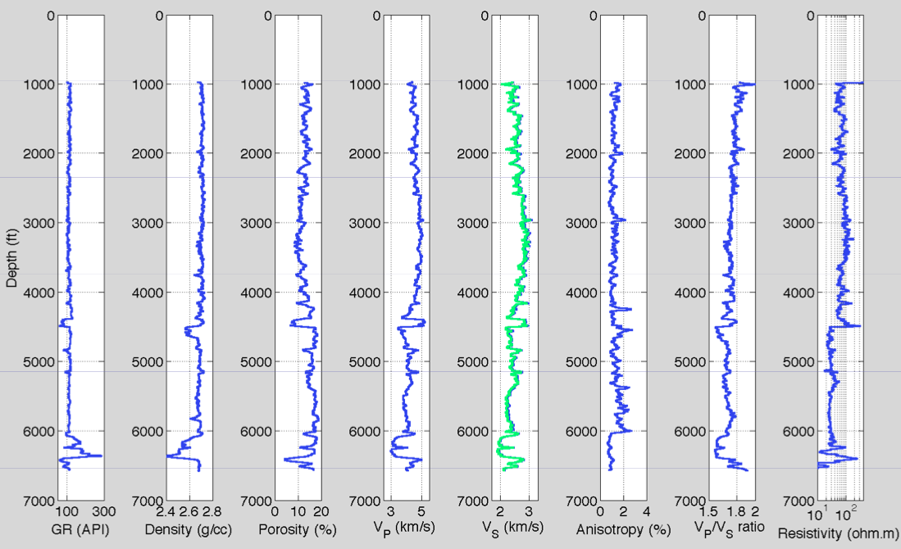
Well log data
Notes:
The marcellus is thick, about 300ft or more (327ft at the well location) and buried at relatively deep depths (around 6000ft) it is marked by an increase in the GR and in the resistivity accompanied by a decrease in the density. we can clearly see that we have a porosity density cross over which confirm the presence of gas
The Gamma Ray is not only used to estimate the net thickness of the black shale but also used as proxy for TOC content
And the resistivity is used as proxy for thermal maturity
The influence of organic matter on resistivity varies with the level of maturity. As the source rock matures, a portion of the solid organic matter is transformed into hydrocarbons that possibly displace part of the formation water, hence increasing effective resistivities.
The well logs were loaded in Hampson-Russell in order to generate seismic synthetics for the PP and for the PS.

Slide 12
Seismic synthetics
0.7782
0.7404
PP
PS
Notes:
The blue trace is a synthetic trace calculated using the sonic and density logs and an extracted wavelet.
The red trace correspond to the composite traces which are the average of well neighbored seismic traces
The initial wavelet is statistically generated by the program (Hampson & Russell) and it is is a zero-phase wavelet with an amplitude spectrum derived from the seismic data. After synthetic traces are generated, they are compared with the actual seismic traces. Correlation of two traces updates the synthetics. the only parameter that changes is the wavelet. Then, the new wavelet is applied and synthetics are recalculated. I improve the shape of the wavelet, until satisfying results (large correlation coefficient between synthetic and actual seismic traces are obtained.
After selecting and matching corresponding events on the synthetic and composite traces
we can pick the horizons
With the extracted ideal wavelet, a zero-phase synthetic seismogram can be derived and compared with the actual seismic data. This procedure is important for identifying seismic reflectors by correlating them to the well data

Slide 13
Seismic interpretation of the top of the Marcellus
PP
PS
PP Time structure map
PS Time structure map
Notes:
The reflector marking the top of the Marcellus was more coherent in the PS allowing better and easier interpretation.
it is possible for a lateral geological anomaly to not be seen in a conventional P-wave section, but be detectable in the corresponding PS section (or vice versa). This can occur because S waves respond differently to P waves in various geological situations.
The PP time structure map share some features with the PS time structure map, other features were revealed in either of both.
There is a dip to the west of both PP and PS time structure maps (colored dark blue and purple).
The main trend of the structures is East- Northeast to East- West. These structures are more noticeable in the interpreted PS time structure map (colored dark blue in the central part of the PS map and green in the East part while in the PP map the only clear structure is to the East colored yellow).
In the PP time structure map there is a dip to the Northwest, which is not visible in the PS time structure map. These structural features might be related to the tectonic flow of the Syracuse salt Formation that underlies the Marcellus (Gaiser et al. 2011).

Slide 14
Seismic interpretation of the base of the Marcellus
PP
PS
PP Time structure map
PS Time structure map
Notes:
The two time structure maps look more alike compared to the maps at the top of the formation. However there are few differences. The structures have the same trend as appeared in the top of the Marcellus (the East- Northeast direction). These structures are better pronounced in the PS time structure map (colored dark blue and purple, colored green and yellow in the PP time structure map). An updip having a South- East direction appears in the PP map is barely detectible in the PS map.

Slide 15
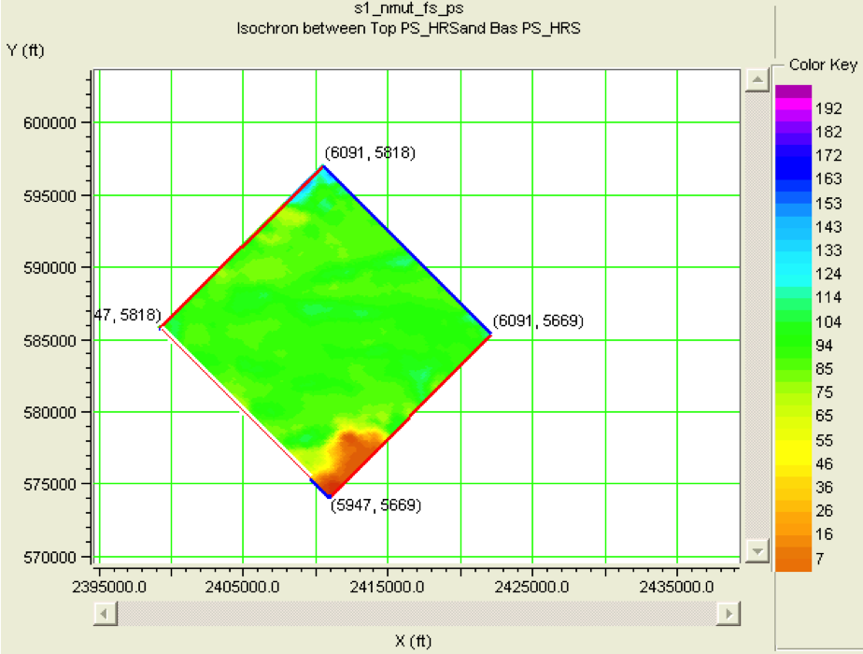
PP and PS isochrons (Tpp and Tps)
Tpp
Tps
Tpp isochron map
Tps isochron map
Notes:
To generate the interval Vp/Vs map, computing the time difference between the top and the base of the reflection events for the PP and the PS is essential.
The PP and PS isochrones computed from the time structure maps displays mainly similar structures
When comparing these two time thickness maps the PP and the PS, it is obvious that the PS isochron exhibits larger time variation (7- 133ms) and an inferior horizontal resolution. The time variation range within the PP isochron is from 13 to 110ms.
The PP isochron presents some anomalous features that are barely noticeable in the PS isochron (colored orange to yellow in the PP isochron map while in the PS isochron these features are light yellow and hardly perceptible). The anomaly seen in the west side of the map presents small variation (5 -10ms). Both isochrones show a slightly dipping event to the south of the maps. However, The data in the edges of the survey are generally not reliable.

Slide 16
Vp/Vs estimation
Vp/Vs – Velocity ratio estimated from PP- and PS-wave data
Δtpp – two-way travel time difference between two events in PP time,
Δtps – two-way travel time difference between two events in PS time
Vp/Vs= (2Δtps –Δtpp )/Δtpp
*
* (Garotta et al, 1987)
Notes:
This velocity ratio is determined based on integrated converted and compressional wave data interpretation. It can be determined via travel times of corresponding horizons in the PP and the PS sections, basically:
The correlation between the two reflection events is the base and presents the most critical issue when analyzing the Vp/Vs distribution.
Ideally, this approach offers the opportunity to delineate prospects by mapping lithological anomaly within the interval of interest.

Slide 17
Vp/Vs map
Notes:
The Vp/Vs doesn’t follow any regular trend. As the data in the edge of the survey are not reliable, by consequence the Vp/Vs values in the edges of the map can’t be consistent.
Most of the Vp/Vs values ranges from 1.7 to 1.83. The lowest values are located to the north and the west sides of the map. Higher values are located to the south and to the east sides of the map. The low values are more important because of the effect of the lithology change on the Vp/Vs. The low Vp/Vs values having a range of 1.73- 1.77 colored light blue to bright green to the west of the map and exhibiting a North- West South –East direction might be interpreted as tight sand
An abrupt lateral variation can be observed in the left half of the map, which can be related to the transition from shale rich materials to sandy materials. The dark blue and purple areas correspond to the shale. This lateral variation is a due to the shales heterogeneity and could be detected using the Vp/Vs attribute because the geological anomaly is either present in the compressional wave section or in the converted wave section.
There is a fairly high concentration of green spots allover the map and especially to the East (the right half) that could be inferred as sand bodies.
The lateral distribution of the Vp/Vs velocity ratio allows delineating potential prospects. These prospects are correlated with a middle range of time thickness for the PP and for the PS (about 55ms for the PP and about 65ms for the PS) and a low Vp/Vs corresponding approximately to 1.75.

Slide 18
Poisson’s ratio
νd=[〖(Vp/Vs)〗^2-2]/[2*(Vp/Vs)^2-2]
*
νd _ Dynamic Poisson’s ratio;
Vp/Vs _ Velocity ratio.
* (Sheriff, 1991)
Notes:
The Poisson’s ratio is an elastic constant that is an indicator of rock strength. This elastic parameter is used in order to identify conventional gas-sand reservoirs.
A high Poisson’s ratio will imply a ductile behavior of the rocks while low Poisson’s ratio will infer a brittle behavior
This formula allowed the generation of the Poisson’s ratio distribution

Slide 19
Poisson’s ratio map
Notes:
The Poisson’s ratio are mainly low allover the survey. It varies from 0.25 to 0.3.
The Poisson’s ratio distribution map shows similar features to the Vp/Vs velocity ratio distribution map. The low values are mainly located to the west side of the map (left half) colored light blue. There are some anomalous low values allover the map matching the low Vp/Vs spots.
The anomaly colored green in the Vp/Vs map and identified as sandy materials is observed in the Poisson’s ratio map. However, the area of the anomaly is narrowed down in the Poisson’s ratio map and the area corresponding to the shale in the west of the map looks broader.

Slide 20
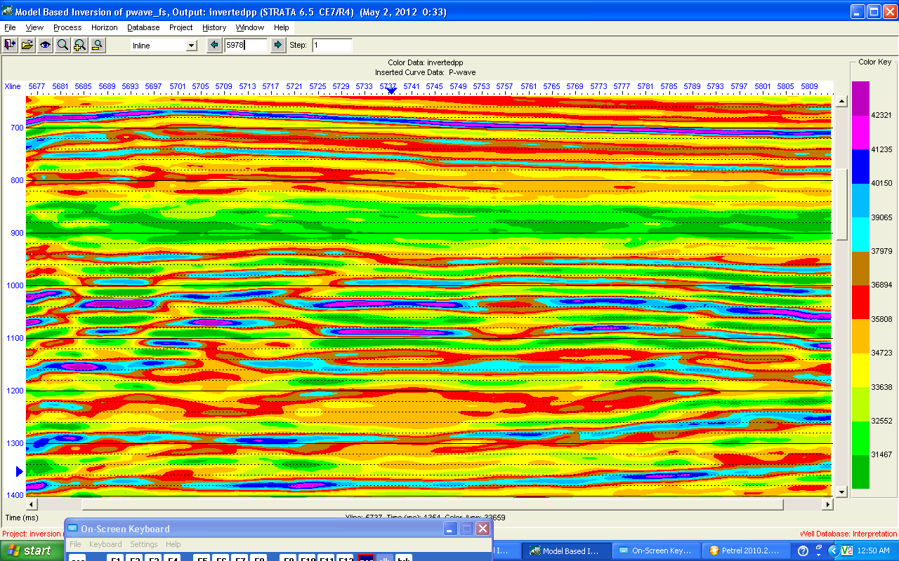
PP seismic inversion

Slide 21
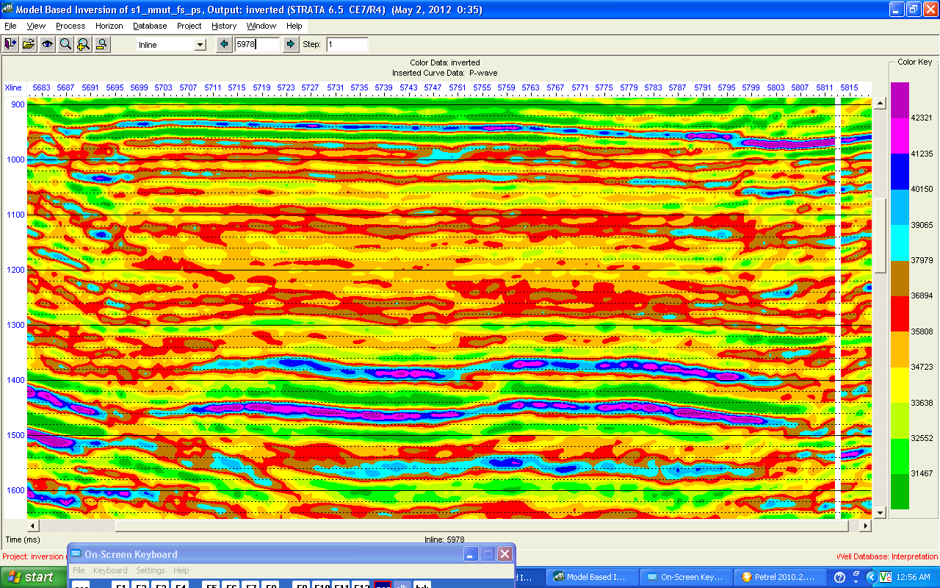
PS seismic inversion

Slide 22
Coherency and curvature attributes at the top of the Marcellus
PP
PS
PP
PS
Notes:
For the development of shale gas plays it is essential to understand the fractures propagation, their geometry and direction.
The natural fractures are abundant within the Marcellus. Actually because the Marcellus formation is conformable with the local Syracuse salt tectonics, it exhibits lateral heterogeneity in the form of folding and faulting
To map these fracture and determine the fracture network within the reservoir, seismic attributes sensitive to the presence of faulting and fracturing were applied
The most common attributes used to detect these discontinuities are the coherence attribute (the variance) and the curvature attribute
The coherency map corresponding to the PS interpreted section displays more incoherency and by consequence major faults are better seen within it. The faults and fractures exhibit mainly the East Northeast direction. Other smaller discontinuities display a northwest southeast direction. These information are conformant with the literature about the two fractures set within the Marcellus the J1 and the J2.
Curvature: The PS seismic section displays more structural features. It is clear that the east-northeast trends are more noticeable in the PS section and the smaller discontinuities having the northwest southeast trend are visible within the two sections (the J1 and the J2).

Slide 23
Coherency and curvature attributes at the base of the Marcellus
PP
PS
PP
PS
Notes:
For the top of the Marcellus, the coherency attributes in the PP and the PS showed almost the same structural features clearer in the PS section. However, for the base of the Marcellus, the two maps are complementary. Some faults are better seen within the PP section, the others are more developed within the PS section. The basal Marcellus looks more coherent compared to the top and the PP section appears more coherent than the PS section.
The curvature attribute corresponding to the interpreted PP section displays white lineaments (which correspond to a maximum curvature) exhibiting a northwest southeast direction. These lineaments were not visible within the coherency attribute maps
Based on the literature, these fracture set correspond to the J2 set of fracture. By consequence, and based on the curvature attribute, the J2 set is more developed in the basal Marcellus. The J1 set is barely noticeable within these maps.
The areas corresponding to the max curvature within the two maps are well correlated with the areas exhibiting low coherency within the variance map

Slide 24
Conclusion
The successful development of gas shale depends upon the ability to understand a number of key factors including identifying the distribution of brittleness and the fracture network
Implementation of converted-wave seismic technologies for the gas shale exploration provides the opportunity to take advantage of integrated P/PS interpretation methods to help characterize geological properties.

Slide 25
Thank you for your attention
“Subtle variation in seismic means major variation in economics”

