Slide 1



Near-surface geophysical imaging in a highly structured area, Beartooth Mountains, Montana
Tania Mukherjee
Department of Earth And Atmospheric Sciences
University of Houston
April 28, 2010

Slide 2
Content
Introduction to the geology and motive of the survey
Acquisition and instrumentation
Well log (Gamma,SP, resistivity,sonic, acoustic televiewer ,neutron porosity)
VSP (simultaneous three component near offset VSP in two borehole)
Surface seismic (2D seismic line )
Gravity ( two perpendicular gravity profile near borehole)
Interpretation
Core samples
Well log
VSP
Surface seismic
Gravity
Conclusion
Future work
Acknowledgement

Slide 3
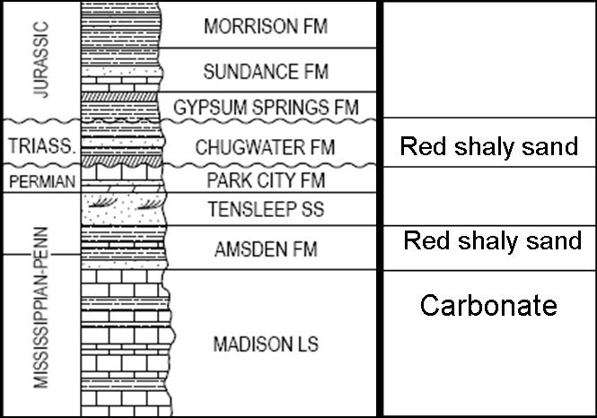
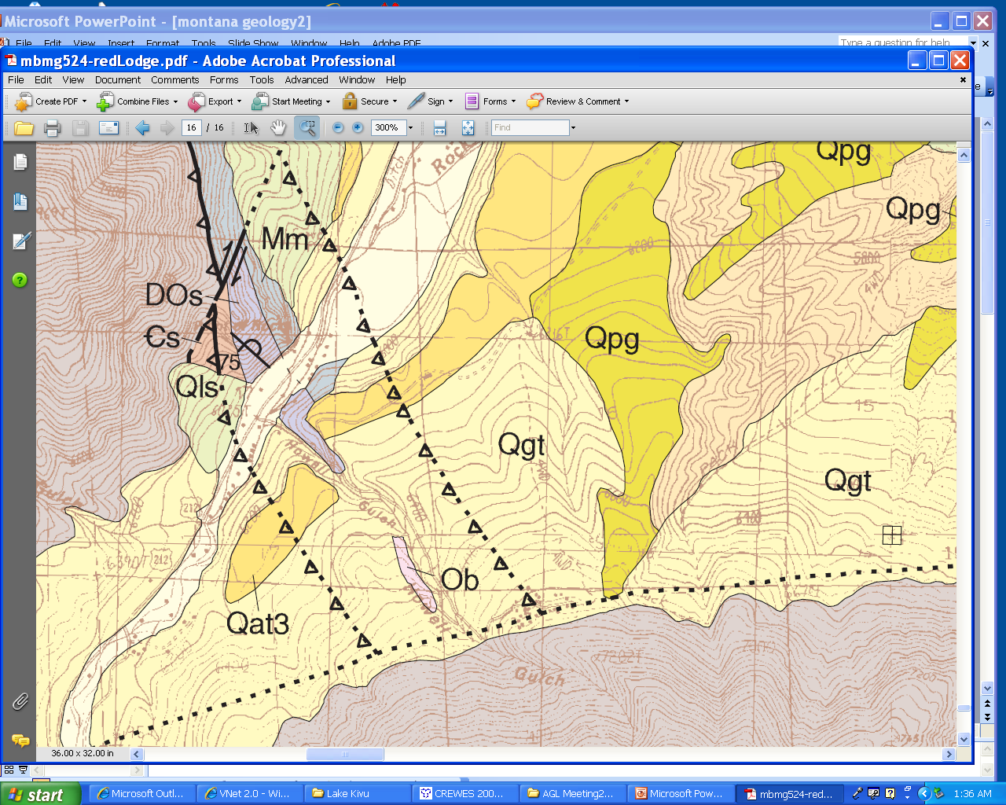
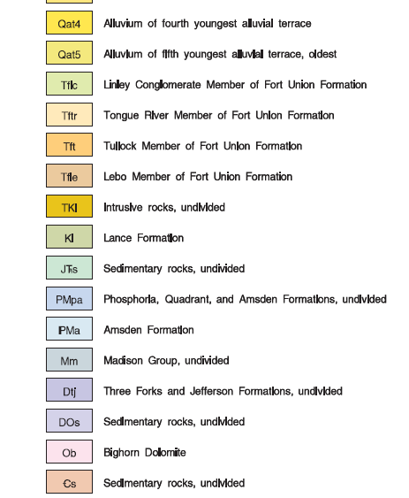
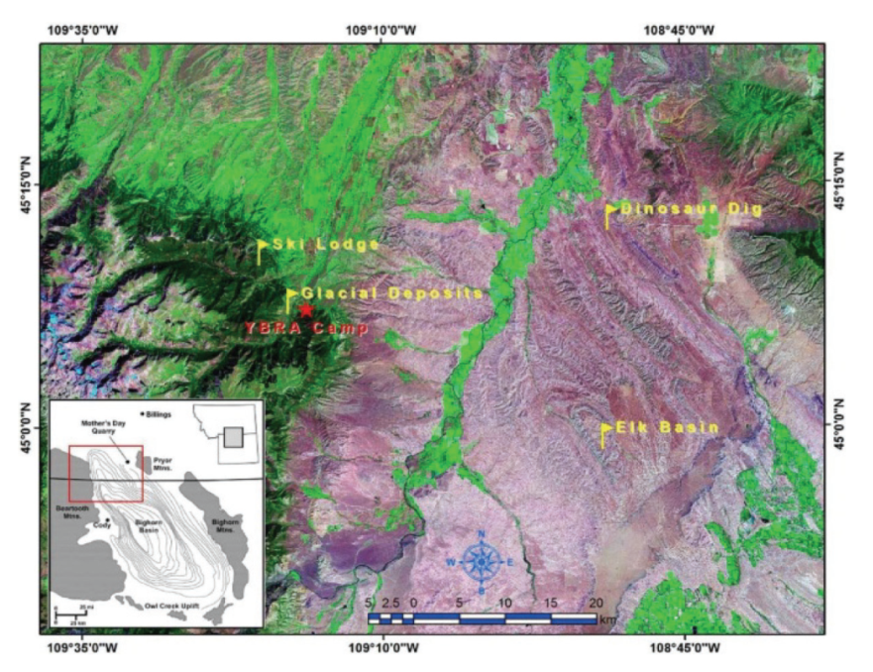
Geology of Beartooth,Montana
N
Simplified statigraphy ( Kauffman et al.(2008)

Slide 4
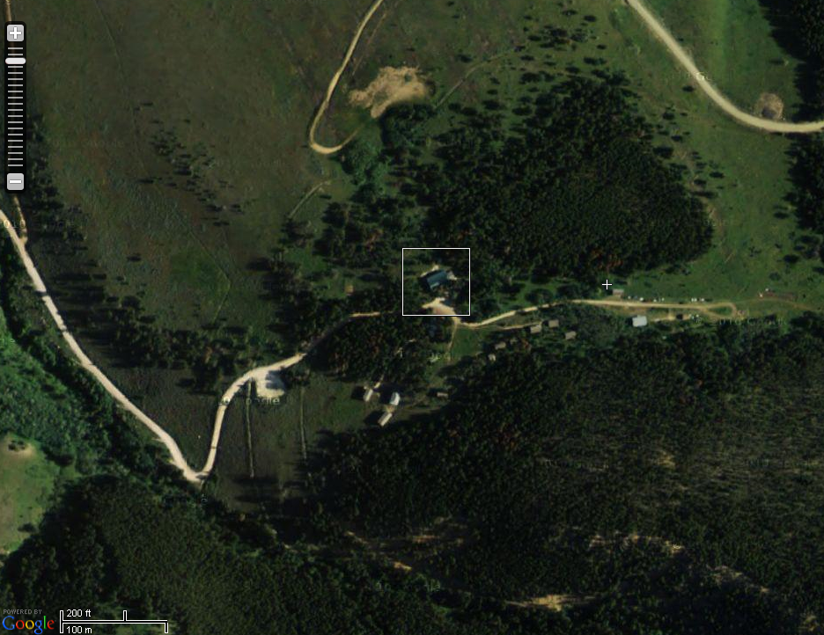
Survey Layout
Gravity profile 2
YBRA CAMP
Seismic line
YB 1 YB2
Gravity profile 1
Tear Zone
Index
Borehole
Gravity profile
Seismic line
Tear Fault

Slide 5
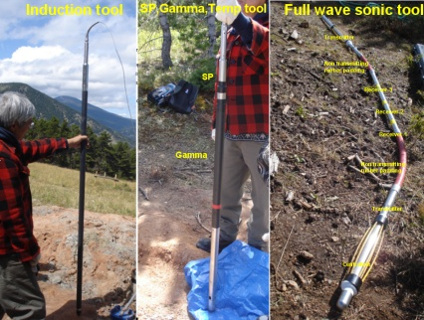
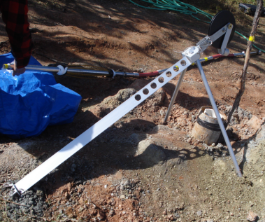
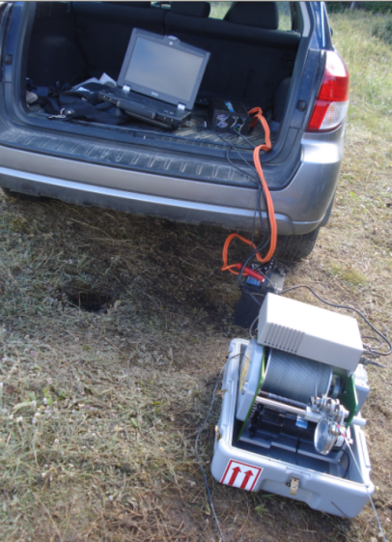
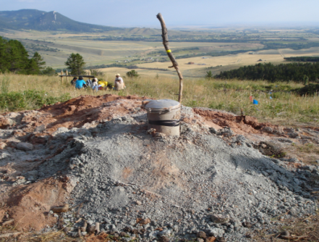
Data acquisition (well logging)
Following logs has been run in YB1 and YB2
Natural gamma,
Spontaneous Potential
Resistivity,
Full wave sonic,
Acoustic televiewer
Neutron porosity.
Century geophysical
Students log the wells along with field instructors.
Tripod stand
Well
winch
Well 2
Logging cable

Slide 6
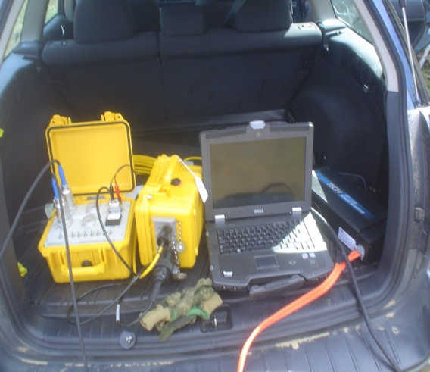
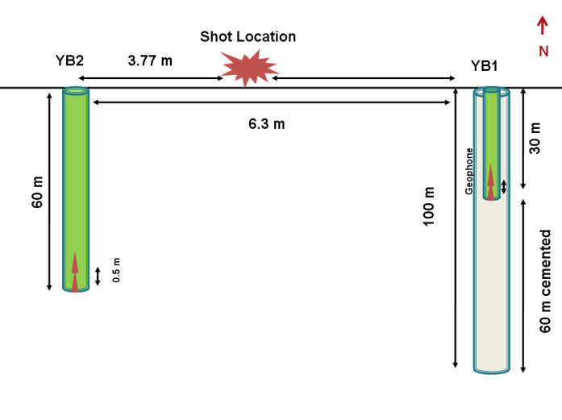
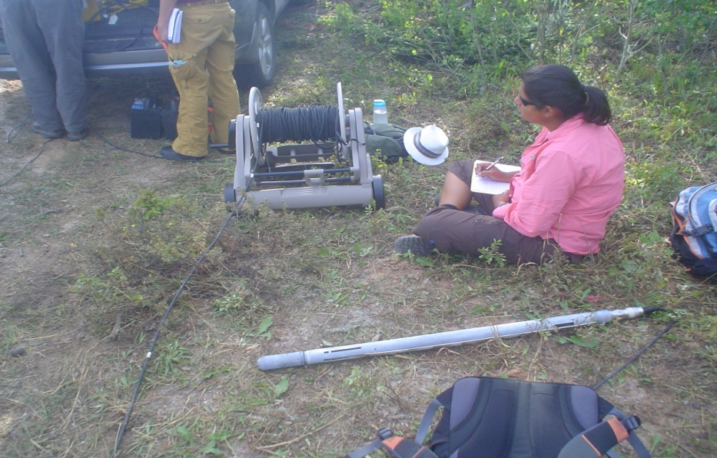
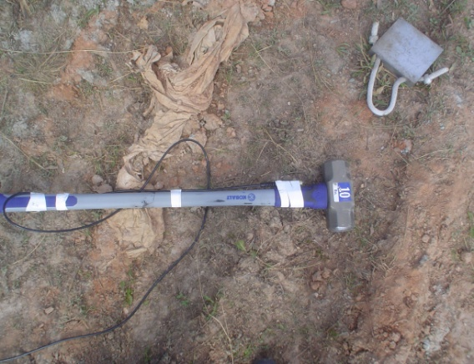
Data acquisition VSP
No of well | 2 (YB1 &YB2) Cemented and cased (PVC)
Location of the wells | YBRA camp
Distance between wells | 6.3 m
Well depth | Yb1 :30 m , Yb2 :60 m
Type of sensor | 3 component down-hole locking geophone.
Recording unit | Dell Tough book laptop
Sampler and digitizer | Geostuff and geode
Controller software | Seismodule by Geometrics
Sampling interval | 0.5 ms
Record length | 1.0 s
Source | 10 lb Hammer
Shot location | 3.77 m from YB2
Geostuff
Data Collector
Geostuff
Digitizer
Inverter
VSP recording cables
Source Trigger Cable
3-C Downhole Geophone
VSP source, 10 lb hammer
Vertical Seismic Profiling was conducted simultaneously in two wells.
VSP geometry

Slide 7
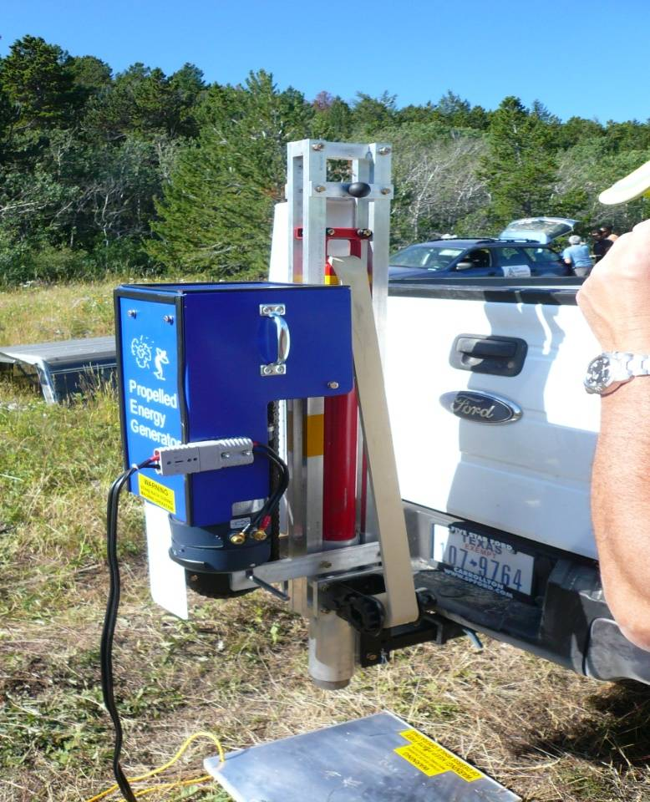
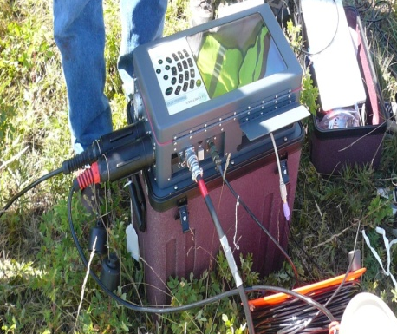
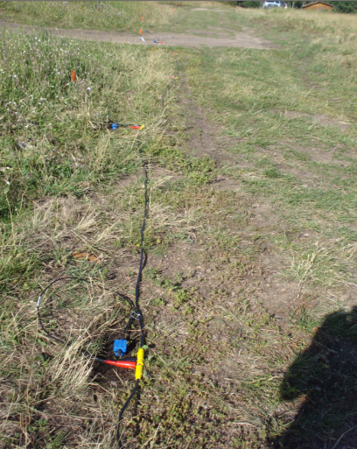
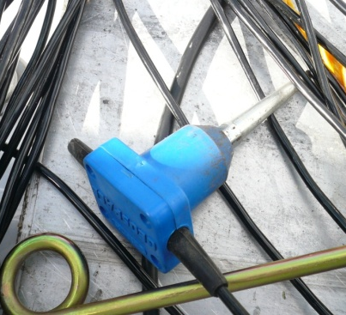
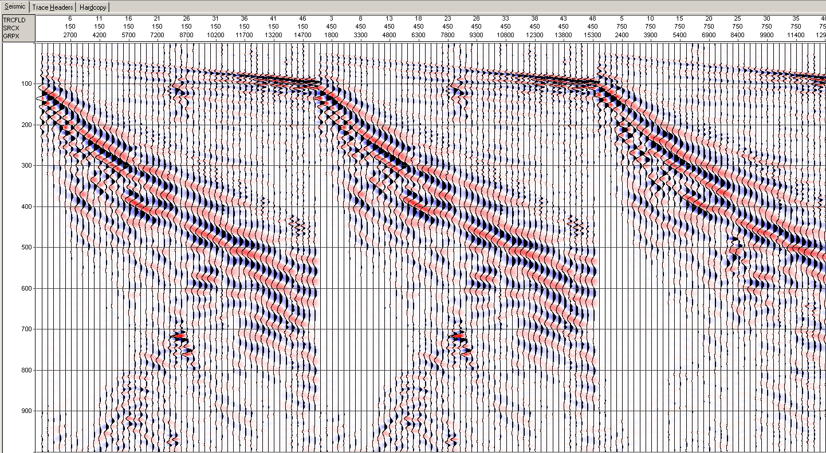
Data acquisition (surface seismic)
Line Location | YBRA camp near 70 m from well 2 ( camp location:45°11’15”N 109°14’55” )
Line orientation | E-W
No of geophone | 48 vertical geophones
Source | 100 lb accelerated weight drop
Recording unit | Stratavisor
Geophone interval | 3 m
Source interval | 3 m (between geophones)
Sampling | 0.25ms
Record length | 1.0 s
No of shots/station | 4
Data
Recorder
[Geometrics
Stratavisor]
Propelled
Energy
Generator
Survey line
Vertical planted
Oyo Geophone
Raw Data

Slide 8




Processing and Interpretation
Lithology interpretation from cuttings
YB1
The wells were drilled with a water-well rig by Douglas Drilling using compressed air.
Cutting samples were collected every 5 ft .
From the cuttings, the first 7m is interpreted to be regolith (landslide, colluvium, and pediment deposits).
At 7m (22 ft), carbonates were encountered (possibly Mississippian Madison limestone),
At 40m (122 ft), a red bed was entered (unconformable Amsden formation or the later Triassic Chugwater formation).
7 m
40 m

Slide 9
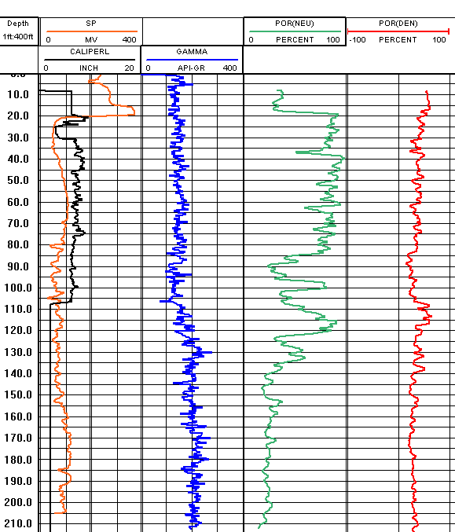
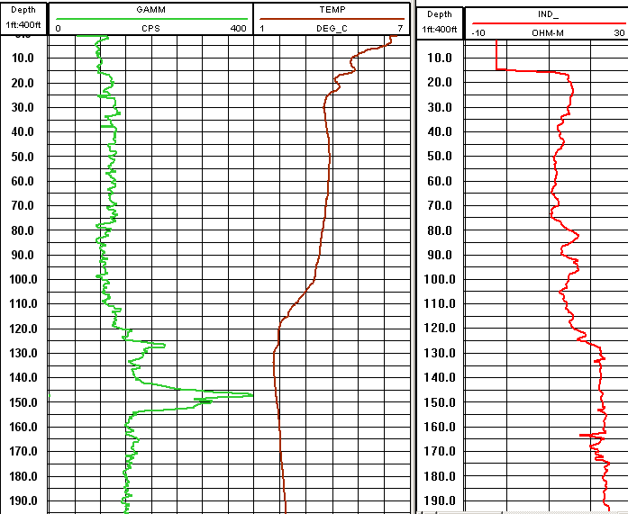
Processing and Interpretation (Well logs )
Carbonate
Carbonate
Shale
Shale
YB1
YB2

Slide 10
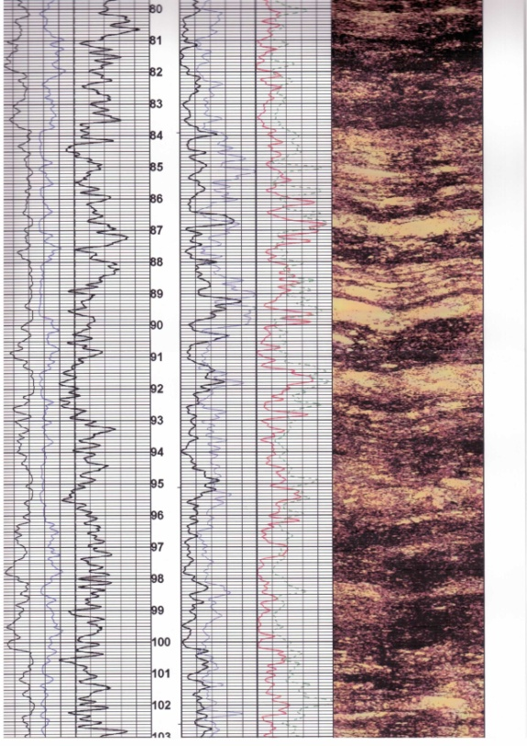
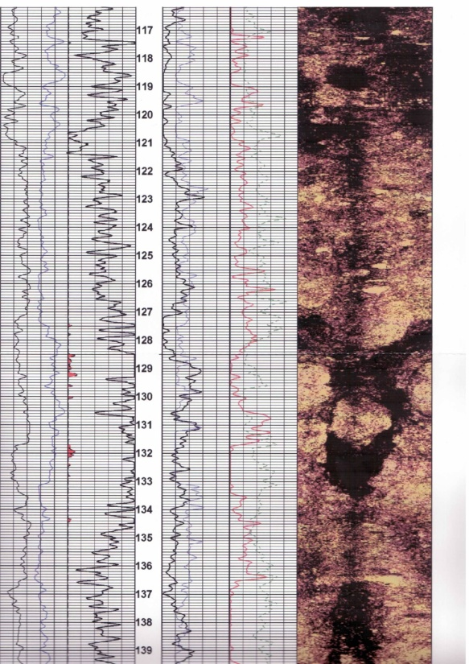
Well log (Televiewer)
Processing and Interpretations
Caliper Gamma
Amp
0 360
Caliper Gamma
Amp
0 360
Dipping beds
Fracture

Slide 11
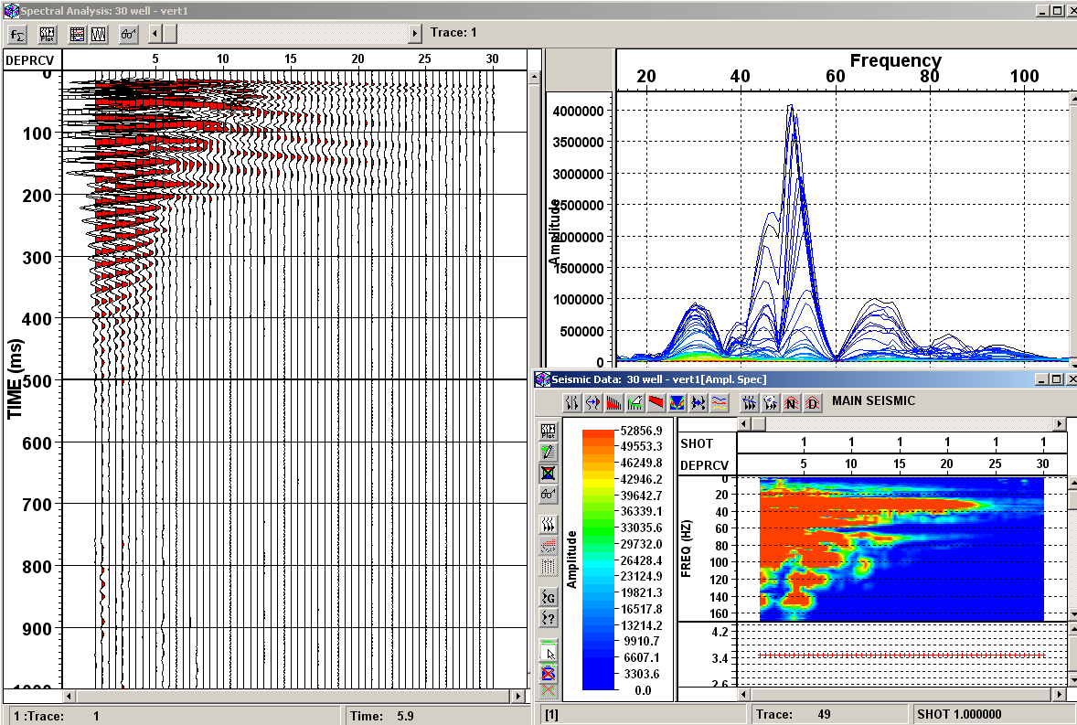
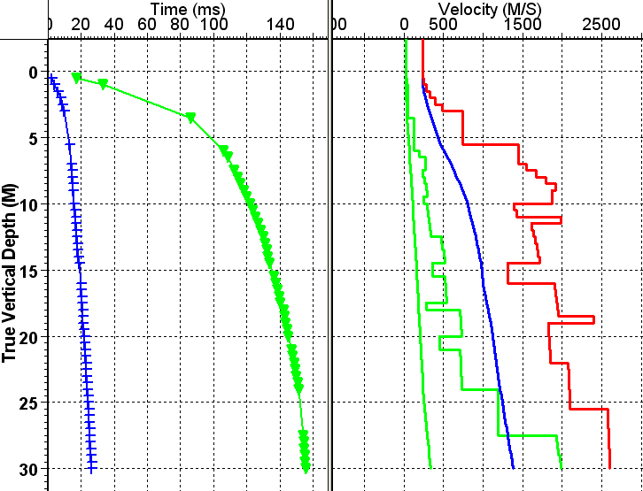
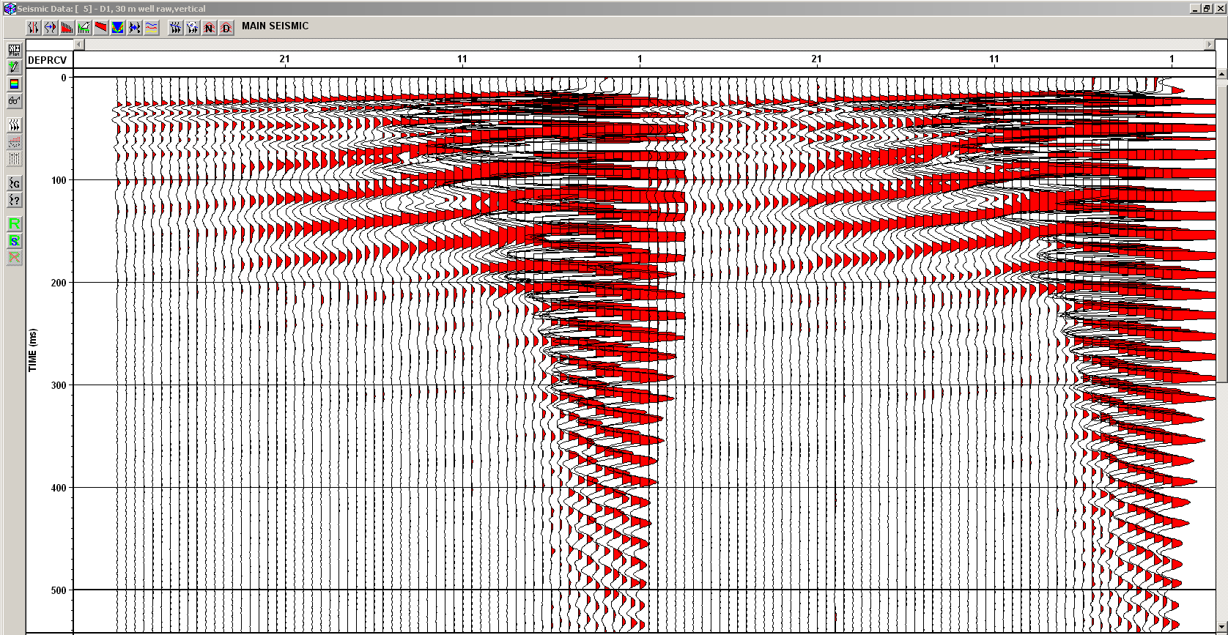
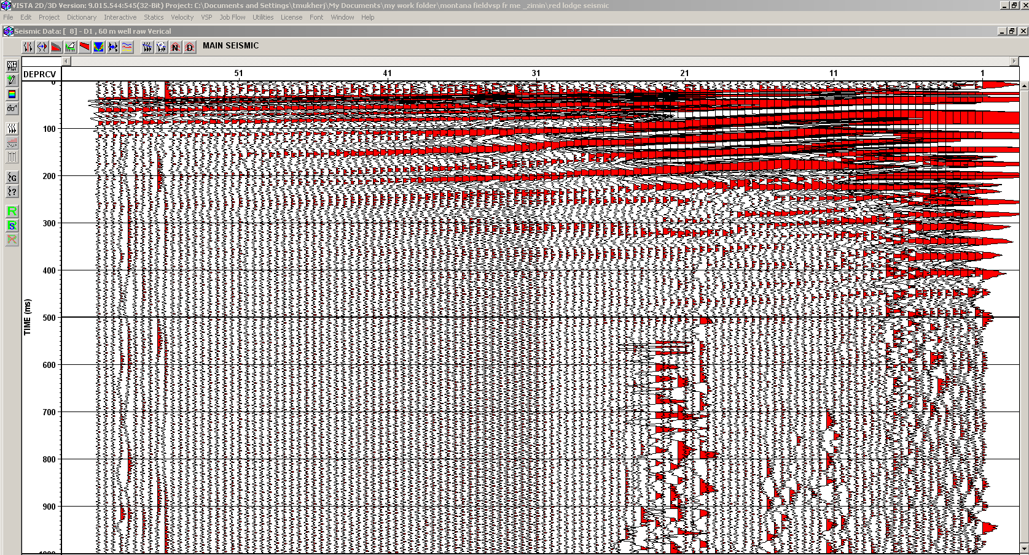
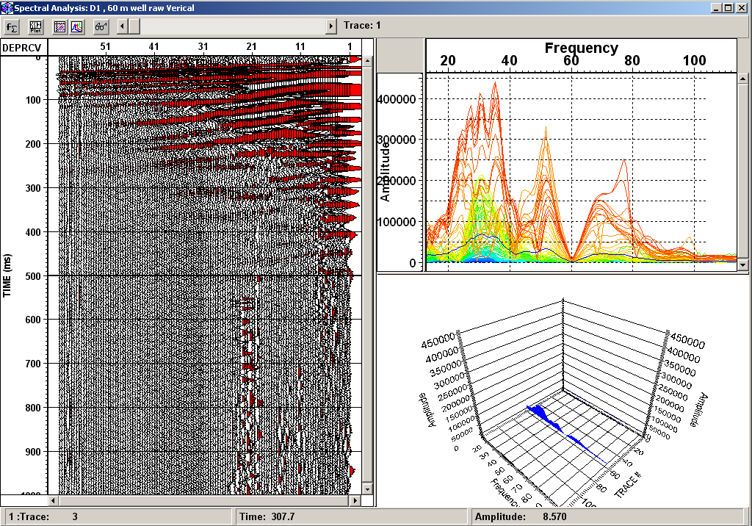
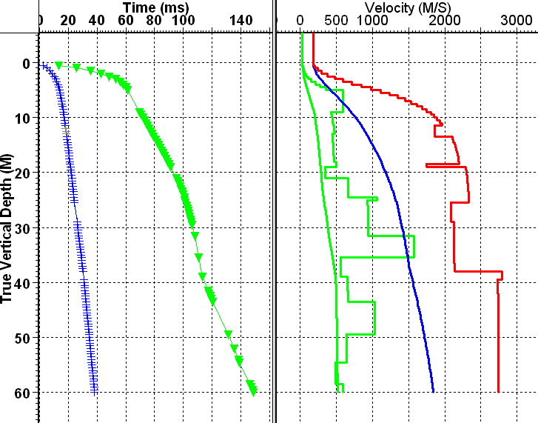
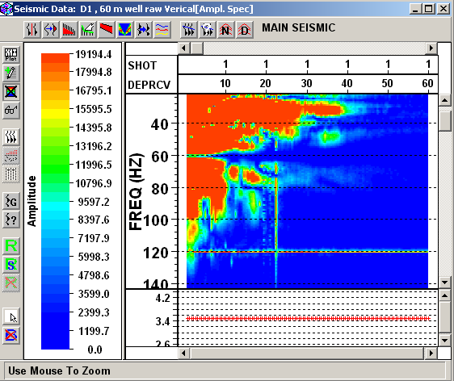
Processing and Interpretations (VSP)
First breaks plot for S
First breaks plot for P
Average velocity (S)
Internal velocity (P)
Average velocity (P)
Internal velocity (S)
Frequency and amplitude spectrum of vertical component VSP if YB1 . The dominant frequency is 45-55 Hz.
Raw vertical component VSP from YB1.Two simultaneous run are plotted together for comparison of repeatability
P and S wave velocity inversion from first break peaks (YB1).
First breaks plot for S
Average velocity (S)
First breaks plot for P
Internal velocity (P)
Average velocity (P)
Internal velocity (S)
Raw vertical component VSP from YB2.
Frequency and amplitude spectrum of vertical component VSP of YB2 . The dominant frequency is 35-40 Hz.
P and S wave velocity inversion from first break peaks (YB2).

Slide 12
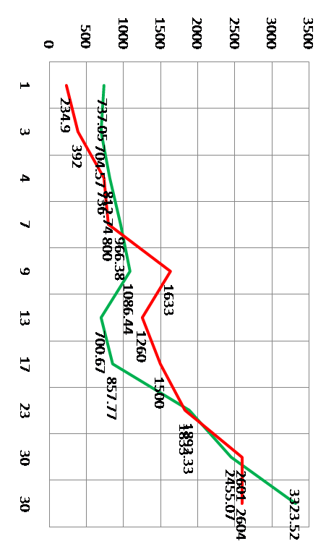
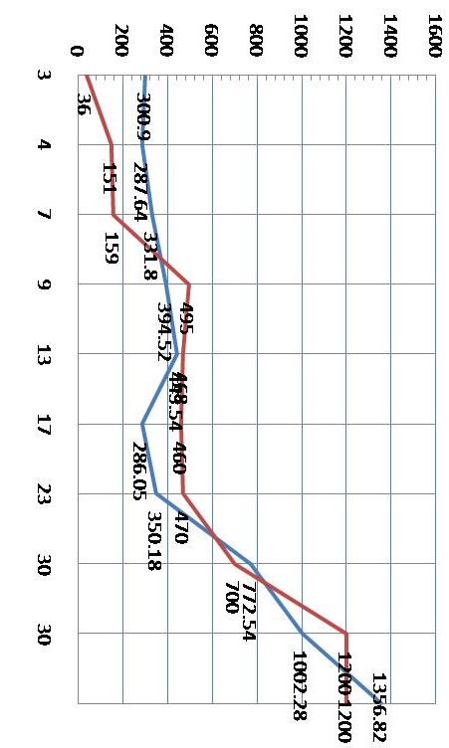
Processing and Interpretation
Vp from MASW and VSP
Vs from MASW and VSP
m
m
Vp from VSP
Vp from MASW
Vs from VSP
Vs from MASW
Comparison of computed velocities and Vp/Vs plots from surface Waves (MASW method) and VSP.
MASW by S. Roy

Slide 13
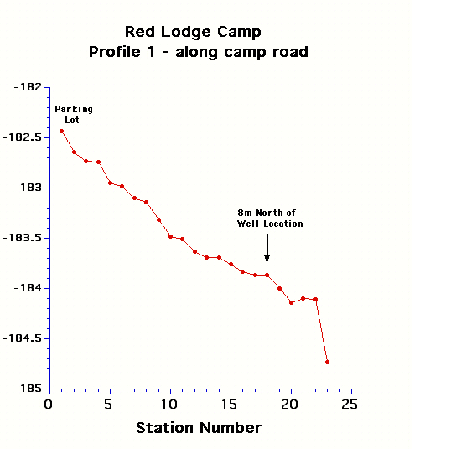
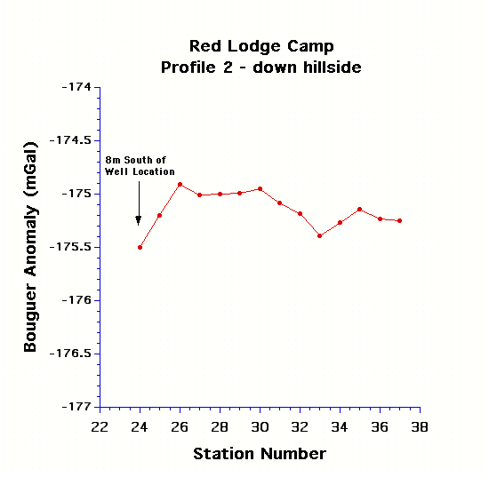
Processing and Interpretation (gravity)
High density to low density

Slide 14
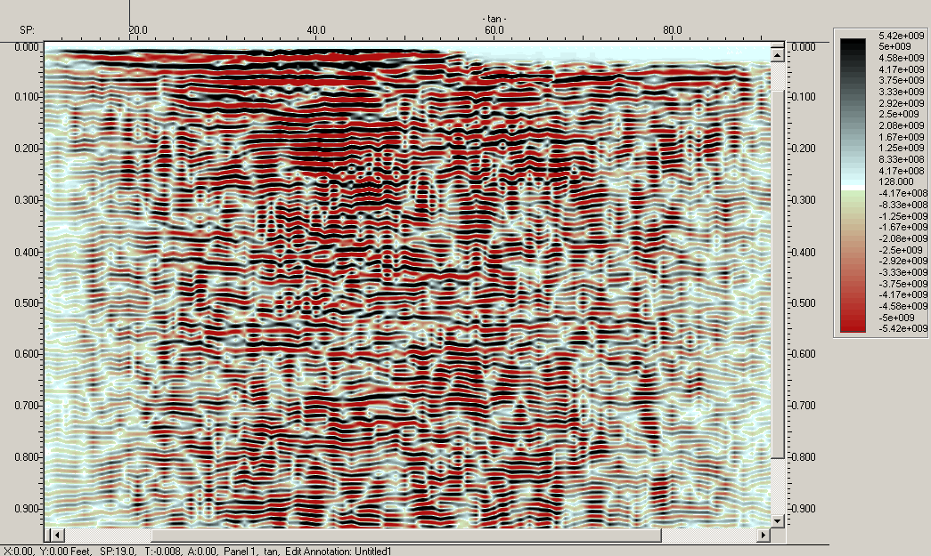
Processing and Interpretation (gravity)
2D line near well YB 2
O.Omoboya

Slide 15
Conclusion
The carbonate (Madison LS?) shows a lower velocity (2600 m/s) than the competent shale beneath(2800 m/s).
The high gamma ray count in carbonate indicates radioactive impurities .
There is a highly fractured zone at about 130 ft (39m). The petrophysical and seismic evidence indicate the transition from carbonate to red shale occurs around 40 m.
The dip of the formation is about 40-45° towards the south.
Near-surface velocities from surface seismic MSAW and VSP are repetitively consistent.
Processed 2D line shows no structure (parallel to fault ).
A Vp / Vs value of 2.2 for the limestone and 1.7 for the shaley unit.

Slide 16
Future work
Multi azimuth and Walkaway VSP.
2D seismic line perpendicular to the present line.
Core sample analysis by geologist .
Well log correlation to find out vertical shift between two wells.
Acknowledgement
Allied Geophysical Lab, University of Houston.
GEDCO and IonGXT.
Dr.Robert R. Stewart (University of Houston ).
Dr. Christopher Liner (University of Houston ).
Dr.Stewart Hall (University of Houston).
Dr. Joe Wong (University of Calgary).
Graduate students Zimin Zhang, S. Roy and O.Omoboya

Slide 17
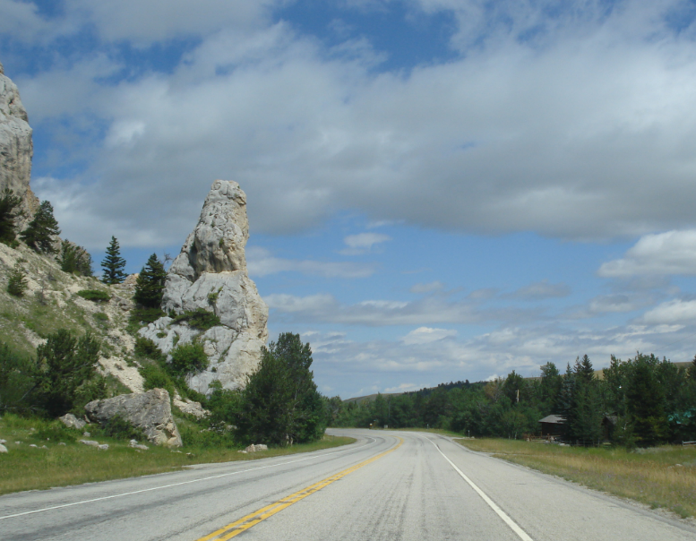

Thank you

