Slide 1



Mirror migration of ocean-bottom node data:
Atlantis, Gulf of Mexico
Department of Earth And Atmospheric Sciences
University of Houston
Emin Emrah Pacal
Advisor: Dr. Robert Stewart
AGL Research Presentations & Update Meeting 2012

Slide 2
Contents
  Ocean-Bottom Nodes (OBN)
  Processing of OBN data
  Fugro Atlantis 3D-4C OBN dataset
  Mirror Migration Technique
  Conclusion

Slide 3
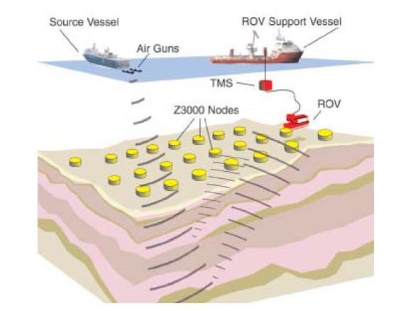
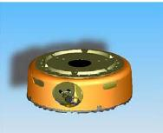
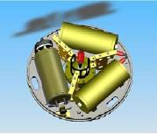
Ocean-Bottom Nodes (OBN)
4 component seismic sensor:
3 geophones (XYZ)
1 hydrophone (P)
Schematic illustration of an OBN node arrays. Image courtesy of Fairfield Industries.
Maxwell, 2007

Slide 4
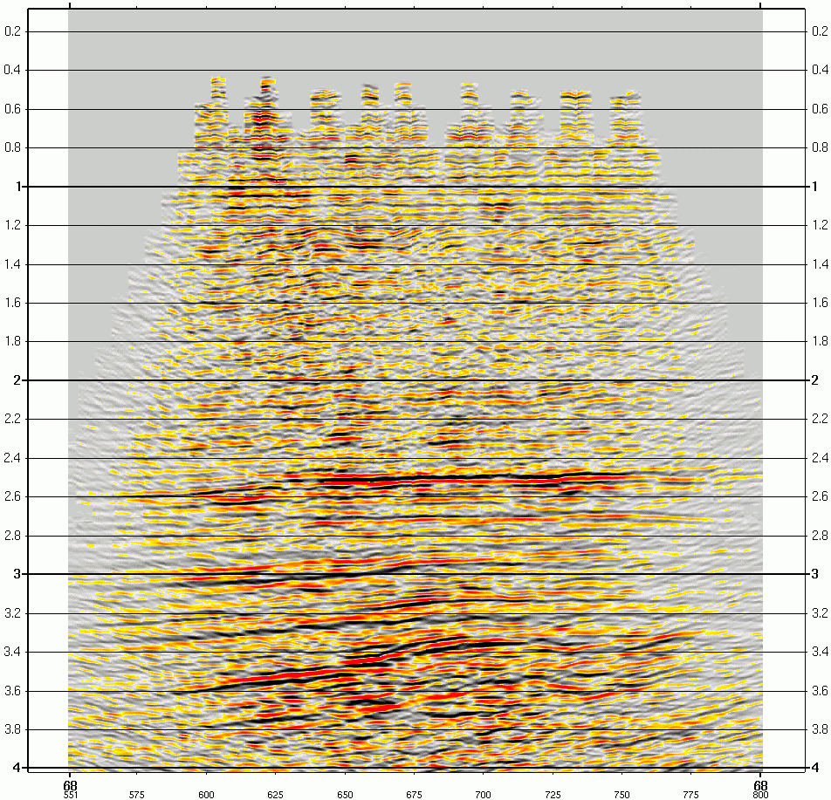
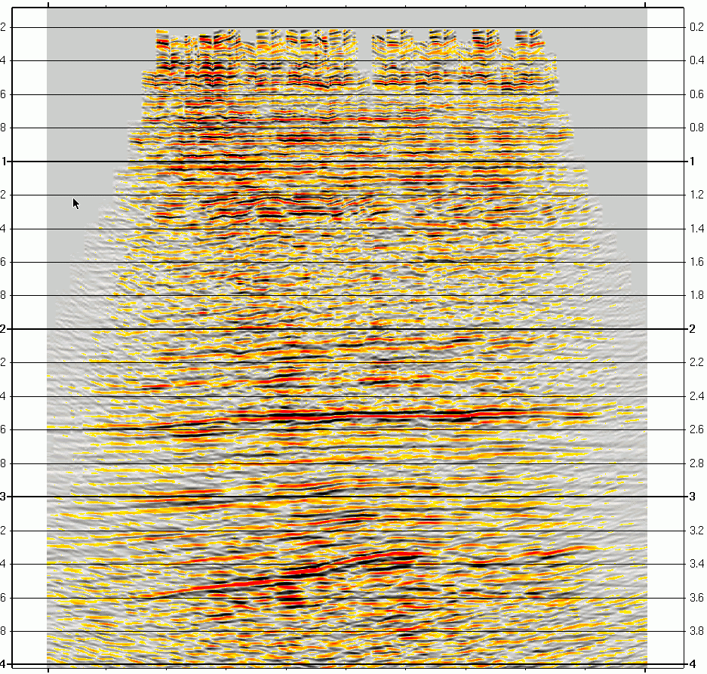
Processing of OBN dataset
A main challenge with the ocean-bottom nodes is now processing and imaging of the data.
Acquiring the data on the sea floor from deep water, with a large distance between nodes makes the conventional processing steps difficult to apply for OBN data.
OBN survey with sparse receiver intervals also provides poor illumination at shallow subsurface.
The mirror migration technique is an effective solution for this challenge by separation of the hydrophone (P) and geophone (Z) data into up-going and down-going waves.
The image produced by conventional migration (up-going imaging)
The image produced by mirror migrating of the
down-going waves
Ronen, 2005

Slide 5
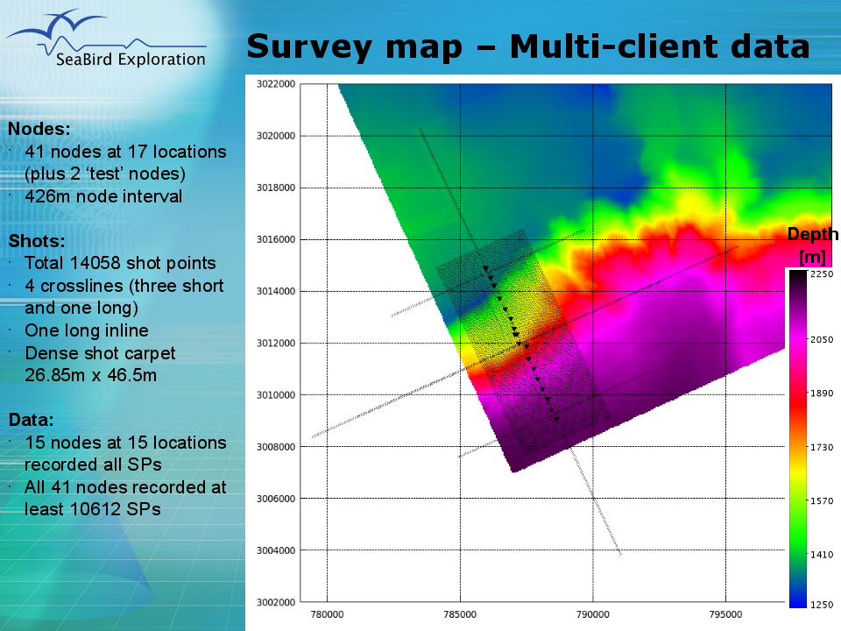
Fugro Seatrial 4C OBN Data
The Seatrial 4C OBN survey is a test survey that was acquired by Fugro in 2009 at the West of the GoM Atlantis field.

Slide 6
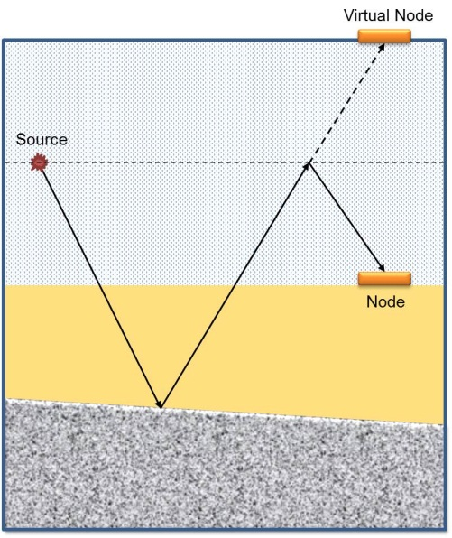
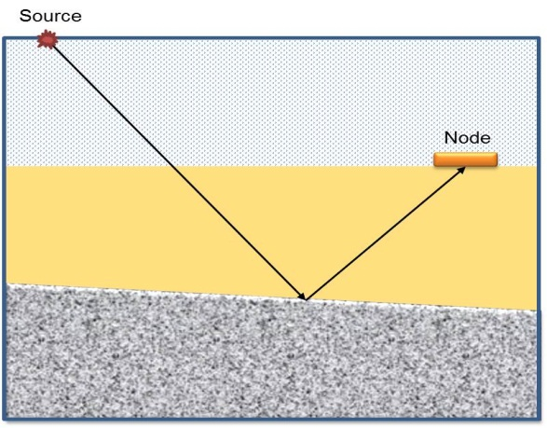
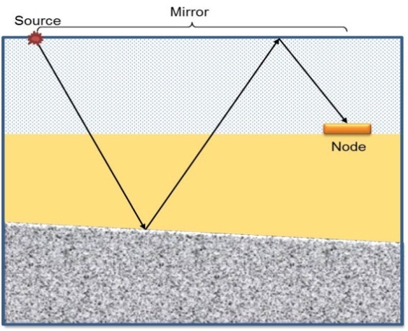
Mirror Migration
Migration of the OBN data by using multiples (down-going receiver ghosts) is called mirror migration because the sea surface takes the role as a mirror which reflects the image of subsurface structure
Up-going
Down-going
Down-going imaging
Ronen, 2005
Notes:
As mentioned earlier, the economical and practical acquisition geometry for ocean-bottom node survey (OBN) is using sparse node intervals with dense grid of shots. However, the sparse node geometry provides poor illumination for shallow reflectors which are shallower under the seabed than the node intervals.
The OBN multiples (down-going wavefield) can be used to have a better structural image of subsurface from wider. The multiples reflect from the same reflectors which the primary waves reflect from. However, multiples take longer wave path and cover wider area than primaries.
Another advantage of multiples over the primaries is that multiples can provide more information than primaries. This is because multiples consist of up-going primaries that reverberate once in the water layer.

Slide 7
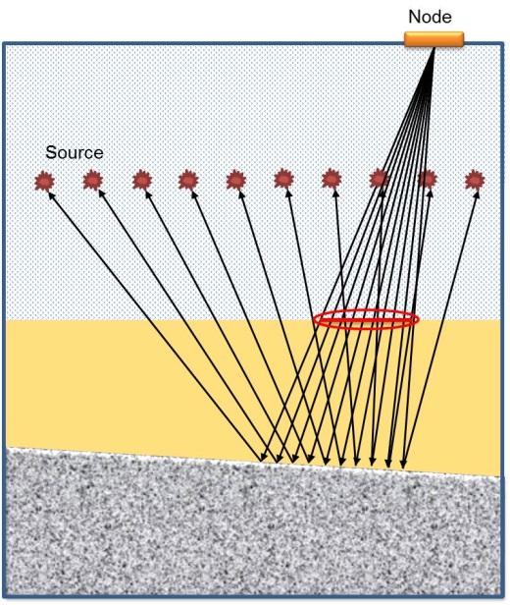
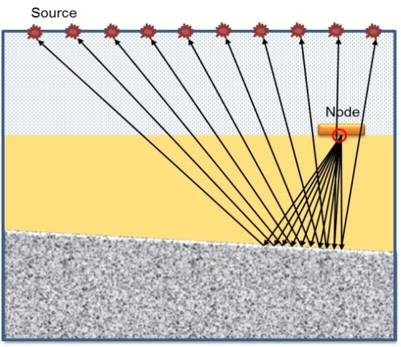
Mirror Migration
Imaging of down-going wavefield provides better and extended illumination of subsurface reflectors than imaging of primaries.
Conventional Imaging
Mirror Imaging
Liu et al. 2011
Notes:
As mentioned earlier, the economical and practical acquisition geometry for ocean-bottom node survey (OBN) is using sparse node intervals with dense grid of shots. However, the sparse node geometry provides poor illumination for shallow reflectors which are shallower under the seabed than the node intervals. Imaging of down-going wavefield provides better and extended illumination of subsurface reflectors than imaging of primaries. This is because primaries cannot reach the shadow zones to illuminate. However, multiples can penetrate into the earth to illuminate the shadow zones.

Slide 8
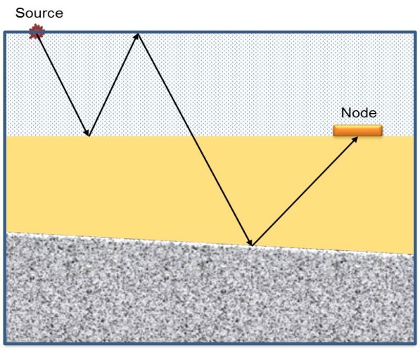
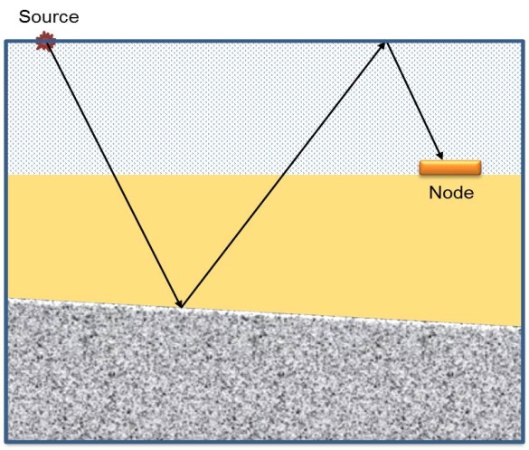
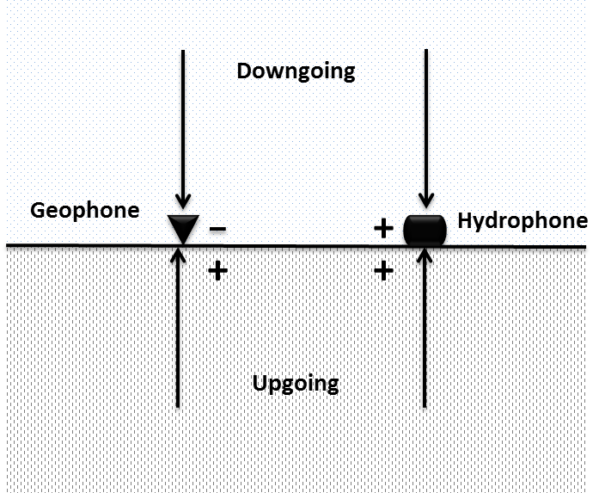
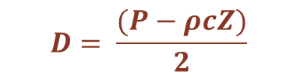
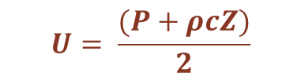
Wavefield Separetion
Source-side multiple
Receiver-side multiple
$$U= \frac{(P+ρcZ)}{2}$$
$$D= \frac{(P−ρcZ)}{2}$$
Dash, 2009
Notes:
The water-column surface related multiples can be classified in two types: source-side and receiver-side multiples. Source-side multiples travel between ocean bottom and the sea surface, then reflect from subsurface reflectors before recording. However, receiver-side multiples reflect from subsurface reflector first, then reflect from sea surface and record
White (1965) was the first to recognize that the receiver side water layer multiples can be removed by combining the pressure and velocity phones. Since pressure is a scalar quantity, which means it is independent of the up-going (U) or down-going direction (D), U and D pressure wavefields have the same polarity on the seafloor pressure recording.
Therefore, wavefield separation into up-going and down-going wavefield on the ocean bottom can be obtained by combining of hydrophone and geophone (PZ summation)

Slide 9
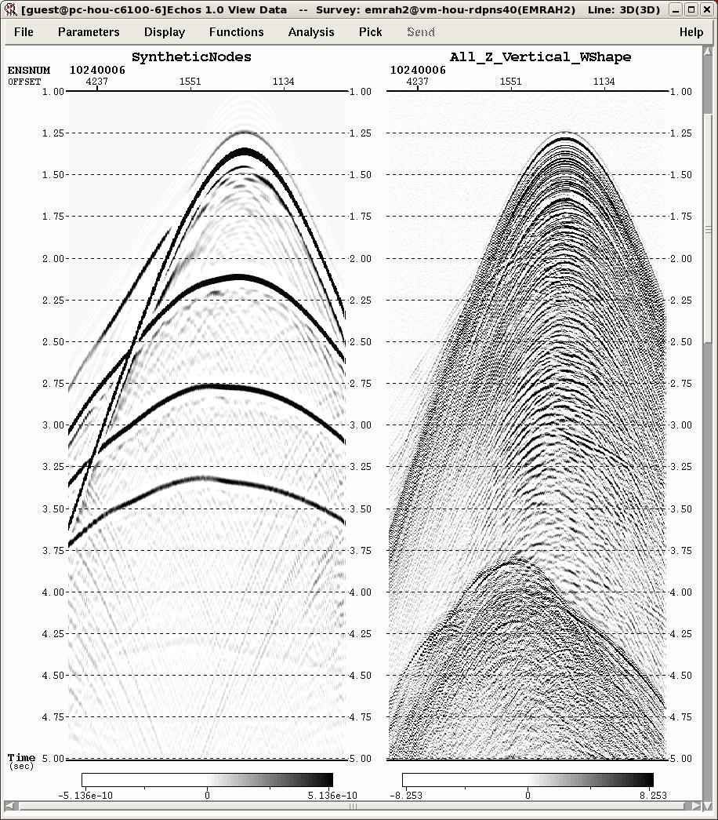
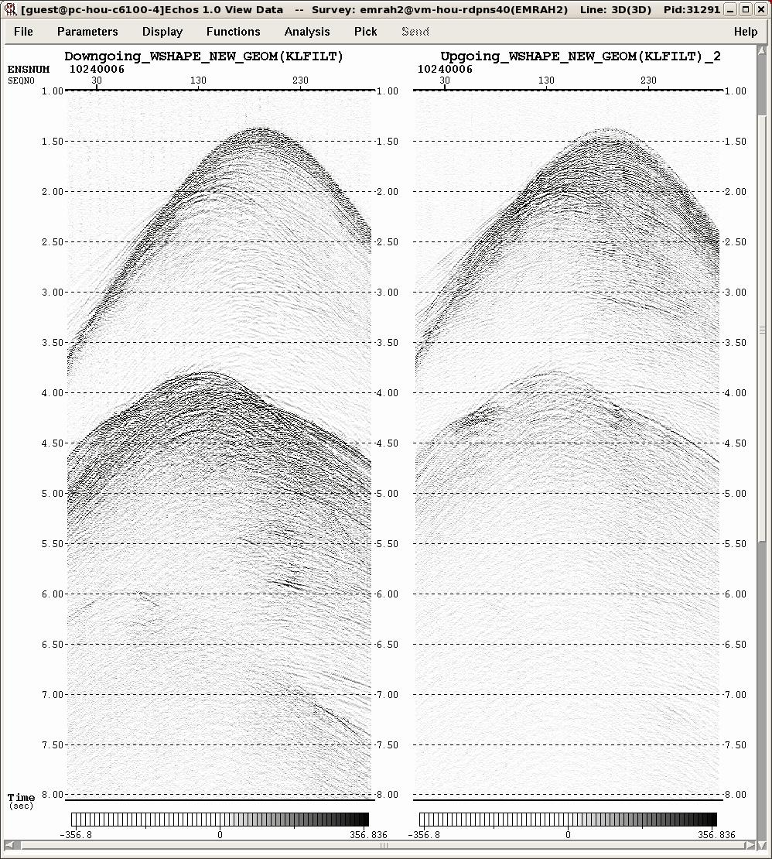
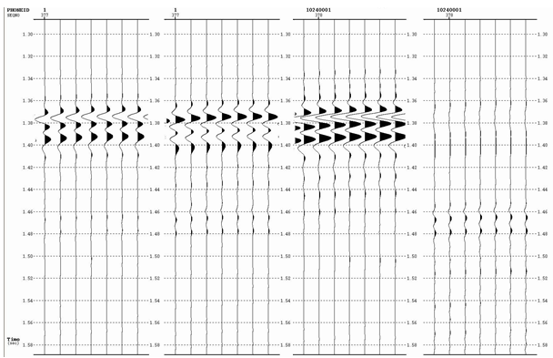
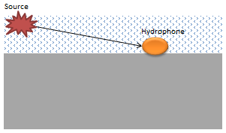
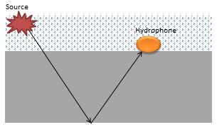
Application to Atlantis OBN dataset
Down-going data
Up-going data
P Data
Scaled Z data
Down-going data
Up-going data

Slide 10
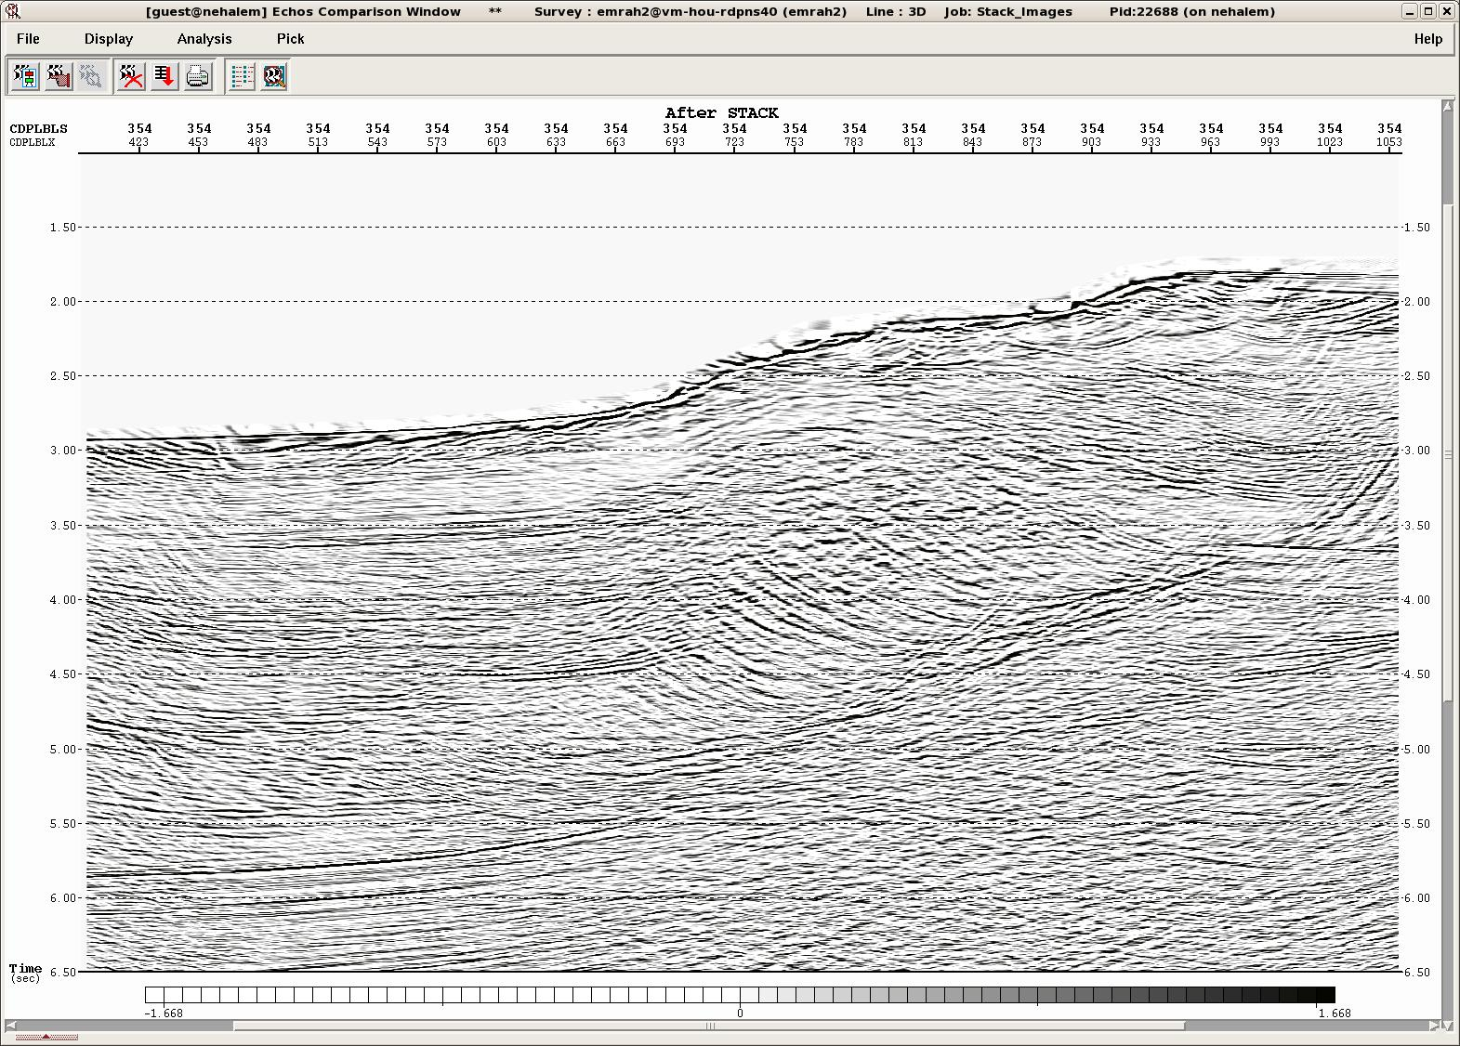
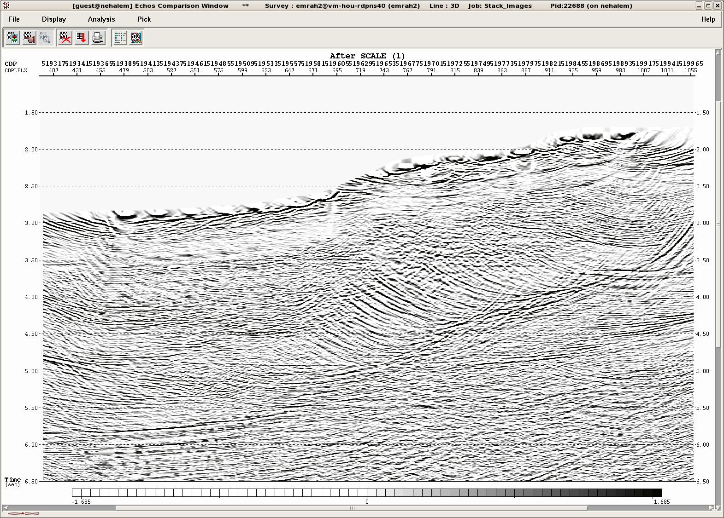
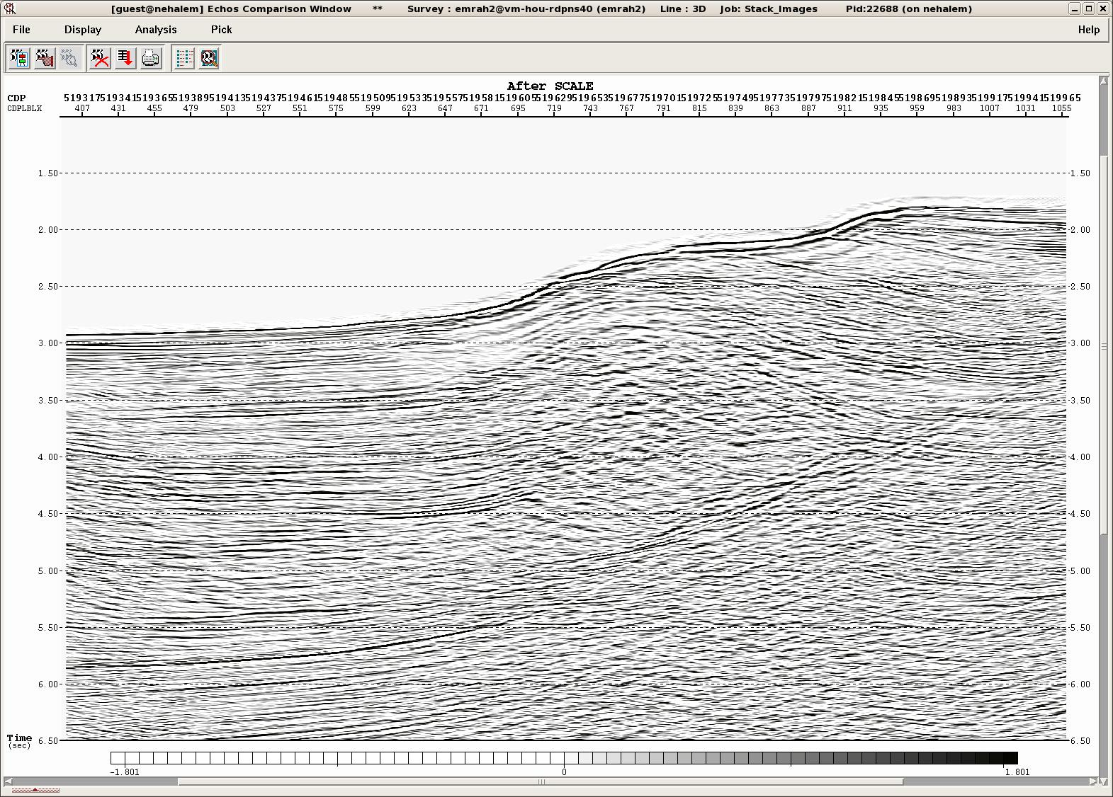
Mirror Migration
Pre-Stack Time Migration of Atlantis data:
Time
(sec)
Time
(sec)
The image produced by conventional migration of the up-going waves
The image produced by mirror migration of the
down-going waves

Slide 11
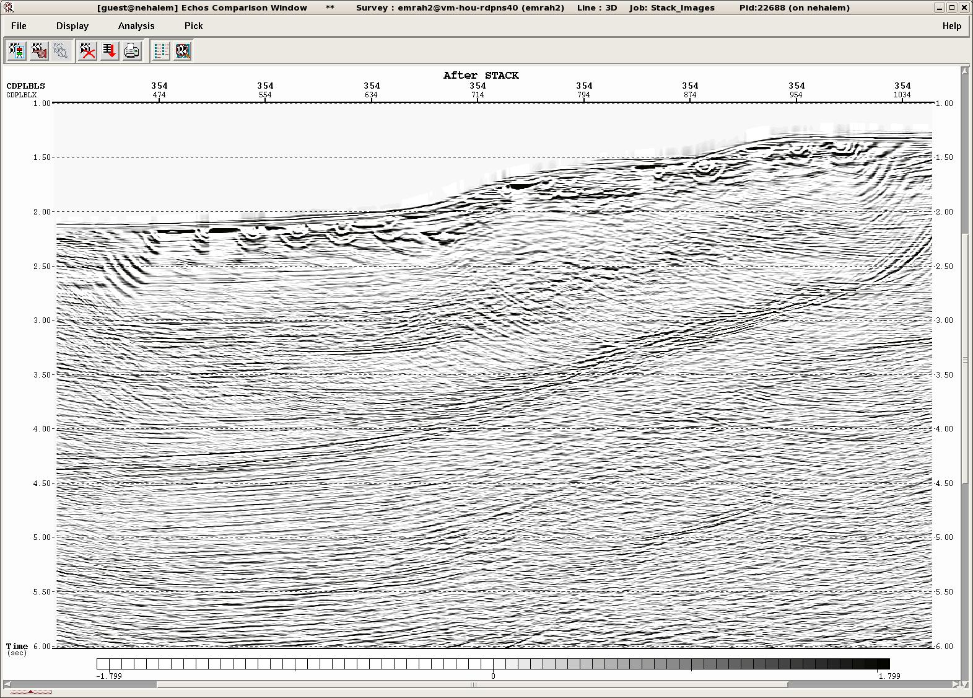
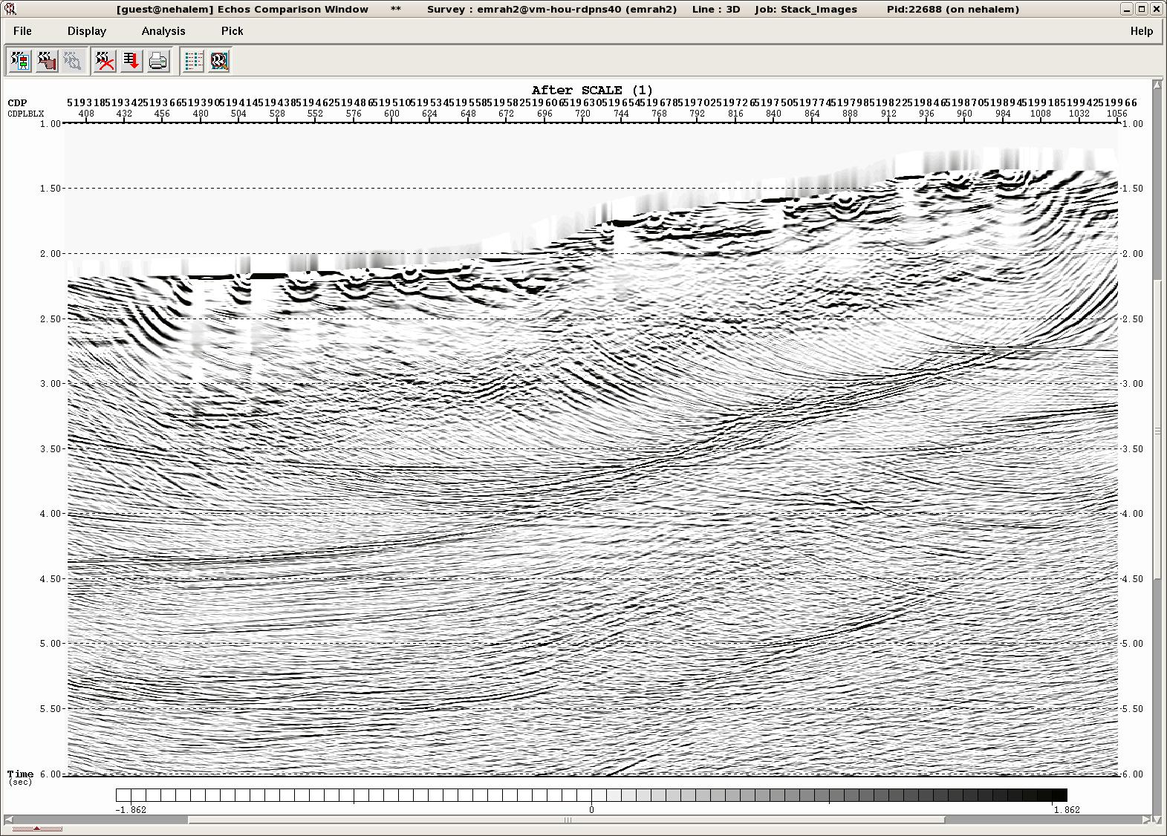
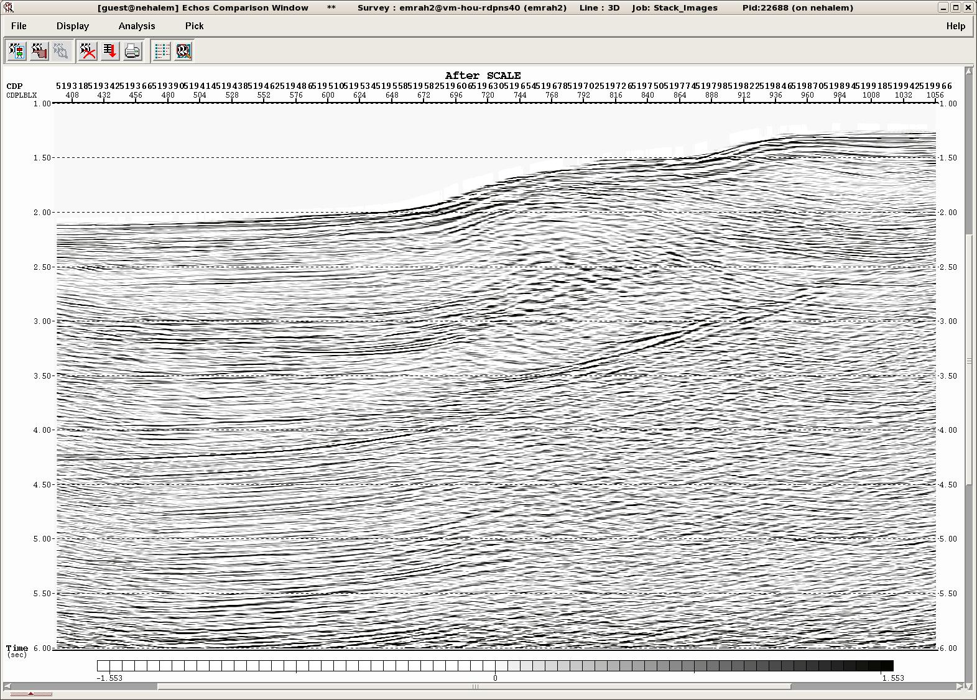
Mirror Migration
Pre-Stack Depth Migration of Atlantis data:
Depth
(km)
Depth
(km)
The image produced by conventional migration of the up-going waves
The image produced by mirror migration of the
down-going waves

Slide 12
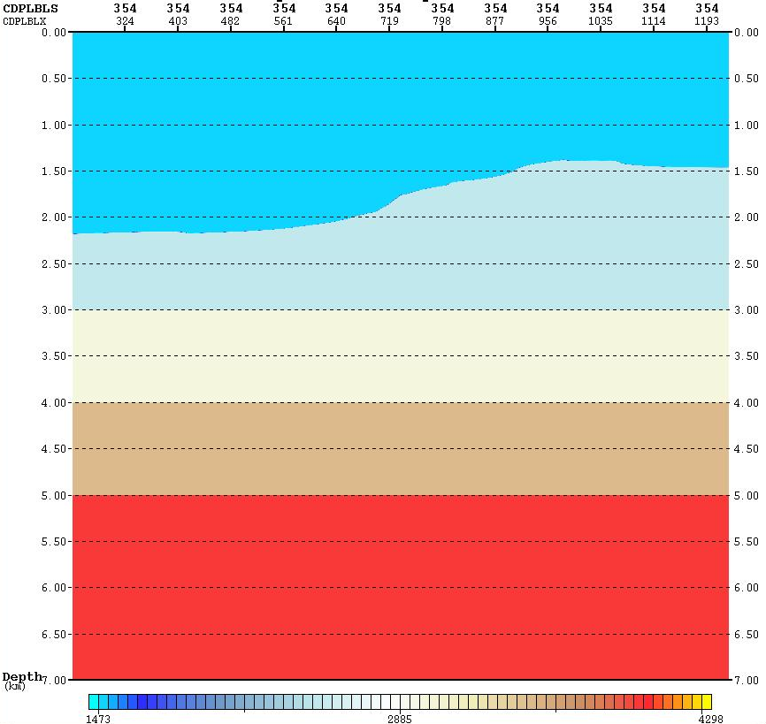
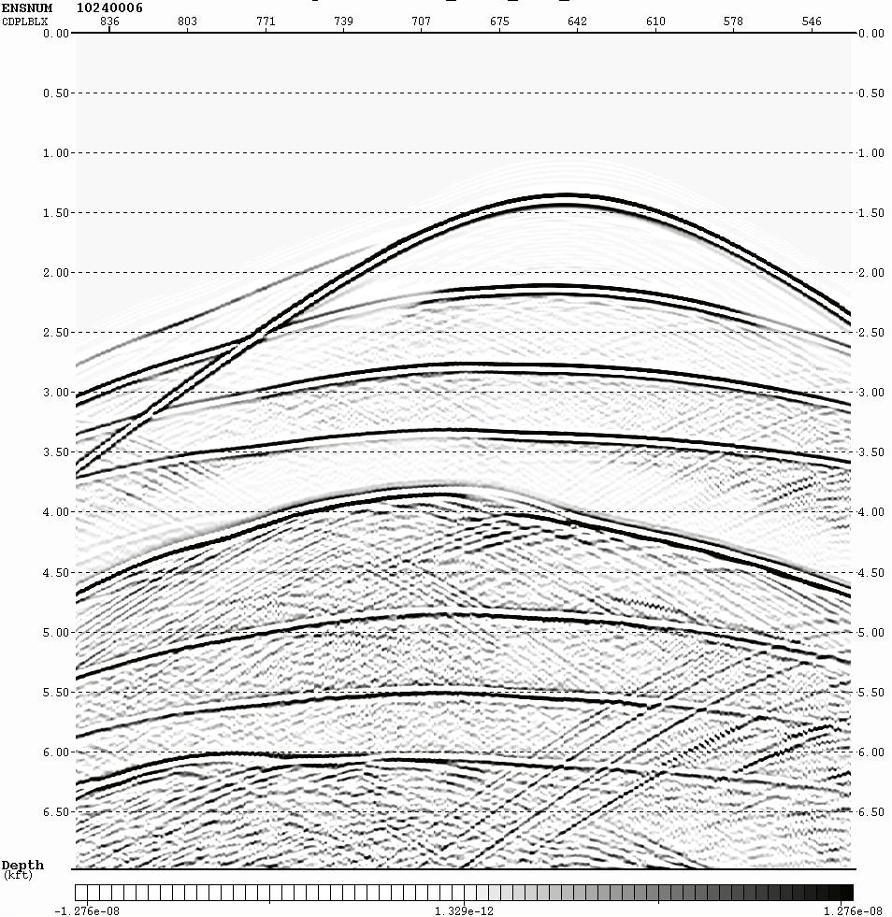
Mirror Imaging
Synthetic Data Generation:
Direct Arrivals
V₁= 1500 m/sn
Primaries
V₂= 2500 m/sn
V₃= 3000 m/sn
V₄= 3500 m/sn
Water- Bottom Multiples
V₅= 4000 m/sn
Receiver-side multiples
Interval Velocity Model
Notes:
To understand mirror image technique, we first performed this imaging technique on synthetic dataset which is generated from the Seatrail Atlantis OBN survey by using 3D finite-differences method.
I extract the water bottom depths from real Seatrial OBN dataset, to create a synthetic model with the same depth of the sea floor as in real survey. The model consists of ocean bottom and three flat reflectors.

Slide 13
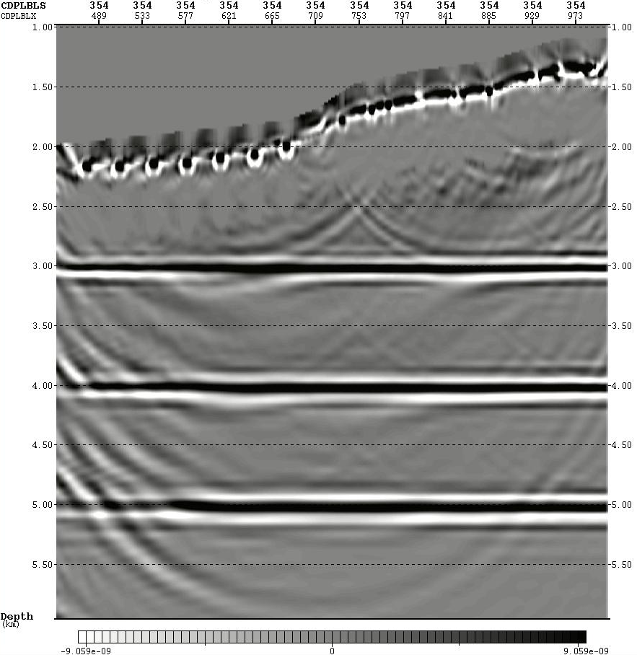
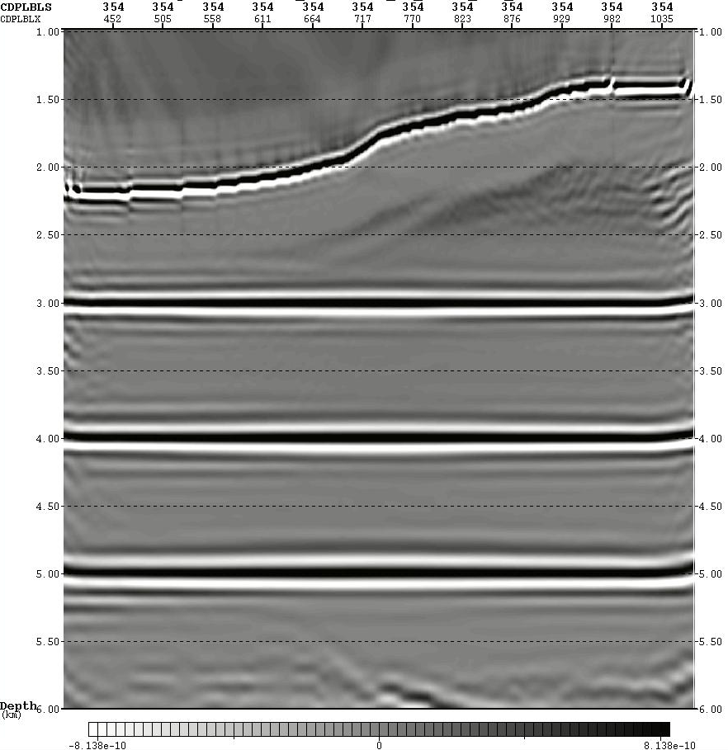
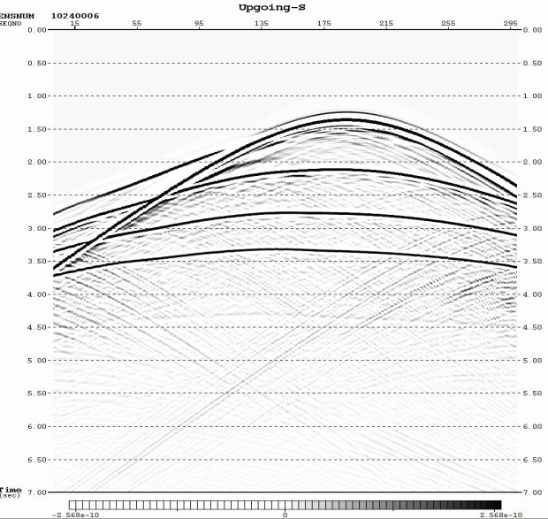
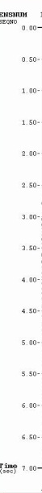

Mirror Migration
Reverse Time Migration (RTM) of Synthetic data:
The image produced by conventional reverse time migration of the synthetic up-going waves
The image produced by mirror reverse time migration of the synthetic down-going waves
Notes:
Reverse time migration (RTM) can be used as a tool for the migration of multiples. RTM uses the full wave-equation modeling to image the data. That is why reverse time migration is a powerful tool which can effectively handle multi-arrival seismic waves.

Slide 14
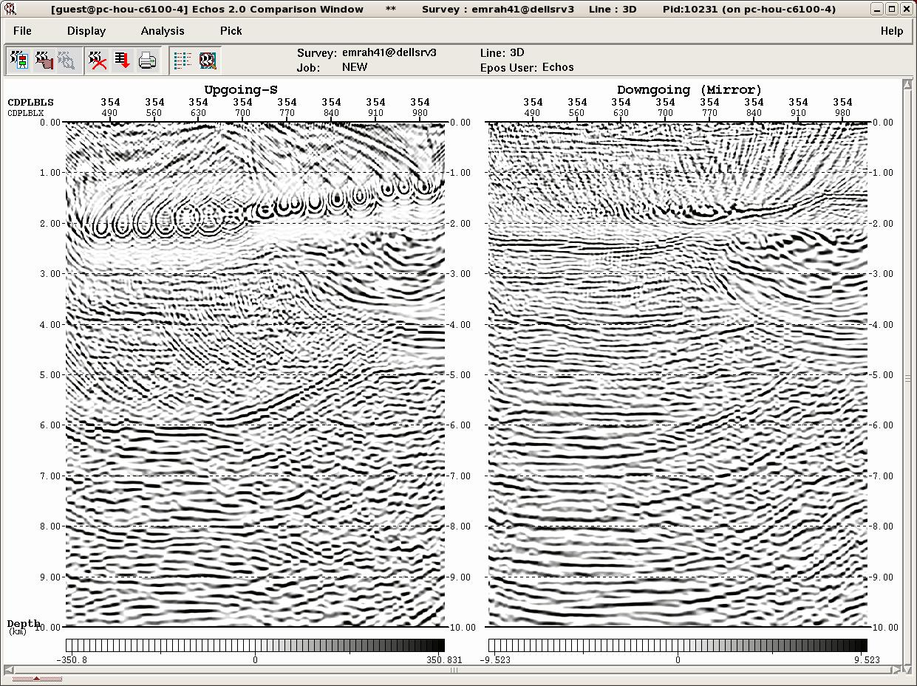
Mirror Migration
Reverse Time Migration (RTM) of Atlantis data:
The image produced by conventional reverse time migration of the up-going waves
The image produced by mirror reverse time migration of the down-going waves

Slide 15
Conclusion
Structures under complex overburdens such as subsalt can be imaged with OBN system.
Acquiring the data on the sea floor from deep water, with a large distance between nodes makes the conventional processing steps difficult to apply for OBN data.
Processing and imaging of the OBN data is now main challenge. However mirror migration results show that it can be an effective solution for this challenge.
The down-going waves contain no primaries, only multiples. However, they provide a better image than the up-going waves, which contain mostly primaries.

Slide 16
Reference List
Maxwell, P., Grion, S., Haugland, T., and Ronen, S., 2007, A New Ocean Bottom Node System: Offshore Technology Conference.
Beaudoin, G., 2010, Imaging the invisible- BP’s path to OBN node: SEG, Expanded Abstracts.
Wang, Y., S. Grion, and R. Bale, 2010, Up-down deconvolution in the presence of subsurface structure: 72nd Meeting, EAGE, Extended Abstract.
Ronen, S., Comeaux, L., and Mioa, X., 2005, Imaging Downgoing waves from Ocean Bottom Stations: 75th Annual International Meeting, SEG, Expanded Abstracts.
Burch, T., Hornby, B., Sugianto, H., and Nolte, B., 2010, Subsalt 3D imaging at Deimos field in the deepwater GOM: Special Section-Borehole Geophysics, The Leading Edge.
Alerini, M., S. Le Bégat, G. Lambaré, and R. Baina, 2002, 2D PP- and PS- stereotomography for a multicomponent datset: 72nd Annual International Meeting, SEG, Expanded Abstracts, 838–841
Ronholt, G., Aronsen, H. A., Guttormsen, M. S., Johansen, S., and Klefstad, L., 2008, Improved Imaging Using Ocean Bottom Seismic in the Snøhvit Field, 70th EAGE Conference&Exhibition.
Liu, Y., X. Chang, D. Jin, R. He, and H. Sun, 2011, Reverse time migration of multiples for subsalt imaging: Geophysics, 76, no. 5.

Slide 17
Acknowledgement
Dr. Robert Stewart
Dr. Chris Liner
Mr. Bjorn Oloffson
Dr. Edip Baysal
Dr. Orhan Yilmaz
My collogues in the AGL
THANK YOU

Slide 18
Acknowledgement
FUGRO (for the OBN data)
GEDCO (for OMNI 3D and VISTA software packages)
PARADIGM (for Echos, GeoDepth and RTM software packages)
THANK YOU

