Slide 1

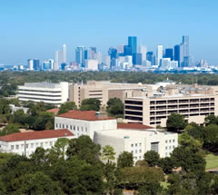
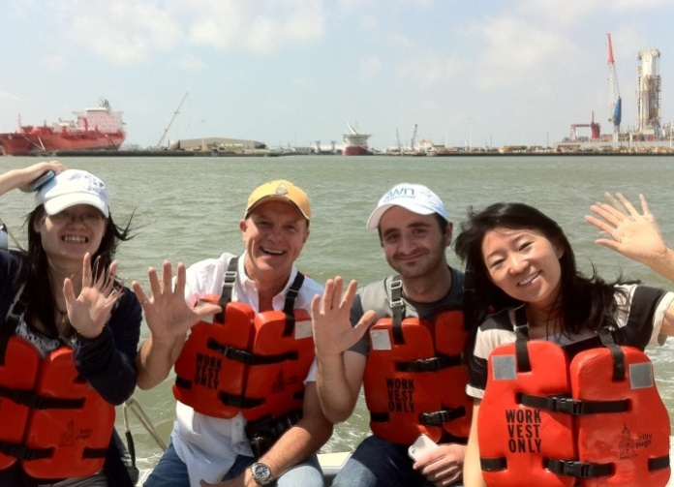

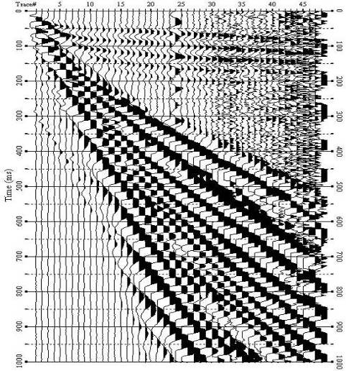
Applied Geophysics: U. of Houston
Robert R. Stewart
Director, AGL
AGL Update Meeting
Houston May 2nd, 2012

Slide 2









Welcome to UH and AGL!
Overview of the day
  • 9:00am – 10:30am Technical session 1; break
  • 10:45am – noon Session 2; lunch (provided)
  • 12:45pm – 2:30pm Session 3; break; posters
  • 3:00pm – 5:00pm Session 4; displays, lab
Thank you so much to our AGL supporters:

Slide 3
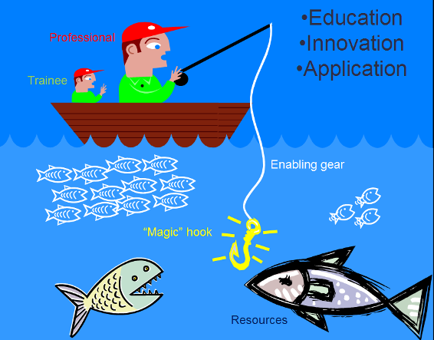
Interlocking geoscience partnerships
University’s 4C mandate:
Create
Conserve
Communicate, Commercialize
Universities
Instrument & service providers
Professional Societies
Energy companies
Agencies
Notes:
3

Slide 4
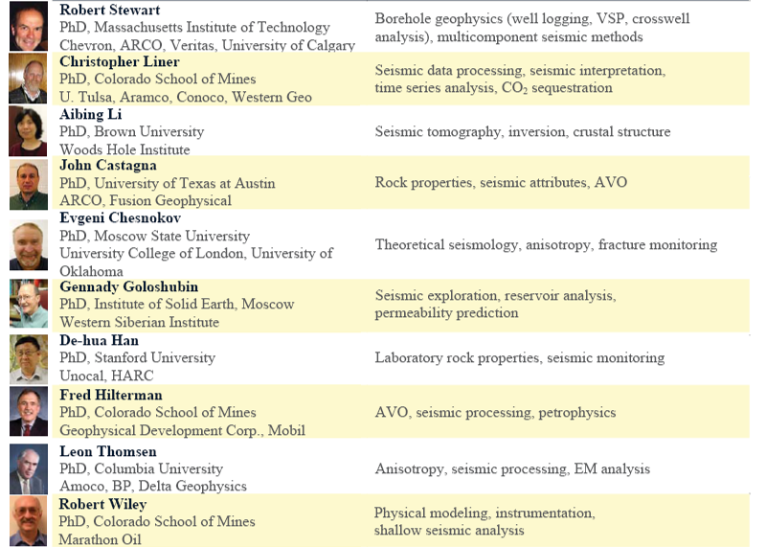
UH/AGL geophysics faculty & their expertise
Further geophysics faculty and their interests
Edip Baysal – seismic imaging
Stuart Hall – potential fields
Bob Sheriff – exploration geophysics
Jolante Van Wijk – tectonics
Three more geo-faculty joining us: Rock physics,
Marine geophysics,
& Exploration geophysics
Notes:
4

Slide 5

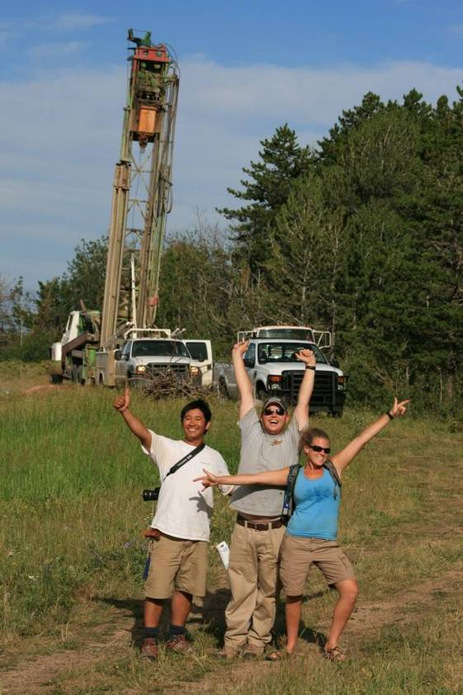
Geoscience at the
University of Houston
May, 2012 - 140 geophysics graduate students
(100 MS, 40 PhD) and 40 more approved for Sept.
~ 90 geophysics undergraduate majors
Notes:
5

Slide 6
UH Graduate Geophysics Courses Fall 2012
Computational Geophysics | Castagna
Borehole Geophysics | Stewart
Microseismic Analysis | Chesnokov
Applied Geophysics Seminar | TBA
Seismic Geomechanics | Sayer
GPS and Geodesy | Wang
Rock Physics | Castagna/Chesnokov
3-D Seismic Exploration | TBA
Seismic Wave & Ray Theory | Li
Groundwater & Engineering Geophysics | Wiley
Basin Analysis for Petroleum Exploration | Mann
Professional Masters Program in Geophysics; Summer Courses in Exploration Geophysics

Slide 7
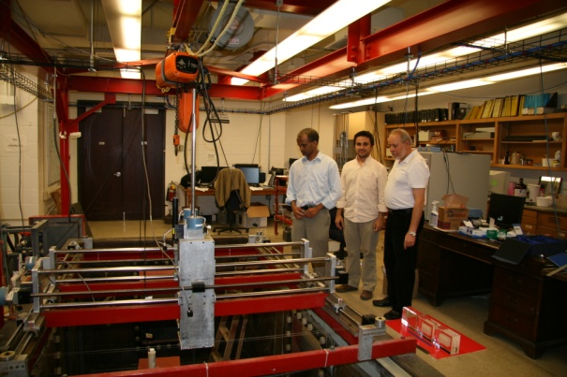
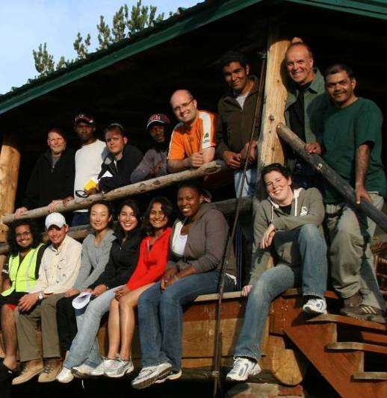
Allied Geophysical Lab
Physical (robotic) modeling
  New recording electronics, piezopins and films
  Laser-etched & 3D printed models, anisotropy, 4D
Field acquisition
  Vibe truck (P & S), 240-channel Geodes, VSP, downhole source, well logging
  CG-5 gravimeter, three GPR systems, Leica total station, MicroEel streamer
Data processing & interpretation
  GEDCO VISTA, Paradigm, SU, MATLAB, Hampson-Russell, SMT, Petrel
Case histories
  Pierce Junc., LaMarque, ERP, Blue Lagoon, Hockley, TX
  Galveston, TX; Meteor Crater, AZ; Sacramento, CA;
  Jemez Pueblo, NM; Elk Basin, MT
  Dickman, OK; Barnett, TX; Bakken, ND; Marcellus, PA;
  GoMs; Tenerife, Colombia; Mexico

Slide 8
AGL Direction
Goal: Ranked in the top three universities in the world doing exploration geophysics
    Graduates, data, software, patents, papers, awards…
Science: Fully understand & use the complete seismic wavefield for improved subsurface assessment
Application: Help find and responsibly produce energy and other resources
Strategy: Experimental geophysics, industry collaboration, advanced analysis, & full team

Slide 9
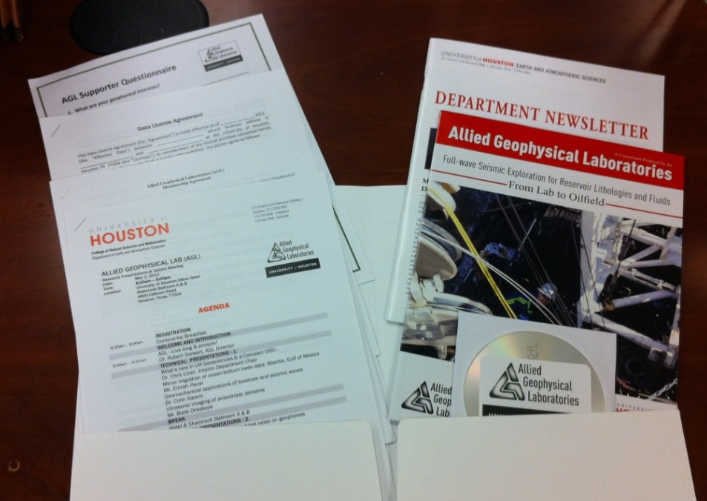
Your AGL folio
Today’s agenda
CD of twenty-three MS and PhD theses
  Nineteen research reports and abstracts
AGL Membership agreement
Department newsletter
Data license template
AGL Overview
Questionnaire
  Express your interest!

Slide 10
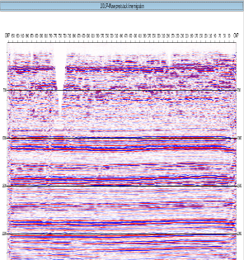
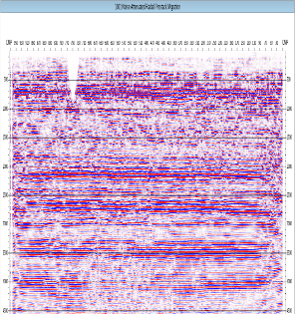
Summary
Pressing needs for better subsurface imaging & assessment plus education & personnel development
Remarkable team of geophysical researchers and students assembled in the Allied Geophysical Lab
Lots of exciting developments in land & marine acquisition and imaging – research needed
AGL is looking to create further collaborations and projects with you (’all)!
Bakken shale (Hess & AGL)
PP
PS

Slide 11
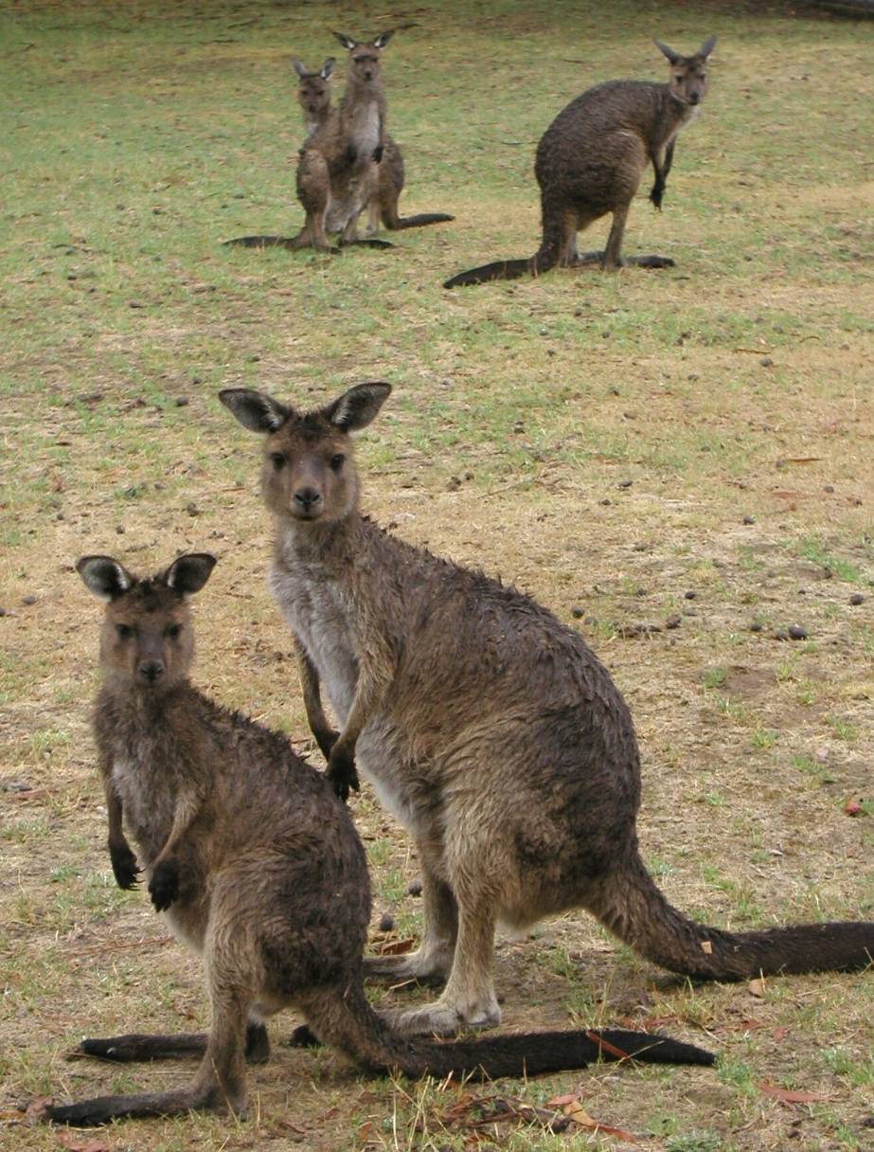
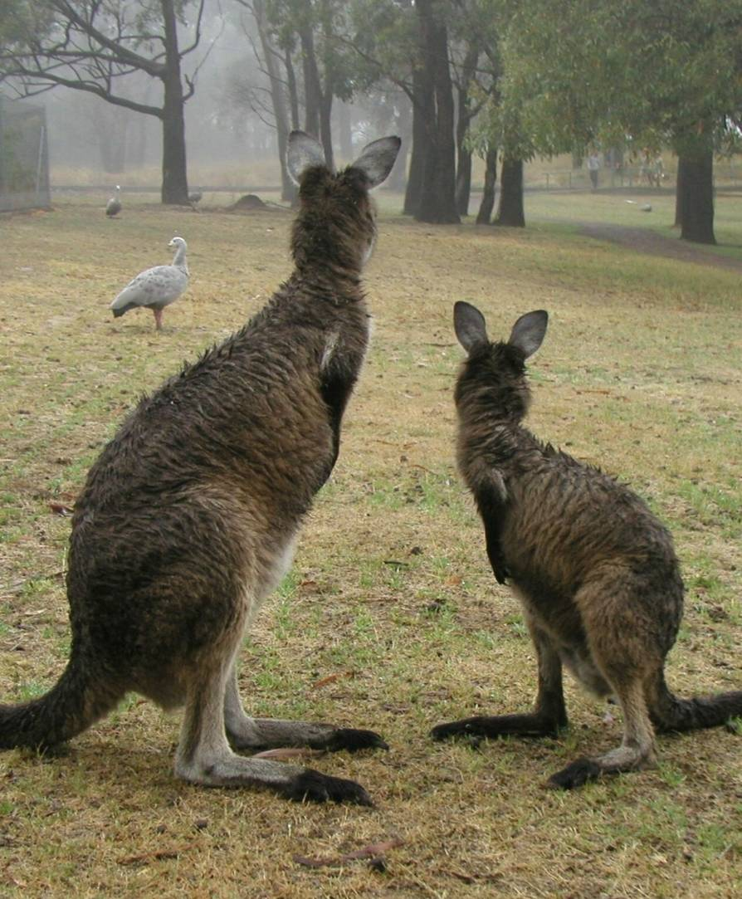
… we hope that you enjoy the rest of the day
Thank you for your attention …
Special appreciation to our arrangement staff: Penny Maher, Anoop William, Ady Geda, & Laura Bell

Slide 12

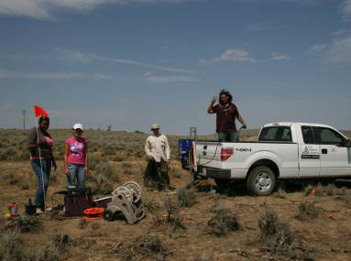
Allied Geophysical Lab
Applied Geophysics Research, Education, and Application
for Hydrocarbon Exploration
Research
Education and Training
Collaborations & Applications
Instrumentation, Robotic acquisition,
Field surveys
Undergraduate (B.S.) and
Graduate (M.S., Ph.D.) Programs
Joint Projects/
Group Surveys
Sponsored-research Transfer
Near-Surface Methods
International Training
Other Institutions, Agencies,
and Companies
Signal Processing & Imaging
Continuous Professional
Learning
Multi-component Seismic Methods
Professional Accreditation
Well-logging, VSP, and Petrophysics
Notes:
12

